Slide 1

Responsibilities in Action
Understanding the Connection
Revision Overview June 2020
Notes:
Welcome to the Responsibilities in Action Revision Overview. By viewing webinars marked as required, within the specified time period, you’ll meet the MAP Trainer meeting attendance requirement. I’m Gina Hunt, a Department of Developmental Services MAP Coordinator and I’m you’re webinar presenter. As of June 2020 the revised curriculum is available online to be used as both required training and program reference material. You’ll want to begin phasing it in as you phase out the July 2017 version. The expectation is that you’ll transition to this version by June 30 of 2022. Revisions were made based on feedback from MAP Trainers, Providers, the Departments of Public Health, Mental Health and Children and Families. General revisions include

Slide 2
General Revisions
Massachusetts Rehabilitation Commission (MRC)
  Effective 07-01-20
MAP Policy
  Specific reference removed
  Symbol remains
Index
Notes:
the addition of adult residential and day programs funded by the Massachusetts Rehabilitation Commission as an agency in which MAP Certification is now valid. You’ll notice specific MAP Policy numbers have been removed throughout in anticipation of approval of a revised MAP Policy manual. The index was updated to reflect enhanced content and the addition of an appendix. The next slides capture the more notable changes in the introduction and units.

Slide 3
Introduction
Massachusetts Controlled Substances Registration
Test Master Universe
  TMU©
Notes:
There is now a brief description of a MAP Massachusetts Controlled Substances Registration. In addition, the D&S Technology testing company information was updated to reflect the Test Master Universe website.

Slide 4
Where MAP is not Valid
  Assisted Living Facilities
  Community-Based Acute Treatment
  Correctional Facilities
  Crisis Intervention Centers
  Day Habilitation
  Detox Centers
  Home Care
  Intensive Community-Based Acute Treatment
  Rest Homes
  Schools
Notes:
The introduction includes additional locations where MAP Certification is not valid.

Slide 5
Medication Administration
  Demonstration of Process
      Complete 3 Checks
      Apply 5 Rights
          10 minutes or less
  MAP Trainer Feedback
Notes:
A change in the medication administration demo pretest component, is the elimination of the option for a MAP Trainer to allow a peer to provide feedback. Now only the MAP Trainer may do so for pretest purposes. The MAP Trainer Instructions and corresponding checklist used to evaluate the competency of staff demonstration of this skill was updated to reflect the change. To locate the documents,

Slide 6
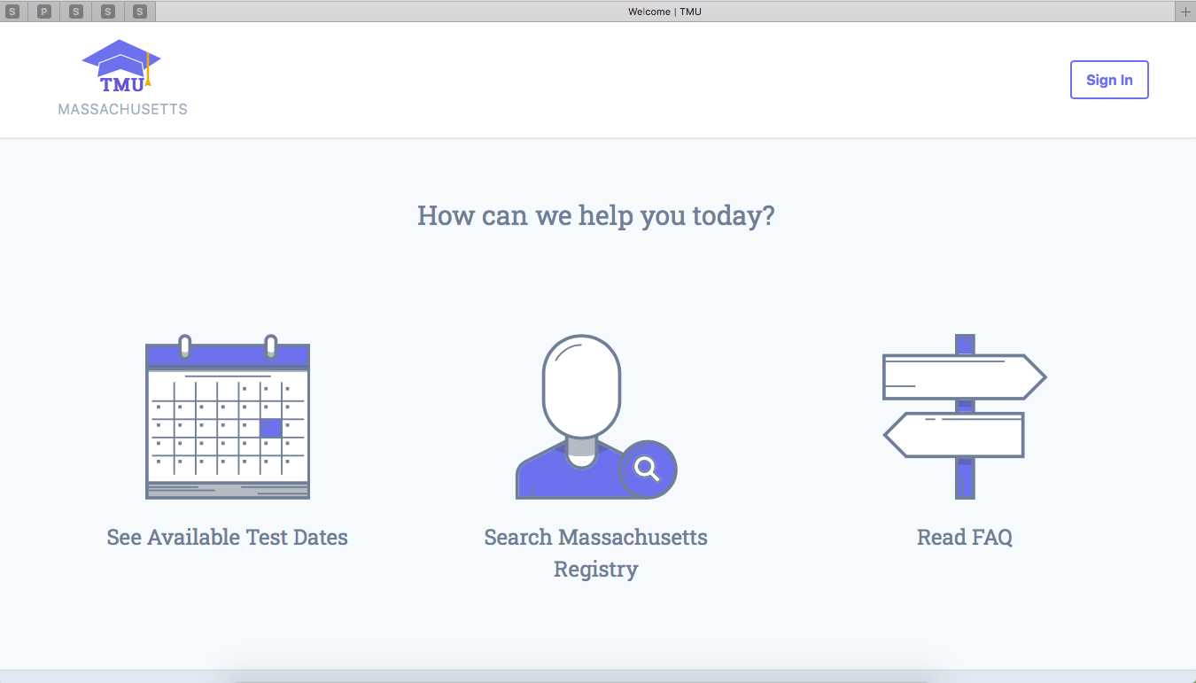
www.ma.tmuniverse.com
Notes:
go to the TMU website and sign in.

Slide 7
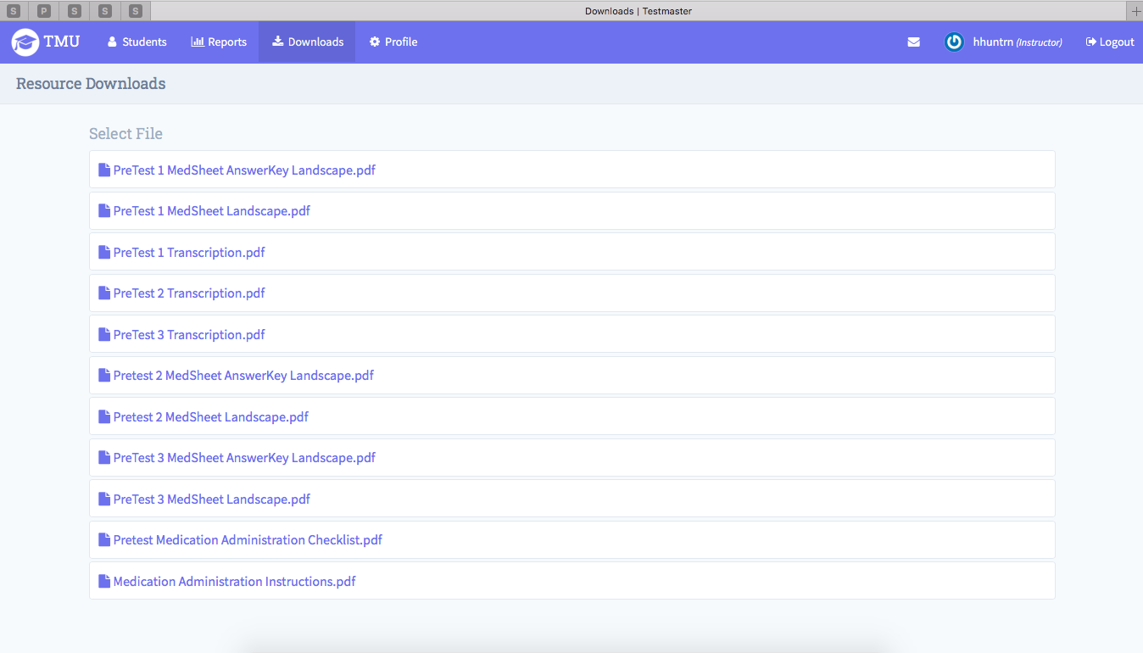
www.ma.tmuniverse.com
Notes:
Click on the downloads option at the top of the bar to access

Slide 8
Pre-test Documents
Trainer Instructions
Trainer Checklist
Medication Administration Demonstration
^{Pretest Component May 2020}
^{Process}
During or after completion of MAP Certification training, the MAP Trainer will evaluate each staff’s competency demonstrating the medication administration process.
A medication administration scenario should will be presented to staff including a person’s name, the time and the date.
The medication used must be a regularly scheduled countable controlled medication packaged in a blister pack.
Ideally staff will have at least two regularly scheduled countable controlled medications listed on the medication sheet with only one of the two being the correct medication to administer based on the scenario presented to staff.
Documentation after the medication administration process is demonstrated, documentation must be completed using a
mock medication book (containing the HCP order, medication sheet and medication information sheet) and a
mock Count Book (including an index, count sheet and count signature sheet.)
^{Scoring}
There are 12 boxes in the corresponding medication administration demonstration checklist used to evaluate staff competency. Passing is considered 10 boxes ‘checked’ out of the 12 possible boxes.
Staff must know, in order to be successful, they must to continue to practice from the time the training program ends up to their skills test date.
Medication Administration Demonstration
Certification Pretest Component Checklist May 2020
Staff Name
Instructions: Observe and place a check in each box as the student
demonstrates the medication administration process outlined below.
Prepare
☐Read the medication (med) sheet to identify the med to administer ☐Unlock
☐Locate the correct med
Administer
☐Crosscheck 1-Verbally Check 5 Rights (HCP order and pharmacy label) ☐Crosscheck 2-Verbally Check 5 Rights (pharmacy label and med sheet) ☐Prepare the med
☐Crosscheck 3-Verbally Check 5 Rights (pharmacy label and med sheet)
☐Give the med
Complete
☐Look again (silent comparison between pharmacy label and med sheet) Document
☐Initial med sheet
☐Using index, on count sheet, subtract # of tabs removed from blister package ☐Secure the med
Date
MAP Trainer Name
Feedback
Notes:
the Trainer instructions and the corresponding checklist. The instructions were rewritten, however, other than only the MAP Trainer providing feedback, there are no other changes in the process or in the scoring.

Slide 9
Unit 1
Working at a MAP Registered Program
Notes:
In Unit 1 a few sentences and the medication principles exercise were slightly modified for clarity with no change in overall subject matter. In addition

Slide 10
Ellen Tracey Support Plan
Ellen Tracey Support Plan
Anxiety Management
No Known Allergies
Specific symptoms that show us Ellen is anxious:
Biting hands for more than 4 minutes
Head slapping for longer than 30 seconds or more than 5 times in 4 minutes
  Staff will attempt to talk to Ellen in one on one conversation regarding current feelings and difficulties
  Staff will attempt to direct and involve Ellen in a familiar activity such as laundry, meal preparation, etc.
If unsuccessful with A and B, the Ativan may be administered.
Ativan 0.5mg once daily as needed by mouth; must give at least 4 hours apart from regularly scheduled Ativan doses. (Refer to HCP order)
If anxiety continues after the additional dose, notify HCP.
HCP signature: Shirley Glass MD 2/1/yr
Posted: Sam Dowd 2-1-yr 4pm
Verified: Linda White 2-1-yr 4pm
Notes:
No known allergies was added to Ellen Tracey’s support plan.

Slide 11
Unit 2
Observing and Reporting
Notes:
In Unit 2

Slide 12
Reporting
Immediate Reporting
  When to call 911
    You are unsure person is okay
    Directed by HCP order or Protocol
      For example:
        HCP order or Protocol states, ‘Call 911 for seizure activity greater than 5 minutes.’
Notes:
there are additional examples of when to call 911 including if staff is unsure a person is okay and when directed by a HCP order or protocol.

Slide 13
Documentation
Ink color
  Blue
  Black
Notes:
In the documentation content, the ink color to use is now specified as blue or black.

Slide 14
Unit 3
Medications
Notes:
In Unit 3 and throughout the revision…

Slide 15
Content Modifications
Word substitutions
  ‘submits’ or ‘provides’
    replaces ‘written’
  ‘medication release’ document
    replaces ‘transfer’ document
Does not require a HCP order
  Personal hygiene products
Notes:
there are content modifications and resequencing. A doctor now ‘submits’ or ‘provides’ rather than ‘writes’ a prescription. The terms ‘transfer document’ and ‘medication release document’ were used interchangeably throughout the curriculum. Now you’ll only see reference to ‘medication release documents’. There are 2 medication release documents, an LOA form and a transfer form. The statement referencing sunscreen and insect repellant was expanded to include personal hygiene products used to beautify the skin as an additional item that does not require a HCP order.

Slide 16
Content Modifications
Medication Sensitivity
  Gender
  Level of physical activity
Reference material
Notes:
Gender and level of physical activity were added to the list of Medication Sensitivity factors. The ‘Ask Your Supervisor’ question related to required reference material was updated and now states: A current (less than 2 years old) drug reference book (paperback or hardcover) and/or the current (less than 2 years old) printed medication information sheets for all prescribed medications must be in the program.

Slide 17
Unit 4
Interacting with a Health Care Provider
Notes:
In Unit 4

Slide 18
Content Modifications
Objective expanded
Health Care Provider Orders
Emergency Room and/or Hospital
HCP Telephone/Fax Order form
Exhausting a Current Supply
Notes:
The topics listed on your screen are the areas in which content modifications were made.

Slide 19
Objective
Responsibilities You Will Learn
  Exhausting supply of medication
    if dose or ‘frequency’ change
Notes:
The objective regarding using an existing supply of medication now includes a frequency change in addition to a dose change. Language was added to this topic indicating a directions change sticker may only be used for a maximum of 30 days.

Slide 20
Health Care Provider Orders
Acceptable Signatures
  Wet
  Image
  Electronic
Order Expiration
Notes:
The curriculum now includes the various acceptable HCP signatures, as well as content regarding how long HCP orders are valid if the annual physical cannot be scheduled before the order expires.

Slide 21
Emergency Room and/or Hospital
Be prepared to tell Emergency Room (ER) and/or hospital staff why you are bringing person to ER and/or hospital
  Discuss with HCP
    scheduled medication person may miss
      as a result of ER and/or hospital visit
Notes:
The new content in this topic is regarding the importance of discussing with the HCP any scheduled medication the person may miss as a result of an ER or hospital visit.

Slide 22
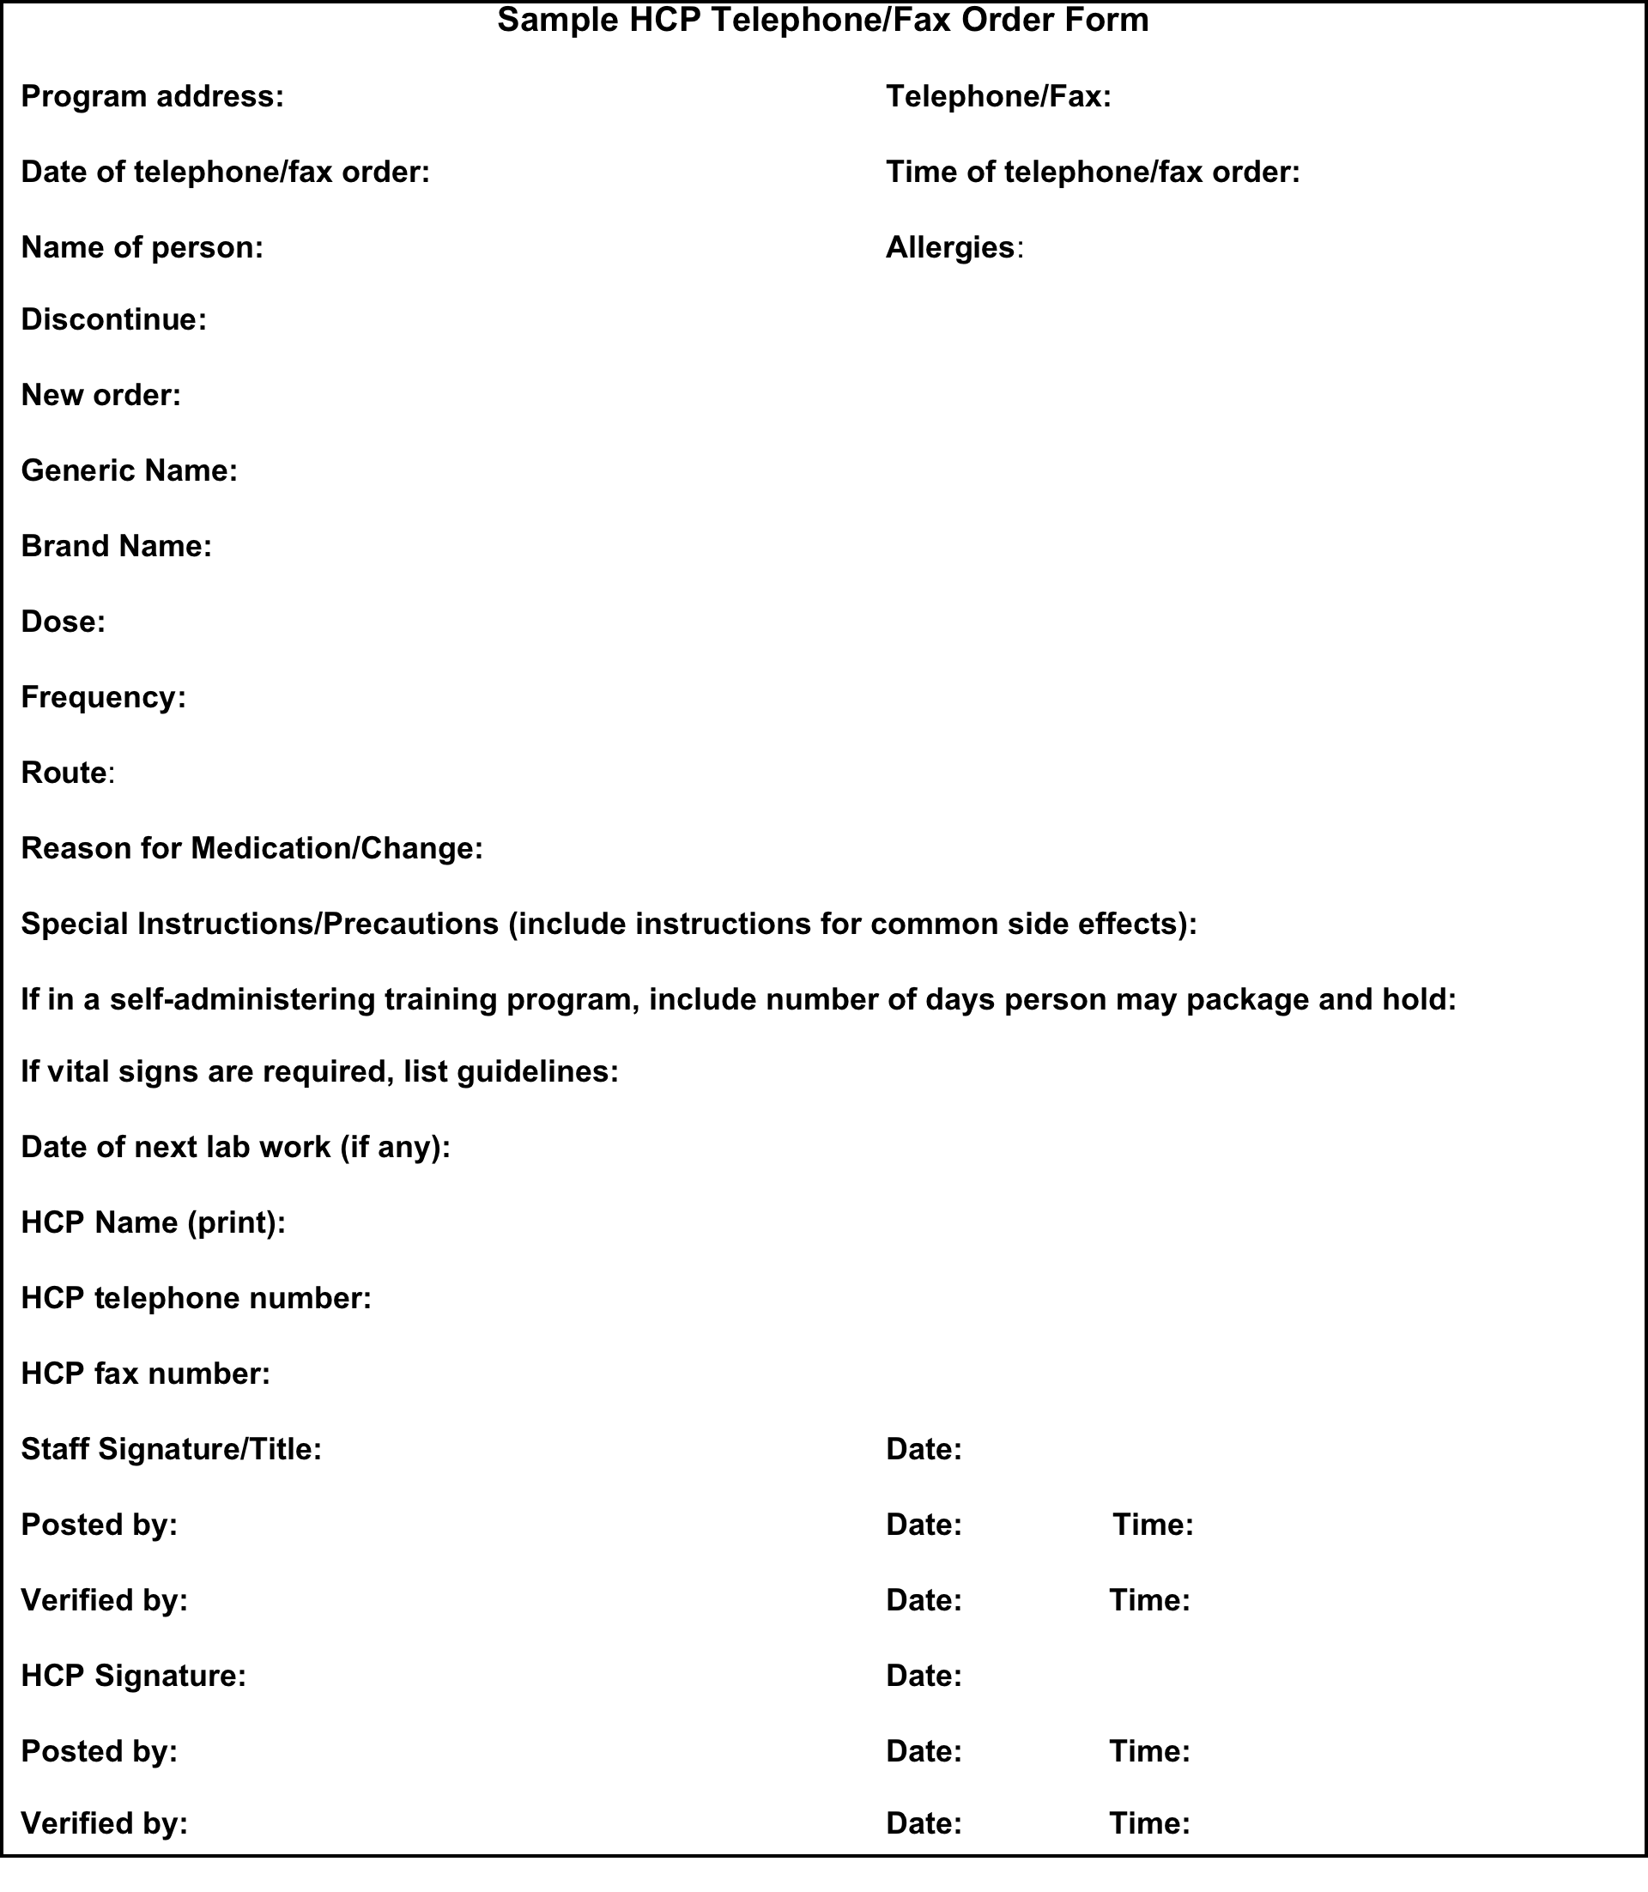
HCP Fax/Telephone Order Form
Notes:
The fax telephone order form example was updated to include a statement that if a person is in a self-administering training program, the HCP is asked to include the number of days that a person may package and hold their medication. In addition, a new statement was added to the process of taking a telephone order, which is: To help ensure accuracy, if you’re the staff that obtains the telephone order, you should be the staff to transcribe the order.

Slide 23
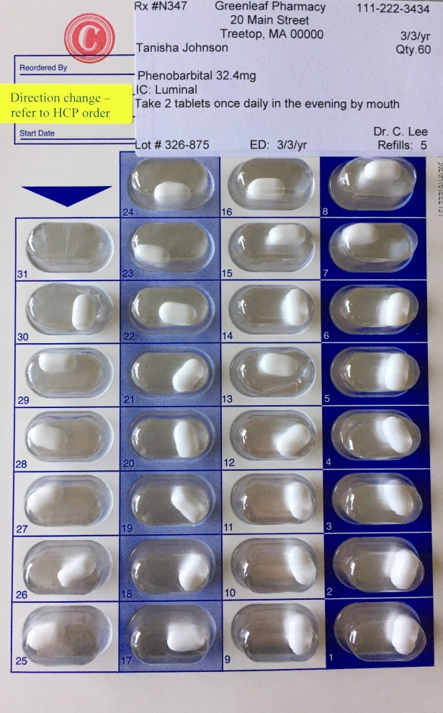
Exhausting a Current Supply
Notes:
The image of a blister pack with the directions change sticker is no different. A new exercise was created to include a corresponding HCP order that shows an increase in the dose of Phenobarbital. Staff are then asked to determine the new amount of tablets to administer.

Slide 24
Unit 5
Obtaining, Storing, Securing Medication
Notes:
In Unit 5 you’ll notice a new sentence that says,“If medication is delivered to the program while you’re busy, you should ask the driver to wait until you can accept it, verify the contents against the ordering and receiving log and then sign for the medication.”

Slide 25
Modifications and Additions
Alternative Pharmacy
Pharmacy Label Components
  Lot Number
When to Request a Refill
Notes:
There’s a new Ask Your Supervisor question in this unit that states, “If a medication is ordered and the pharmacy service typically used by your work location is not available, ask your supervisor which alternative pharmacy is to be used instead to obtain the medication.” A lot number is no longer a pharmacy label requirement. It does remain as a component on labels in the curriculum. The lot number definition was modified and now states, A number that is assigned to each batch of medication produced. All medication from the same batch shares the same lot number. The statement in regard to hearing about recalls in the news now states, “If you do hear about a medication being recalled, contact the pharmacy with the medication name and follow the pharmacists’ recommendations.” A new section was added

Slide 26
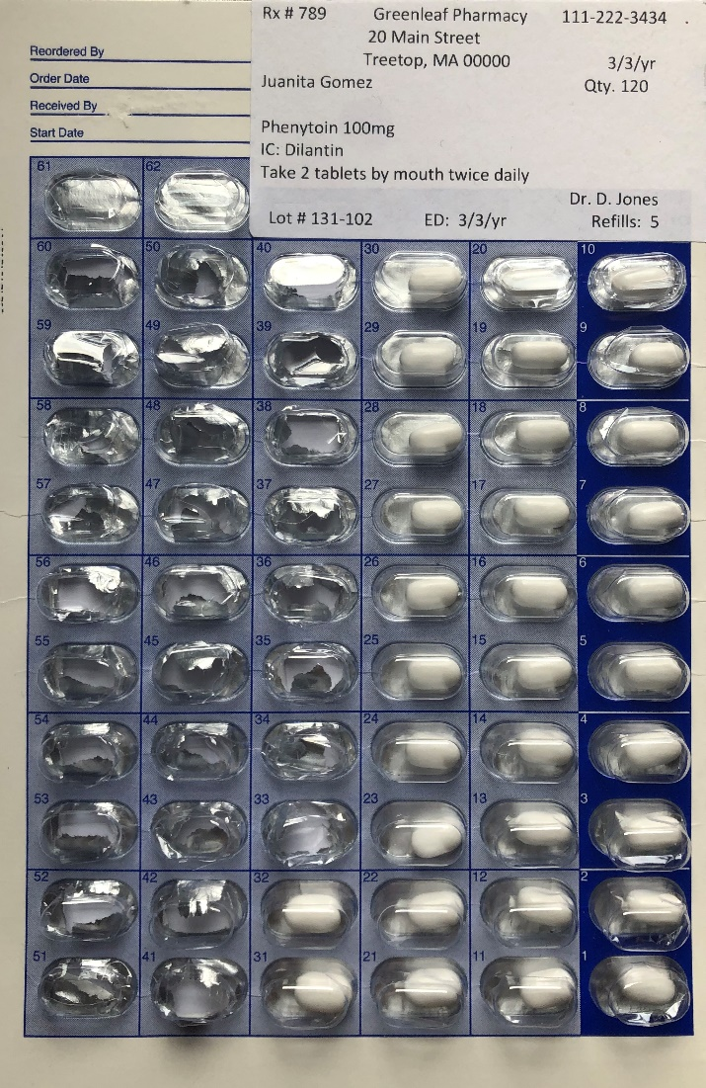

When to Request a Medication Refill
Class Discussion
How many capsules are needed for a 30-day supply? _____________________
How many capsules are currently in the package? _______________________
How many capsules would you expect to see if there was a 7-day supply left in the package? ____________________
Is it time to request a refill? _________
Why or why not____________________
How many capsules should there be in the package when you request a refill? ____________________________________
Why is it important to order a refill when a 7-day supply remains instead of a 3- day supply? _________________
Notes:
titled When to Request a Medication Refill. There is a corresponding Class DIscussion that includes a series of questions related to a blister package image and the importance of ordering a refill when a 7-day supply remains. The end of unit 5 is in regard to storage.

Slide 27
Medication Security and Storage
All medication is key locked
  Countable medication must be double key locked
    A key lock within a key lock
Medication must remain in original container
Minimal distractions
  Avoid distractions from other people
  Turn off your cell phone
Notes:
Modifications to Medication Security, Storage and the preparation area include:
The addition of the word key in regard to securing medication.
The statement that medication must remain in its original container and
To avoid distractions turn off your cell phone.

Slide 28
Unit 6
Recording Information
Notes:
Revisions in this unit include a word substitution, additional abbreviations, new acceptable codes, a revised definition and enhanced content.

Slide 29
Content Modification
Word substitution
  ‘record’
    replaces ‘book’
      e.g., Medication Record
Notes:
The term Medication Record is now used to describe what typically includes an Emergency Fact Sheet, HCP orders, medication sheets and medication information sheets.

Slide 30
Additional Abbreviations
Abbreviations
  IU or units - International Units
  ODT - orally dissolving tablet
  Subcut - subcutaneous
Notes:
The abbreviations for international units, orally dissolving tablets and subcutaneous were added to the list.

Slide 31
New Acceptable Codes
A - absent from site
H - hospital, nursing home, rehab center, respite
NSS - no second staff available
V - vacation
Notes:
Although the med sheets were not revised to include all of the possible acceptable codes allowed, if you use an acceptable code on a med sheet, the code and its meaning must be listed on that med sheet. The use of ‘A’ for absent indicates medication was not administered due to unauthorized reasons beyond staff’s control such as the person left the program without agreement or supervision or did not return as planned without agreement or supervision during medication administration time. ‘H’ now includes respite The use of ‘NSS’ for no second staff available indicates a second staff was not available for dose verification prior to administration of warfarin sodium. NSS replaces the circled x symbol. The use of ‘V’ for vacation indicates medication was administered by Certified staff when the staff accompanies a person on a planned vacation.

Slide 32
Revised Definition
LOA – leave of absence
  Only applies to family or friend
OSA – off site medication administration
  Only applies to Certified staff
Notes:
The use of the LOA code now indicates medication was transferred to a person’s family, guardian or responsible party for administration while on leave of absence. The use of the new OSA code indicates medication was administered by Certified staff at an off-site location, such as the movies or a community outing, etc. The use of these codes and how to document are both covered in detail in Unit 8.

Slide 33
Expanded Content
Frequency
Accuracy Checks
Notes:
Although the information is not new, additional content was added to correspond with the visual examples of when transcribing a frequency and when completing accuracy checks.

Slide 34
New HCP Order
After transcription
  Post/Verify Process
    Blue or black ink
Notes:
Posting and verifying after completing a transcription is still expected; using blue or black ink to do so is acceptable. You’ll notice in the revision the red and green ink colors are no longer used.

Slide 35
Unit 7
Administering Medications
Notes:
in Unit 7

Slide 36
Content Modifications and Additions
Vital Signs monitoring
PRN medications
Other Routes
Check 3
Liquid Medication Label Images
Refusals
Notes:
The next several slides will cover these topics.

Slide 37
Vital Signs (VS) Monitoring
Certified staff must be trained in VS monitoring related to medication administration
VS Training must be conducted by
  HCP
  RN
  LPN
  Pharmacist
  Paramedic
  EMT
Notes:
The information regarding Vital Signs training related to medication administration was added to the curriculum.

Slide 38
PRN Medications
Target Signs and Symptoms
  When to administer
    Temperature more than 100
Reason
  Why medication is ordered
    Fever
Notes:
New sentences were added to the PRN medication content to help distinguish between target signs and symptoms and the reason a medication is ordered. The content also includes that the one hour window does not apply to PRN medication.

Slide 39
Other Routes
Nasogastric and Intravenous
  Removed
Inhalable replaces
  Respiratory
Notes:
Only those routes by which a Certified staff may administer medications are now included.

Slide 40
Check 3
Administer Medication
  Medication is given directly
    from you to person
Stay with Person
  Until medication is swallowed
Notes:
Due to interpretations other than those intended, Check 3 of the medication administration process was reworded.

Slide 41
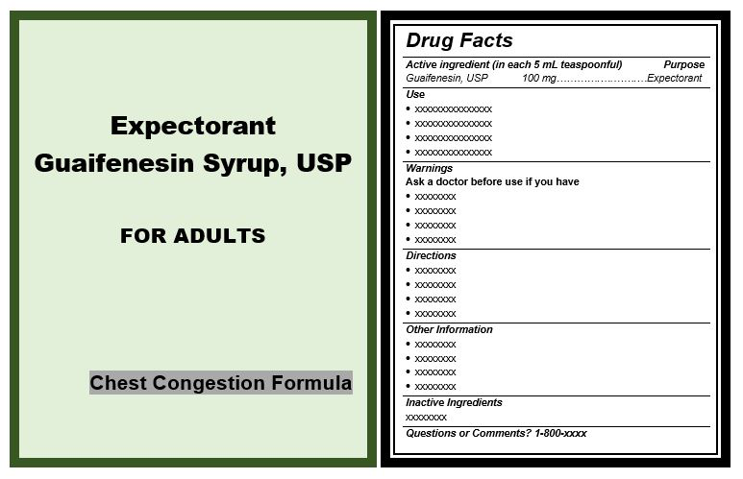
Liquid Medication Label Images
Notes:
There are new liquid medication label images that are easier to read.

Slide 42
Refusals
HCP notification
Reporting
  New Exercises
Notes:
Refusal content was modified to reinforce that the prescribing HCP be notified; not necessarily to obtain a recommendation. In addition, new exercises were added to reinforce to staff that when reporting refusals of someone who refuses often, to be sure to report all of the refusals, not only the one the staff was directly involved with.

Slide 43
Unit 8
Chain of Custody
Notes:
Unit 8 contains both enhanced content and new concepts.

Slide 44
Count Book
Front of book
  Site Address
  Book Number
Index
Count Sheet
Count Signature Sheet
Notes:
In regard to a Count Book, content was added to ensure the site address and a Book number are documented.

Slide 45
Index
Notes:
Language is included so that staff know as the index is updated, the preceding page number is not crossed out.

Slide 46
Notes:
On a count sheet, when transferring information from an old page to a new one, the words ‘page transfer’ are now used.

Slide 47
Count Signature Sheet
Time
Witness
Notes:
When documenting the time a count was conducted language is included to look at a clock and document the time to the exact minute. The use of the word ‘witness’ next to a staff signature on a Count Signature Sheet when the two staff conducting a count are working together has been recommended by DPH. The curriculum content now reflects the DPH recommendation.

Slide 48
Conditions
One Person Count
  Required count has been conducted within previous 24 hours
  A second Certified/licensed staff is not scheduled to be in program when responsibility of medication key needs to be passed
Notes:
The conditions of when a single person count may be conducted were updated.

Slide 49
New Exercise
Medication with ‘0’ Refills
Notes:
There is a new exercise related to staff responsibility if there are no refills remaining.

Slide 50
Medication Administration
At Locations other than Residential Program
Notes:
This unit now has a section titled Medication Administration at Locations Other than the Residential Program.

Slide 51
Other Locations
Day Program
Off-Site Medication Administration
Leave of Absence
Certified/Licensed Staff Vacation
Notes:
The new section titles include medication related responsibilities of both residential program staff and day program staff. There are new exercises and visual examples.

Slide 52
Day Program Staff Responsibilities
System to ensure
  HCP orders remain current
    Including PRN medication
  Amount of medication received
    Is not too much or too little
  Applicable HCP orders are transcribed
    Posted and verified again
      By Day Program staff
Notes:
The new content covering day program staff responsibilities includes the need for a system. The system needs to ensure Number 1: a complete set of current HCP orders are received from the residential program for each person; including PRN medication orders that may be needed during day program hours, Number 2: verify that the amount of medication received from residential program staff is adequate and, Number 3: to transcribe only medications scheduled during day program hours.

Slide 53
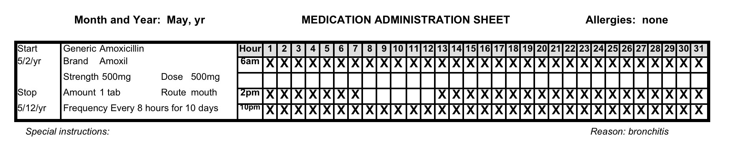
Day Program Transcription
Notes:
There’s a visual example of how to transcribe a medication at the day program, leaving only those boxes open for which day program staff are responsible to administer.

Slide 54
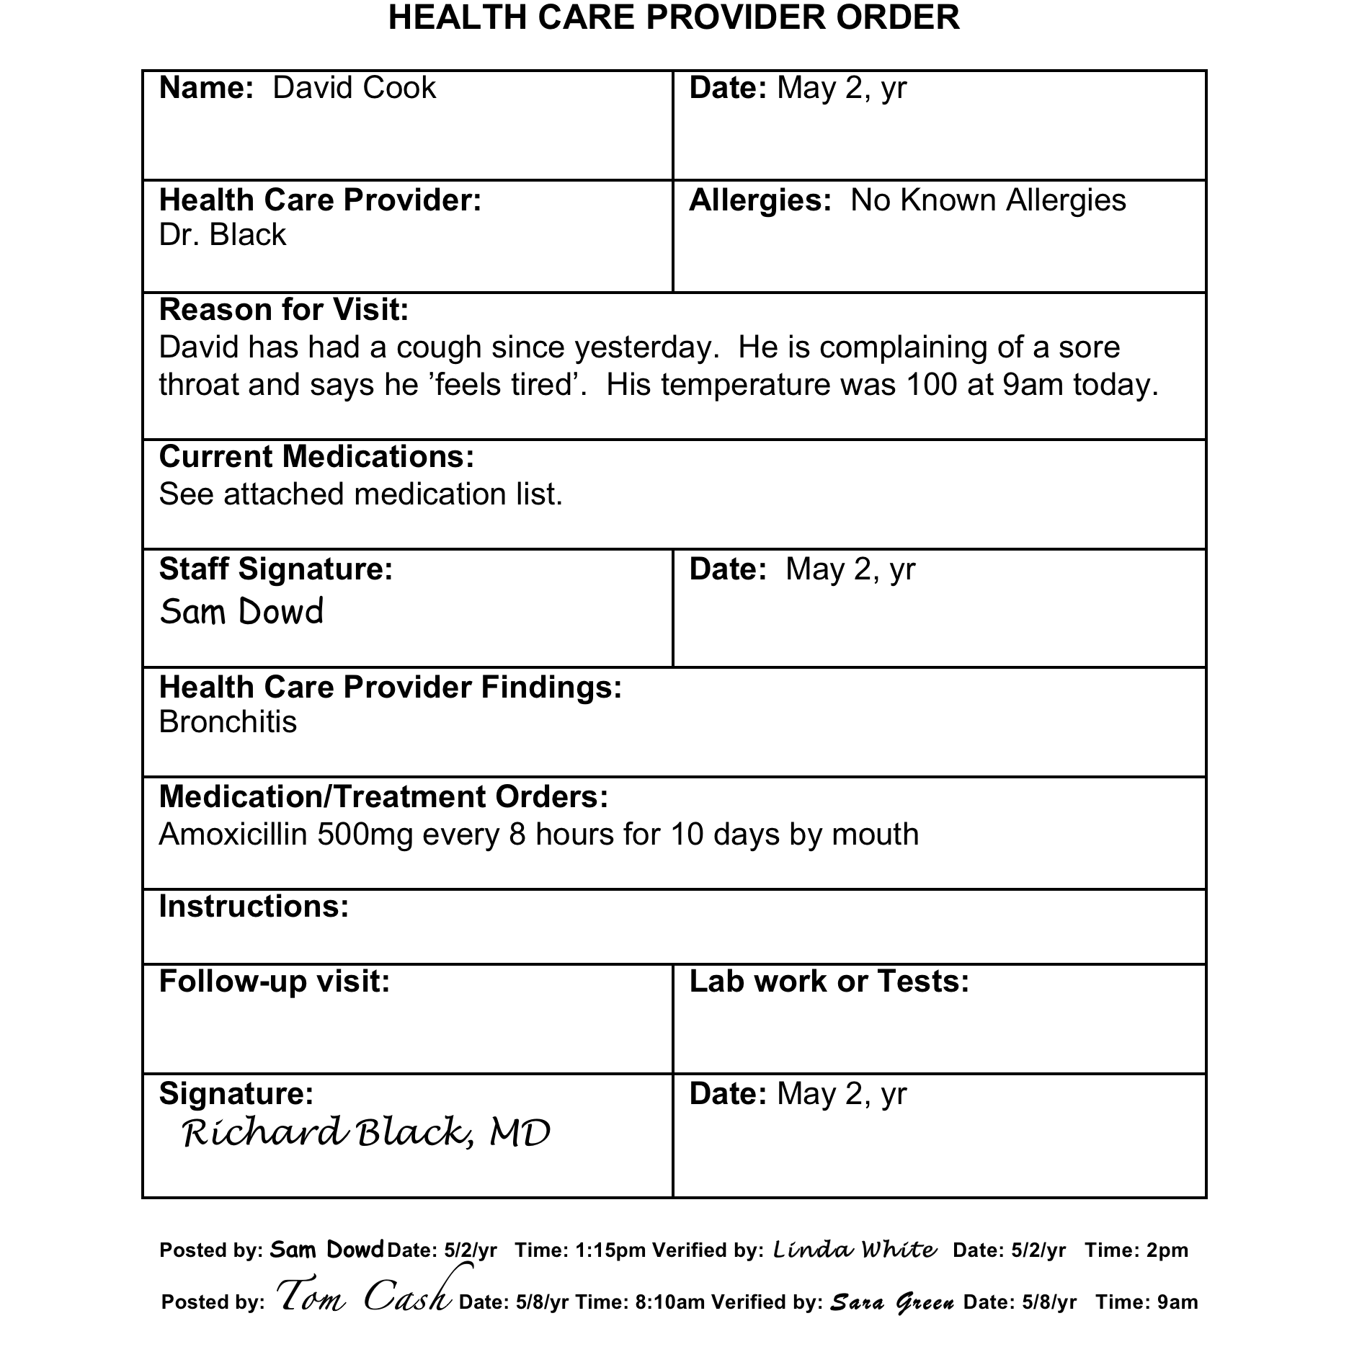
Day Program HCP Order Post/Verify
Notes:
After transcribing, there is an example of how day program staff must post and verify the HCP order under the post and verify section that was completed by residential program staff.

Slide 55
Off-Site Medication Administration
Administered by Certified/Licensed staff
  At an off-site location during hours person would typically receive medication in
    Residential Program
    Day Program
Notes:
Off-Site medication administration is new content in regard to how to prepare, administer and document for those times when a person leaves their residential program for a community outing, the movie theater or the mall and will have their medication administered while attending the activity. Another example that falls into this category is when a person leaves the day program to go to their work location, or to attend an activity, and will have their medication administered during work or while attending an activity during scheduled day program hours.

Slide 56
Off-Site Medication Administration
Preparation
  Pharmacy must if more than 24 hours
  If less than 24 hours
    Staff may prepare medication
      Staff that prepares medication is responsible to administer medication
Notes:
If staff will be administering medication during a time period of more than 24 hours, the medication must be prepared by the pharmacy. If the pharmacy cannot prepare the medication and staff will be administering medication during a time period of less than 24 hours, staff may prepare the medication. When staff prepare the off-site medication, the same staff must also be responsible for administering the medication. The manner of preparation by staff is the same as LOA medication preparation, a coin envelope may be used with all the necessary information included.

Slide 57
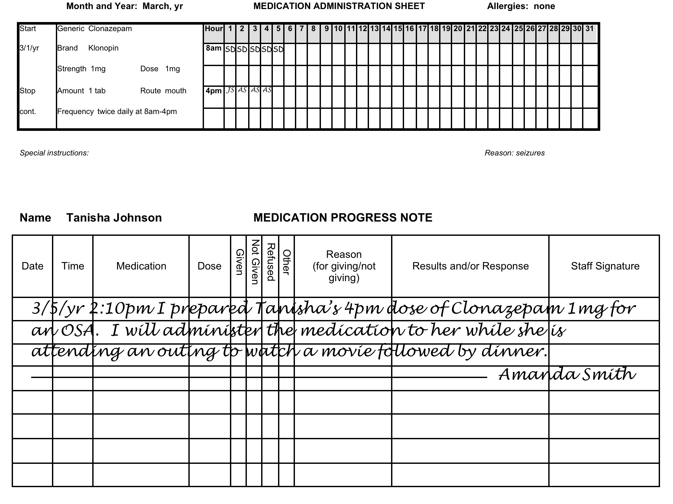
After Preparation
Notes:
After preparation of the OSA medication, staff must document a medication progress or narrative note that includes the location that they’ll be administering the OSA medication. The corresponding medication box remains open.

Slide 58
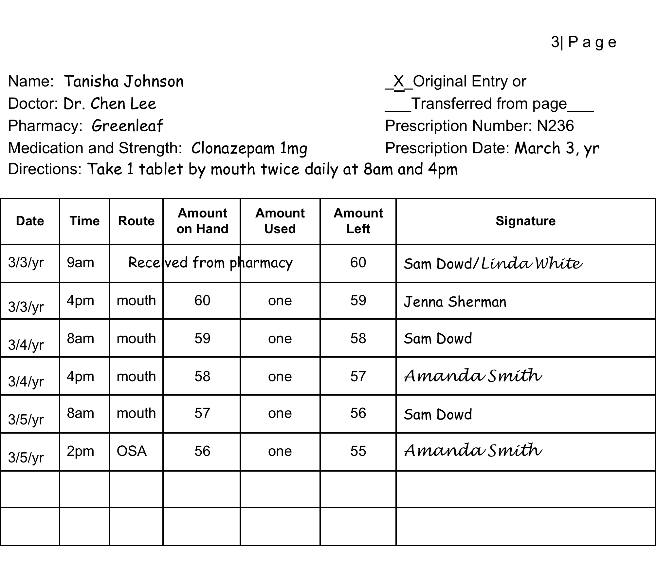
Notes:
When the OSA medication is countable, it’s documented as shown on the slide.

Slide 59
Off-Site Medication Administration
During Off-Site Administration
  Staff must have copy of
    current MAP Certificate
Notes:
During the off-site med administration time, staff must have a copy of their current MAP Certificate.

Slide 60
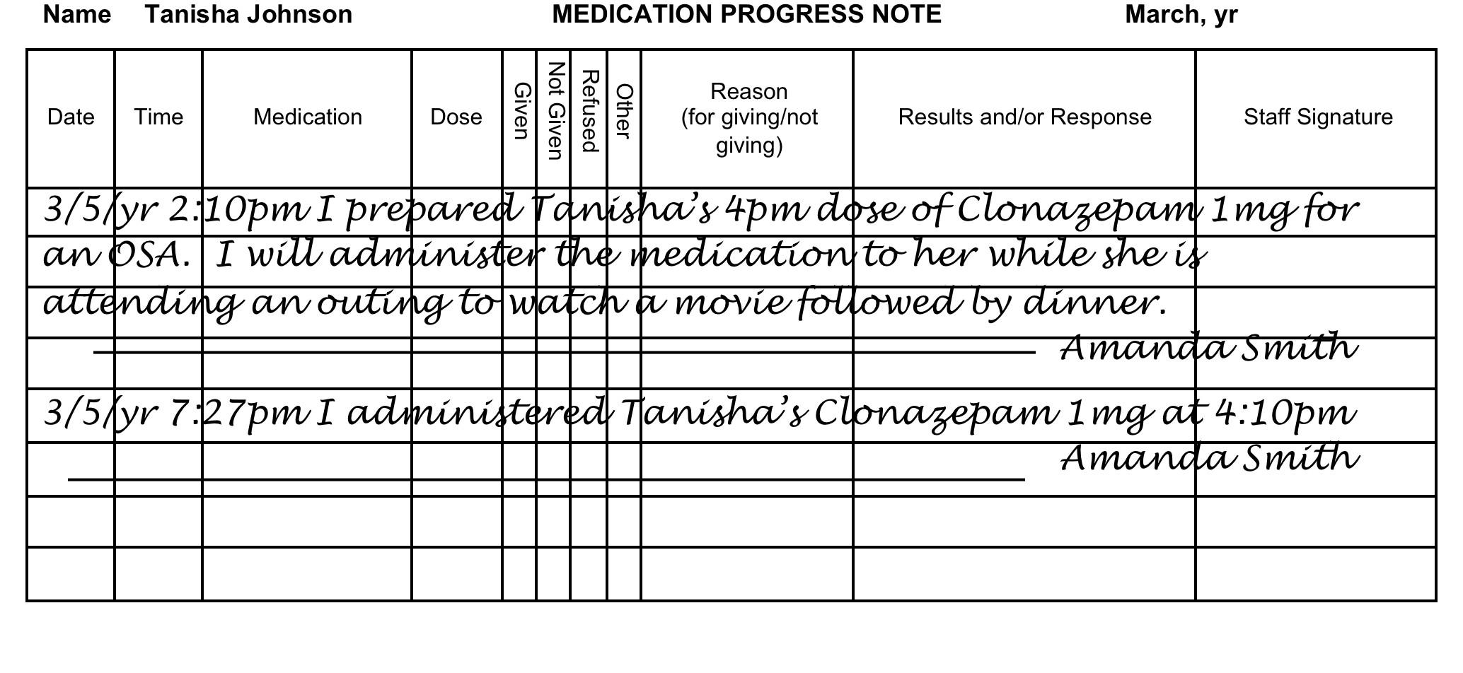
Return From Off-Site Administration
Notes:
When staff return from an off-site medication administration with the person to their home or day program, staff must write a second medication progress or narrative note indicating the medication was administered.

Slide 61
Off-Site Medication Administration
Unused OSA Medication
  Prepared by
    Pharmacy
      If in tamper resistant packaging
        May be returned for reuse
          If countable, add back to count
    Staff
      Must be disposed
Notes:
Any unused OSA oral medication prepared by staff may not be returned for use; the med must be disposed and documented in the disposal log. Any unused OSA oral medication prepared by the pharmacy in tamper-resistant packaging may be returned for use. If it’s a countable medication it must be added back into the count.

Slide 62
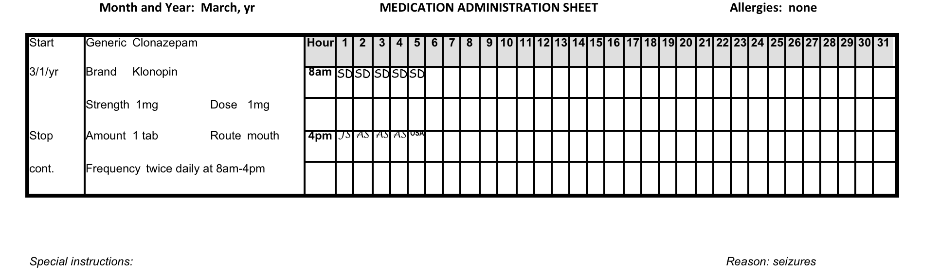
Residential Program
Notes:
The staff responsible for medication administration in the residential program in this example, when the person is away, will document ‘OSA’ in the medication box at the scheduled administration time. The same would apply to day program. The day program staff responsible for medication administration in the day program when a person is away at work, or away at a community activity, will document OSA.

Slide 63
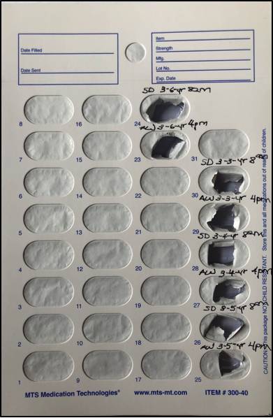
Blister Pack Monitoring
Notes:
There is a new visual and additional content about this topic, explaining, although not a MAP requirement, if used, what to document on the back of the blister pack. The content specifies, when blister pack monitoring is used, staff should look at the set of documentation before theirs. If they notice there is no documentation for an earlier dose of medication that should have been administered by a previous staff, they are required to contact a MAP Consultant. It also explains the second part of blister pack monitoring is a supervisor or their designee periodically reviewing the documentation to ensure medication was given as prescribed.

Slide 64
Medication Supply Discrepancy
Loss
Diversion
Tampering
Documentation Inconsistencies
Notes:
This topic was enhanced to include the process if there is suspected tampering, and what to do if there is a loss, diversion or documentation inconsistencies.

Slide 65
Unit 9
Medication Occurrences
Notes:
Based on hotline data, there was a statement added to Unit 9 that states, “If after ordering a refill you have been told it was too soon to obtain the medication, contact your Supervisor. The Supervisor will review medication administrations compared to the amount received from the pharmacy to determine if too much medication was administered.”

Slide 66
Appendix
Definitions
Documentation Quick Guide
Documentation Examples
Notes:
The appendix is new. It’s not required training content and there’s no test questions from this section. It includes

Slide 67
Appendix
Definitions
  Late Entry
  Real Time
Notes:
the definitions of a late entry and real time. A late entry is a progress note written well after a task was completed and tells a story of what happened earlier. Real time is the actual time, to the minute (what you see on the clock).

Slide 68
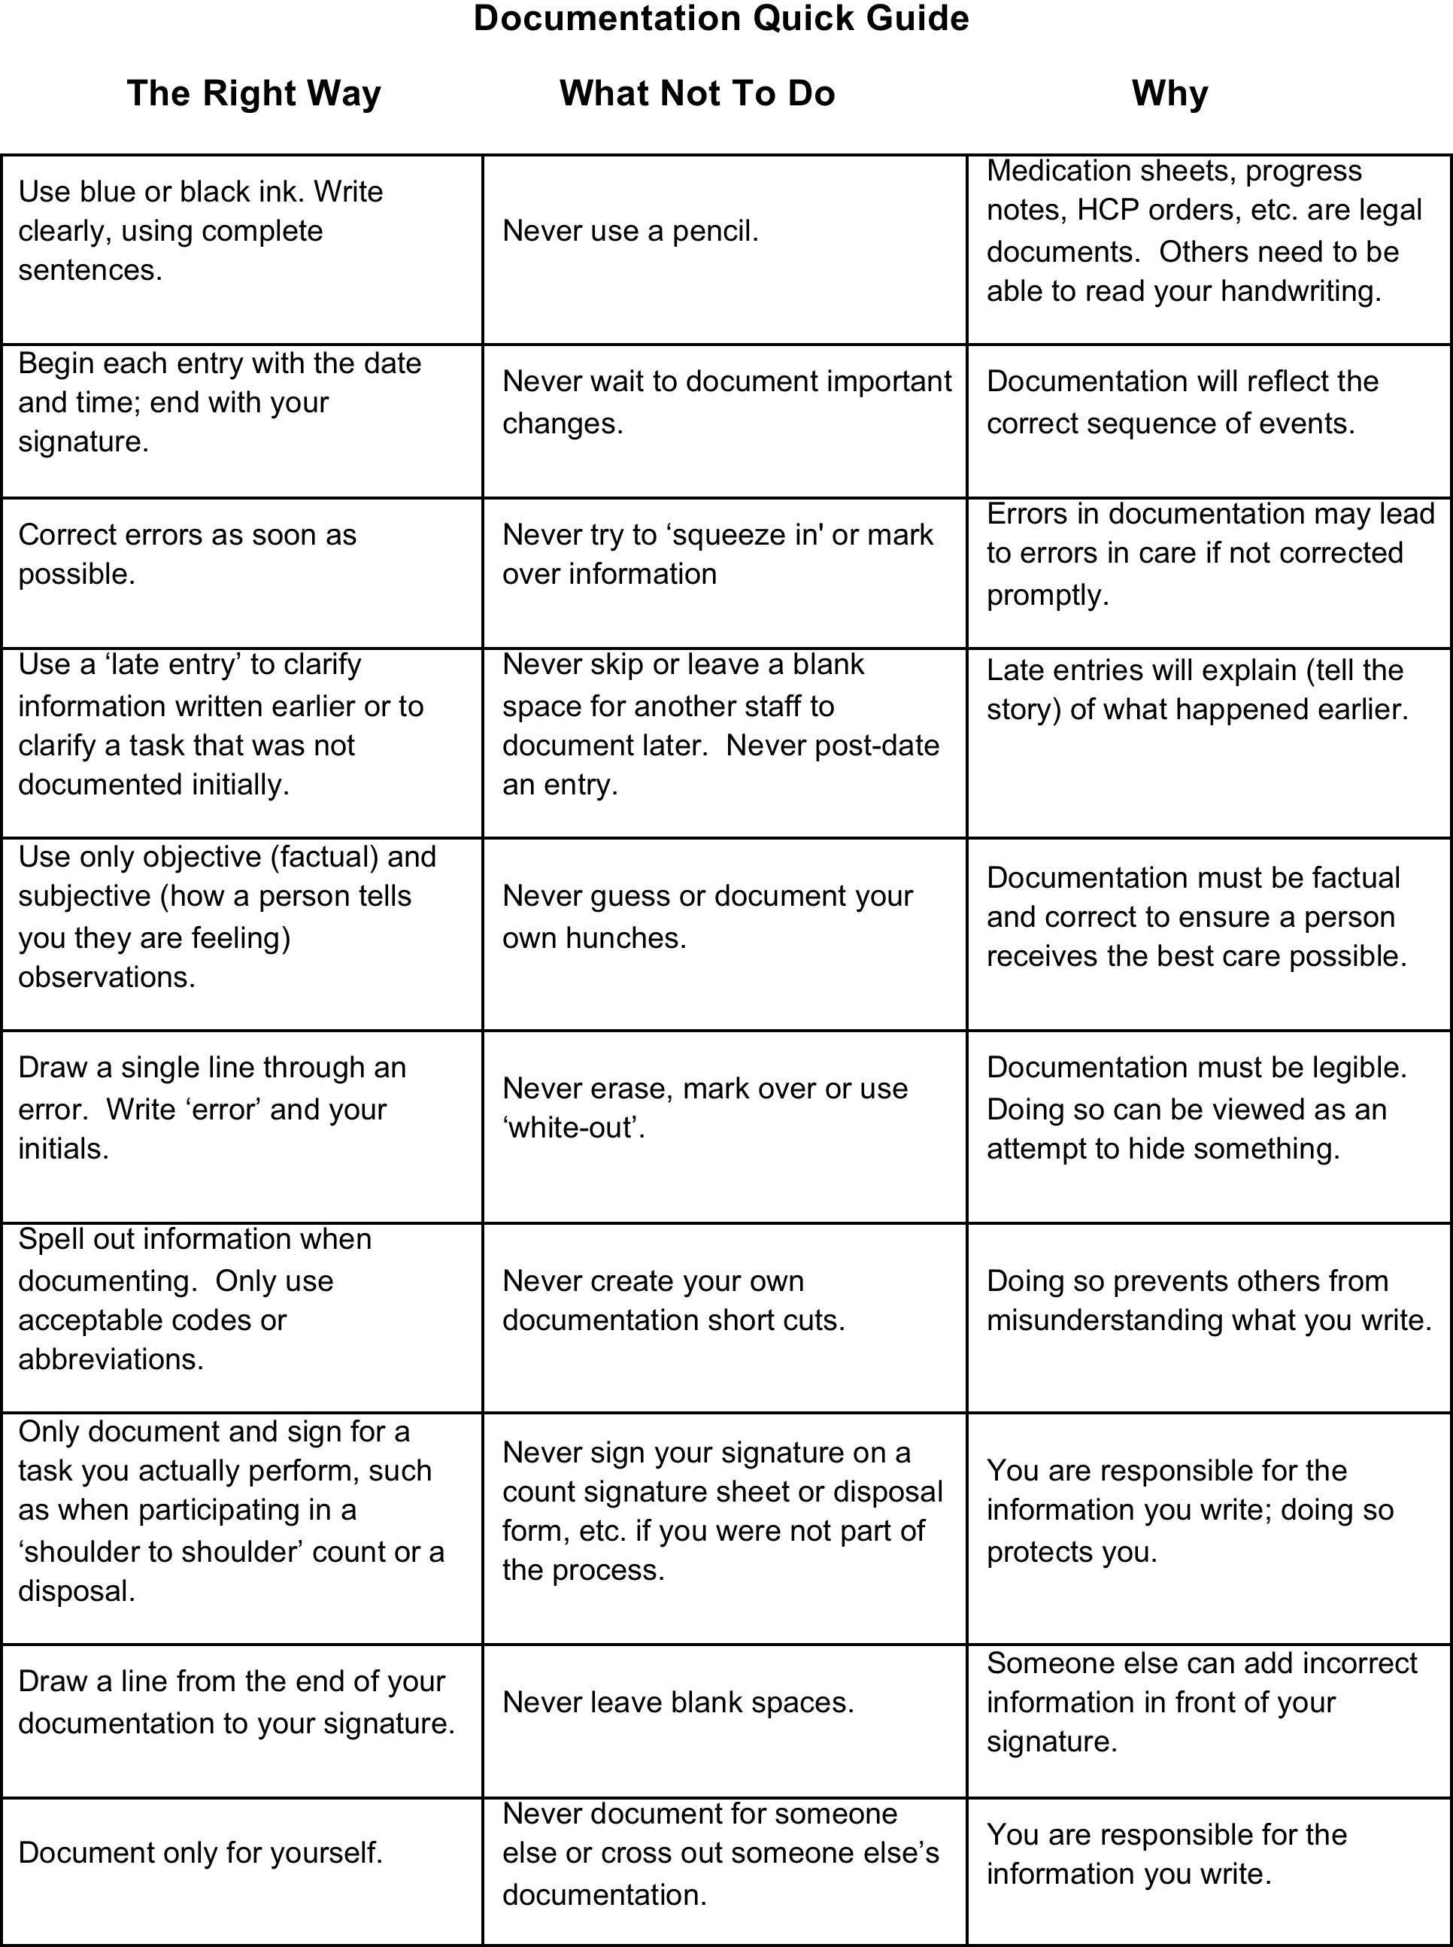
Appendix
Notes:
It includes a ‘Quick Guide’ that explains the right way to document, what not to do and why. This is followed by

Slide 69
Appendix
Requirement: Two Certified staff must verify a countable medication refill.
Scenario: A countable medication is delivered. You are the only Certified staff present.
Responsibility: You add the medication into the count when delivered. The second Certified staff verifies the amount delivered when they arrive to work.
Notes:
typical issues staff may encounter once they’re MAP Certified. Each issue is set up as what’s required, followed by a scenario in which meeting a requirement can happen but just not at that moment and what staff are to do. The issue is followed by

Slide 70
Notes:
a visual example of how to document to meet the requirement.

Slide 71
Responsibilities in Action
June 2020 Revision
  mass.gov/dph/map
Notes:
This concludes the RIA overview. The June 2020 Revision is available online. You have until June 30 of 2022 to transition to this version. Thank you for listening.

