Slide 1
Medication Occurrence Reporting
HCSIS Data Entry
Notes:
Todays webinar topic is Medication Occurrence Reporting, HCSIS Data Entry. My name is Carolyn Whittemore a Department of Developmental Services MAP Coordinator and I will be your presenter.
To correspond with this webinar presentation, it will be helpful to you, if you have a printed copy of the HCSIS MOR form and the corresponding Dictionaries page.
HCSIS stands for “Home and Community Services Information System”. It is an electronic system used for reporting and tracking medication occurrences in DDS.
The medication occurrence reporting system is Provider driven, meaning that only Providers have the ability to create MORs in HCSIS.
Responsibilities of both licensed and non-licensed staff using HCSIS vary from Provider to Provider. Some Providers appoint only key staff to enter information. Other Providers give the responsibility to Site Supervisor staff; there are others who have a two part process, one person enters information and a second person finalizes the report.

Slide 2
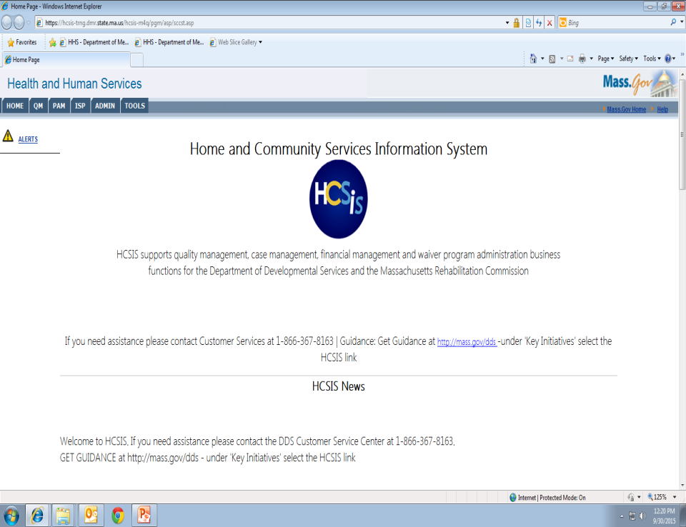
Notes:
To start the process, after entering your User ID and password, you will come to the HCSIS home screen, the USER navigates to the Incident Management Data Entry Screen, by clicking QM,

Slide 3
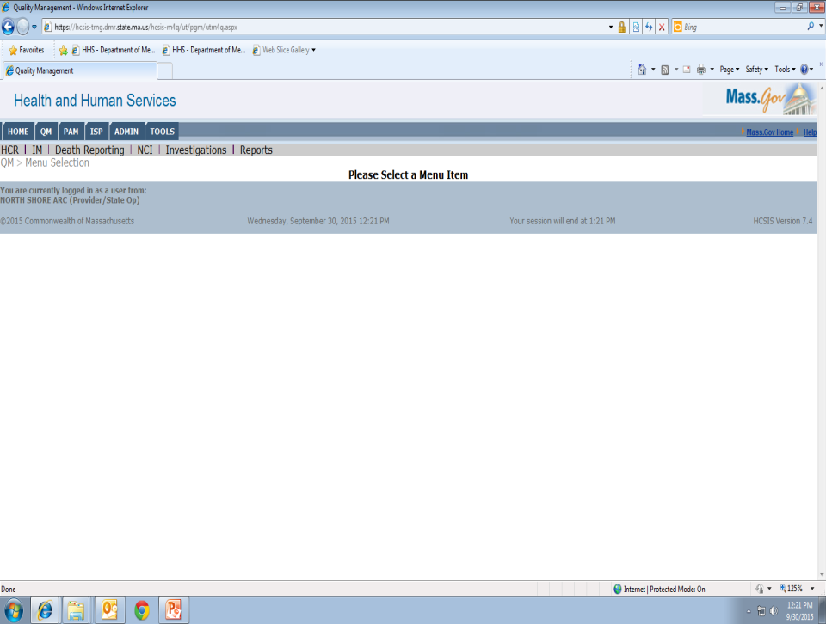
Notes:
Then IM

Slide 4
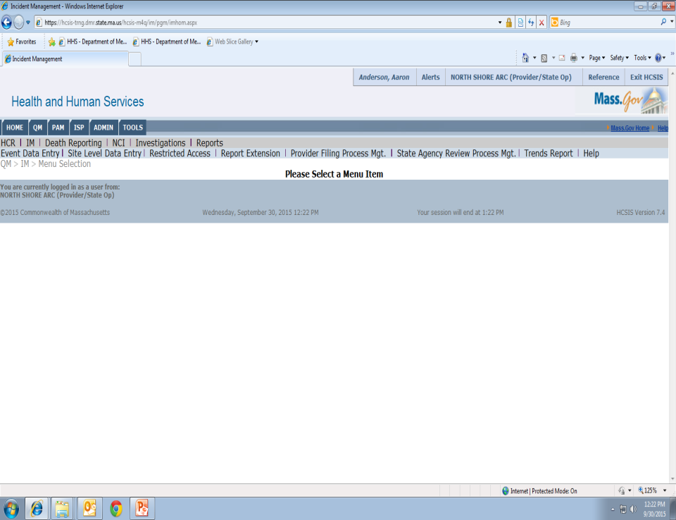
Notes:
Then event data entry

Slide 5
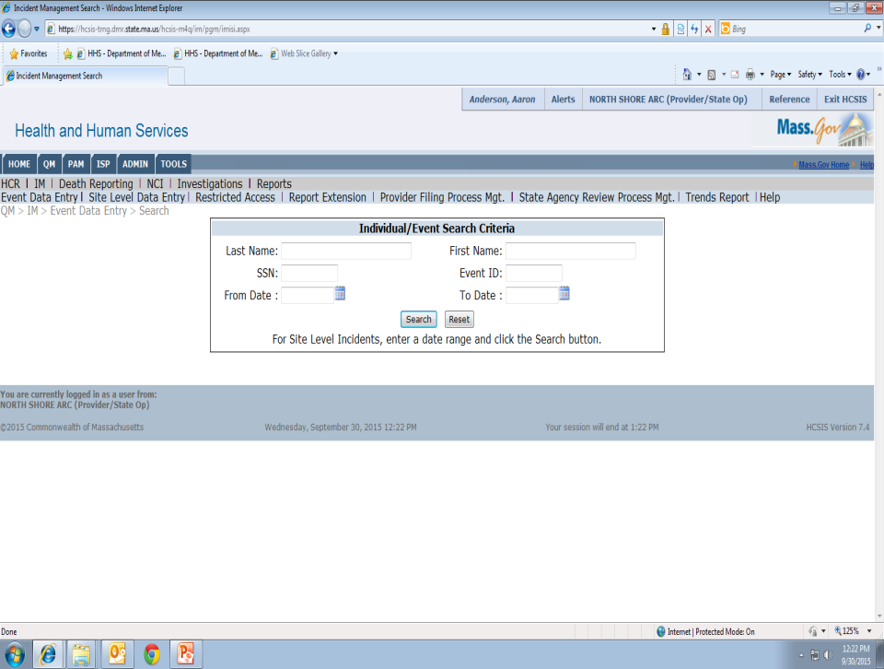
Notes:
Enter the individual’s name then click the search button.

Slide 6
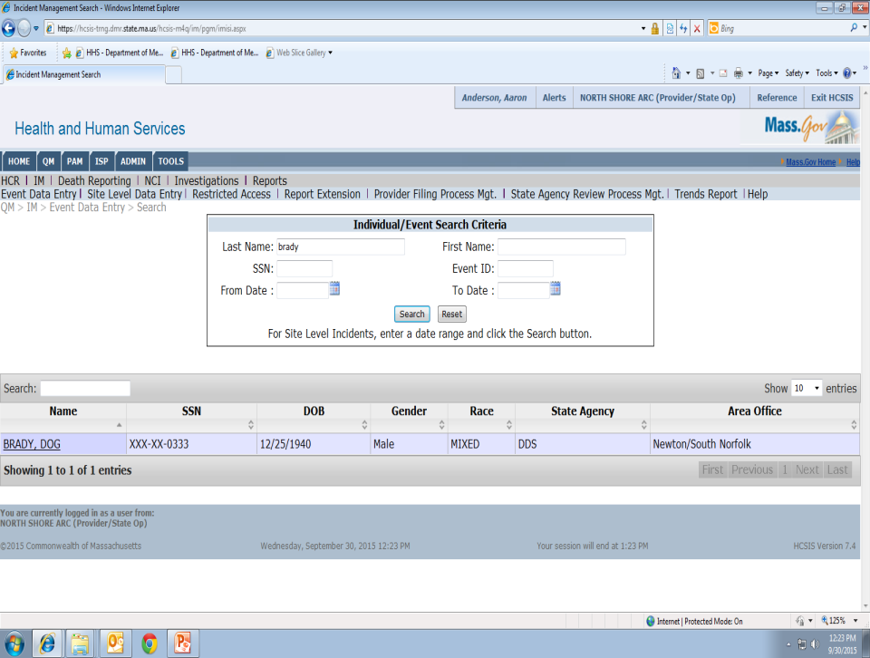
Notes:
Click on the individual you were searching for and it will bring you to…

Slide 7
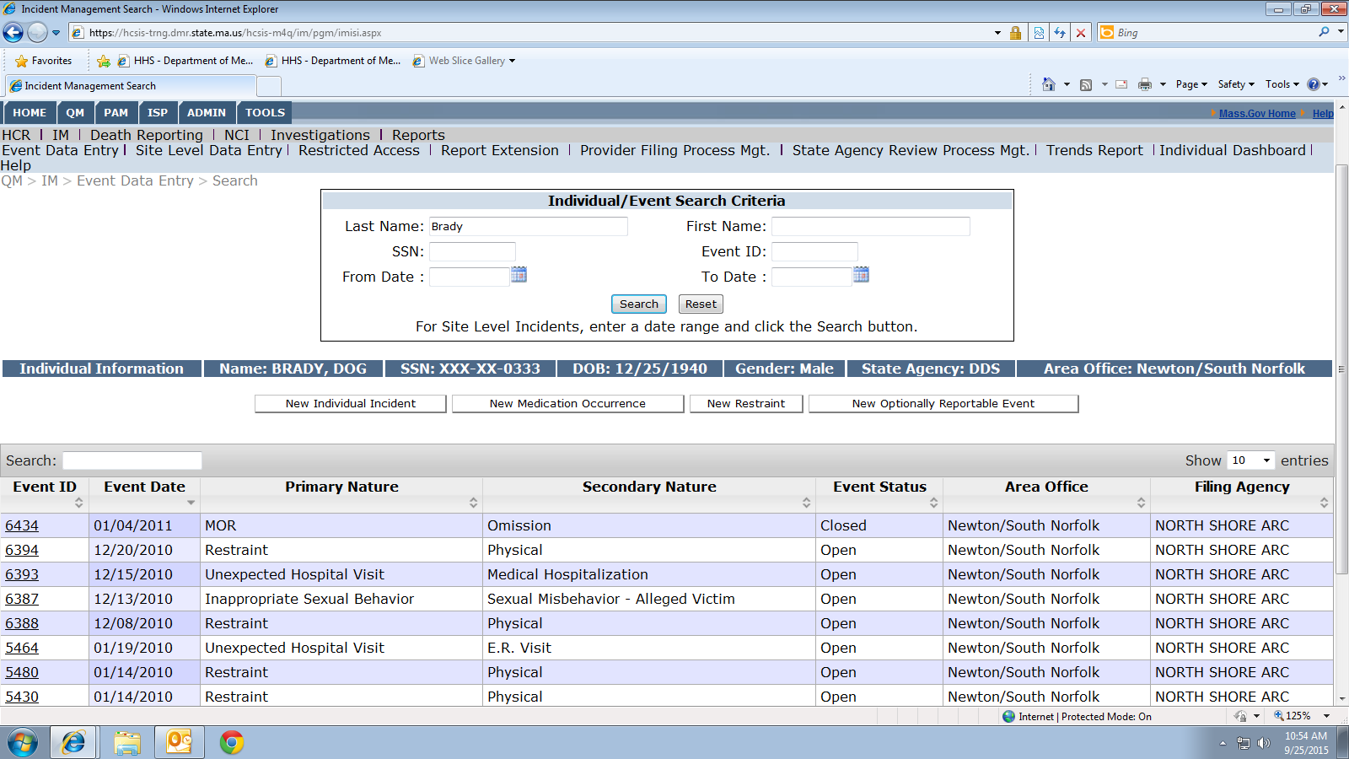
Notes:
The Incident Management Screen, which shows all opened and closed incident events for the individual. To enter a new medication occurrence, click the New Medication Occurrence button, circled on your screen, to start the MOR data entry process.

Slide 8
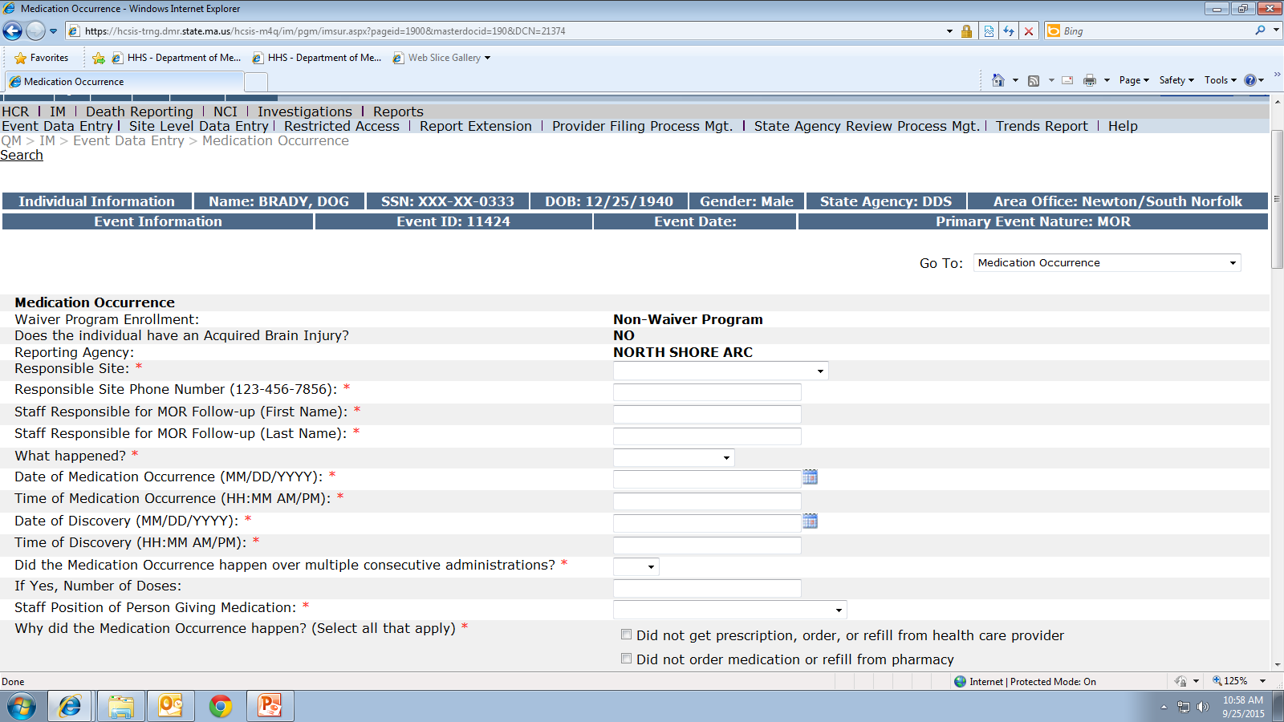
Notes:
The beginning of the medication occurrence form is prepopulated with whether or not the individual has an acquired brain injury and your agency name.

Slide 9
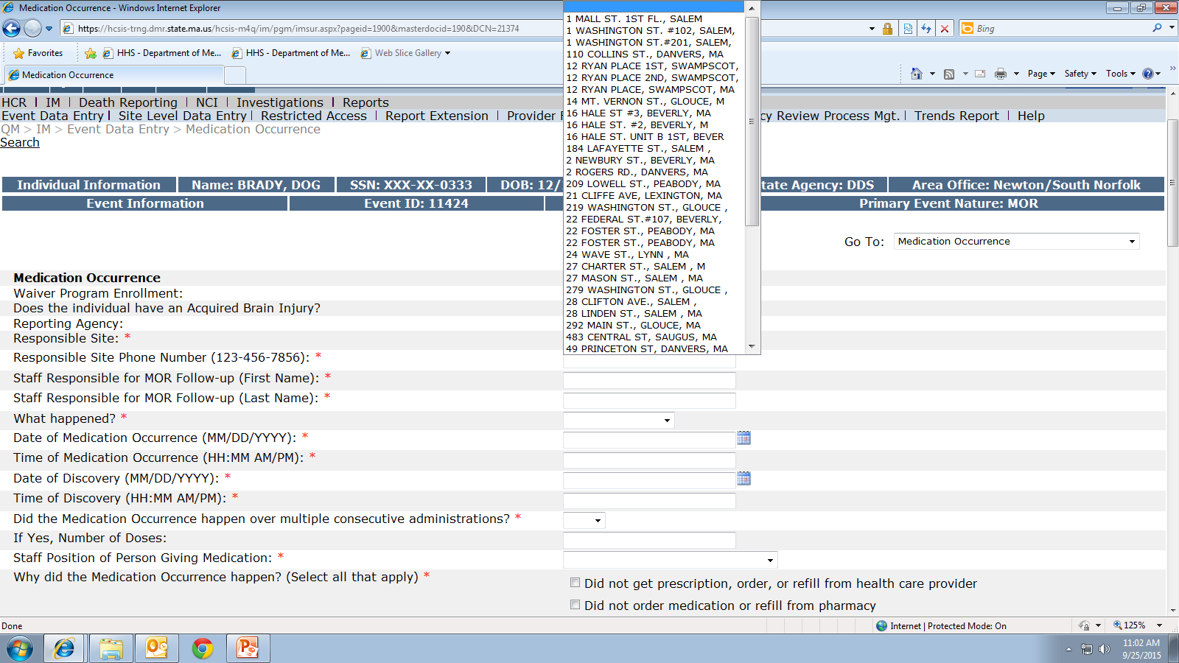
Notes:
Field 2, the responsible site must be listed. This is the site where the medication occurrence took place.
From the dropdown, select the site address. If you do not see the site address in the dropdown, you must contact the HCSIS helpdesk to get the site address added; do not select “NA” from the dropdown menu, complete the rest of the report and then submit the mor to the MAP Coordinator for review. If you do, it will be returned as ‘not approved’ asking that you contact the HCSIS Helpdesk to get the address added.

Slide 10
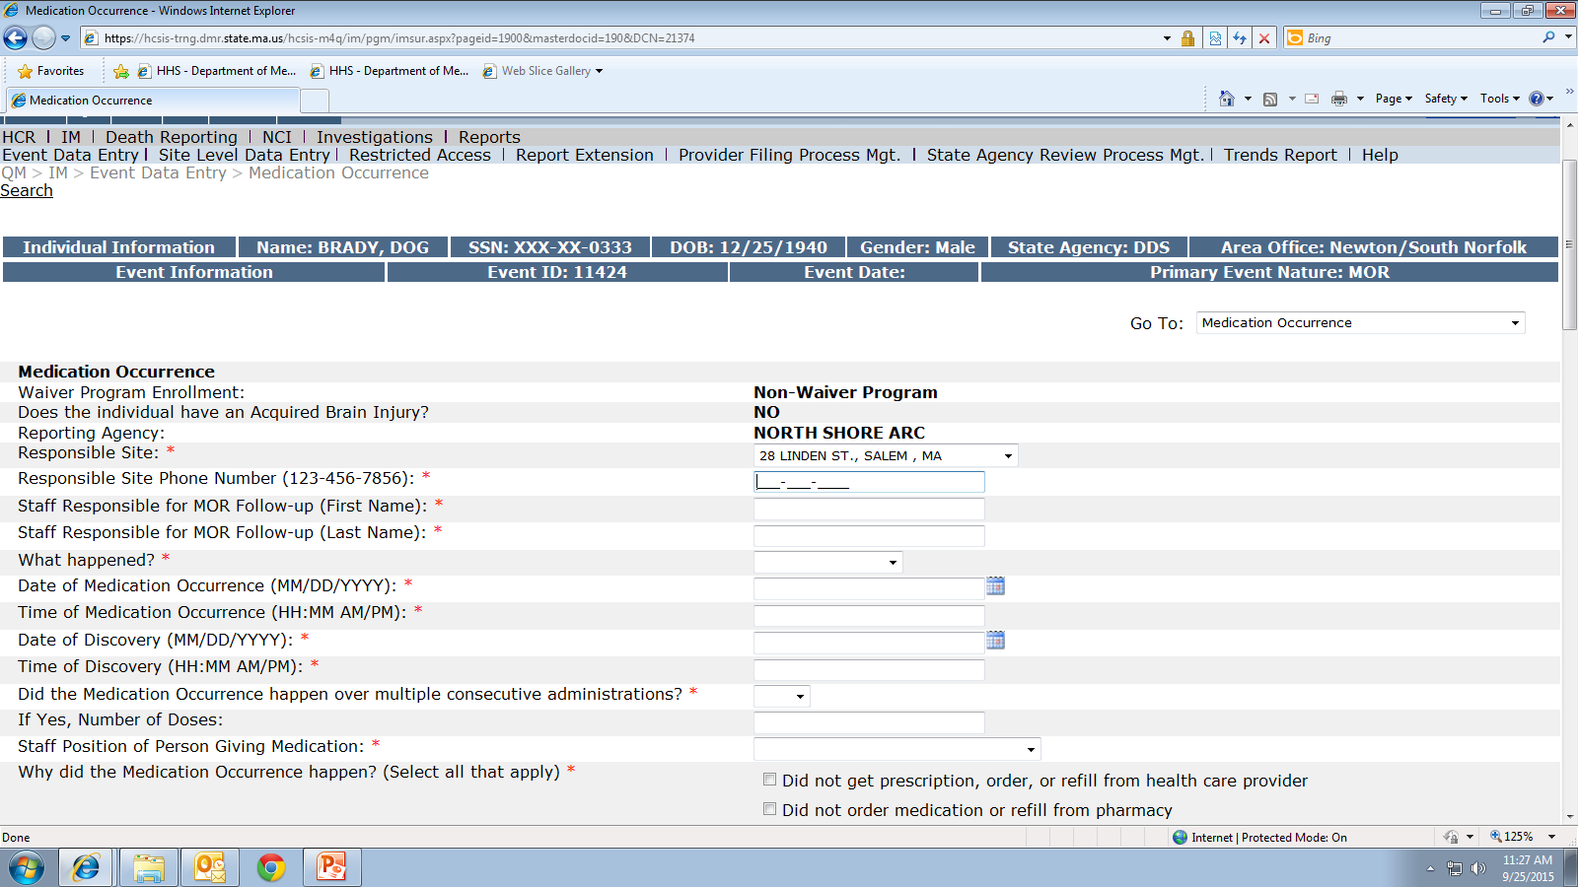
Notes:
Field 3 is the site phone number in which the medication occurrence took place.
Sometimes when reviewing an MOR the MAP Coordinator may need additional information directly from the program staff, so please enter the site phone number, not the number for your agency main office.

Slide 11
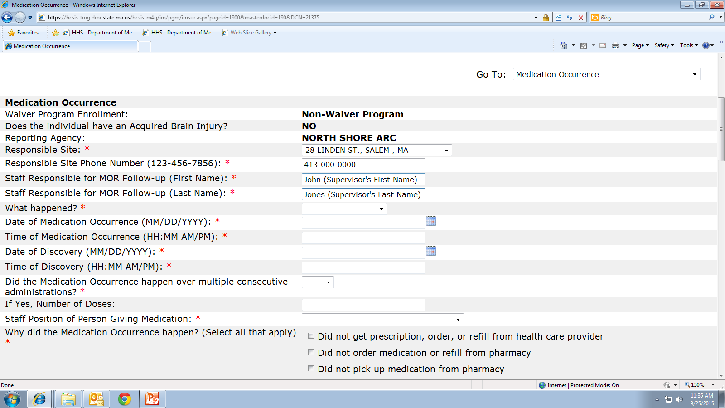
Notes:
Field 4 is the name of the supervisor responsible for the MOR follow up. MORs are sometimes marked ‘not approved’ because the name of the certified staff who made the error or the name of the nurse who will be retraining is entered in this field. Even though the nurse may have a role in retraining staff, the Site Supervisor is responsible for MOR follow up and their name is entered here.
This field was recently updated online to state “Supervisor” Responsible for MOR follow up, the old wording stated “Staff” as seen on your screen; hopefully the change in wording will make it more clear the information to be entered in this field. (Please be aware, the printable paper version, just like this screen shot, still has the old wording.)

Slide 12
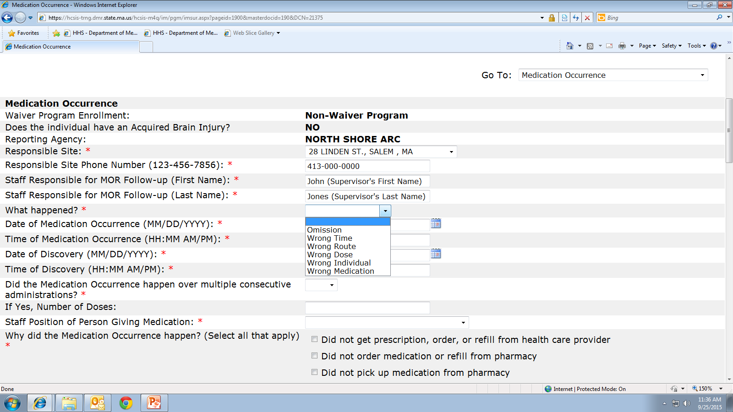
Notes:
Field 5- What happened? A medication occurrence means one of the 5 ‘rights’ went ‘wrong’, notice there are 6 selections, omission being a subcategory of wrong time. From the dropdown, choose which type of medication occurrence happened.
In response to this question, HCSIS allows for only one category to be selected. Sometimes, more than one type, or category, of occurrence happens within the same med pass.
As long as the occurrence was on the same date and time, to the same individual, during the same med pass, only one MOR is submitted. I’ll show you some examples in a few slides.
First we’ll do a quick review of the medication occurrence categories.

Slide 13
Omission
Medication was not given
  Possible reasons
    Forgotten
    Unable to locate med
    Prior authorization
    Refill
      Not ordered
      Did not come in
Notes:
An omission is when the medication is not given at all, the individual never received the med. Some possible reasons are listed on the screen.

Slide 14
Wrong Individual
Medication taken by a person it was not ordered for
  Possible reasons
    Distracted
    Misidentified person
    Pre-poured
    Medication left unattended
      Another person ingests it
Notes:
An example of wrong individual would be if a set of meds was prepared for one individual and then accidently administered to a different individual or if a set of meds was prepared, left unattended and an individual they were not ordered for ingests them.

Slide 15
Wrong Time
Medication was given too
  Early
    Ordered once daily in pm but
      Administered at 8am
  Late
    Ordered once daily in am but
      Administered at 1 pm per MAP Consultant recommendation
  Many times
    Ordered once daily and given twice daily
Notes:
A wrong time is when a med is given either too early before the ordered time….. too late after the ordered time …… too many times in the same day…..or….

Slide 16
Wrong Time
Medication was given
  Not following parameters
    Ordered: hold for blood pressure (BP) less than 90/60
      Administered without taking BP
      Administered with a BP below the stated parameters
Notes:
it could be if a parameter is included in the order and not followed. For example; if a medication has a parameter to take the blood pressure daily, hold for blood pressure below 90/60, if the med is administered without taking the blood pressure first, this is considered a wrong time. Or if the blood pressure is taken, the result falls below the stated parameter and the medication was given when it should not have been.

Slide 17
Wrong Medication
Examples
  Gave a medication
    That was discontinued
    Using an expired HCP order
Notes:
A wrong medication is either when a medication is given without an HCP order, using an expired order or a medication continues to be given after it was discontinued.

Slide 18
Wrong Route
Examples
  Ear drops administered into eyes
  Eye drop ordered for right eye administered in left eye
  Medicated gel ordered topically to rash was administered orally
Notes:
Some examples of wrong route are listed on your screen….

Slide 19
Wrong Dose
Administered too
  Much
    As ordered: Depakote 250mg
    As given: Depakote 500mg
  Little
    As ordered: Depakote 500mg
    As given: Depakote 250mg
Notes:
A wrong dose is when either too much or too little of the ordered medication is given at the specified time.

Slide 20
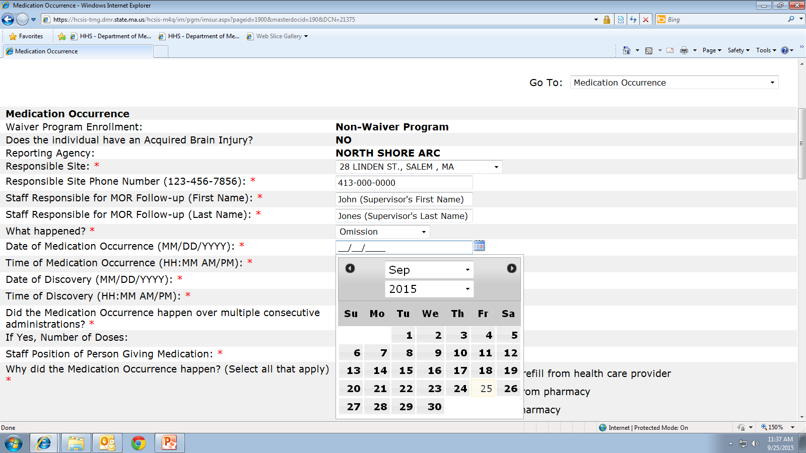
Notes:
Fields 6-9. Date and time of the medication occurrence and date and time of discovery.
To enter this information, click on the calendar symbol and the current calendar page will open. Using the dropdowns, select the month and year of the medication occurrence, then click on the appropriate day.

Slide 21
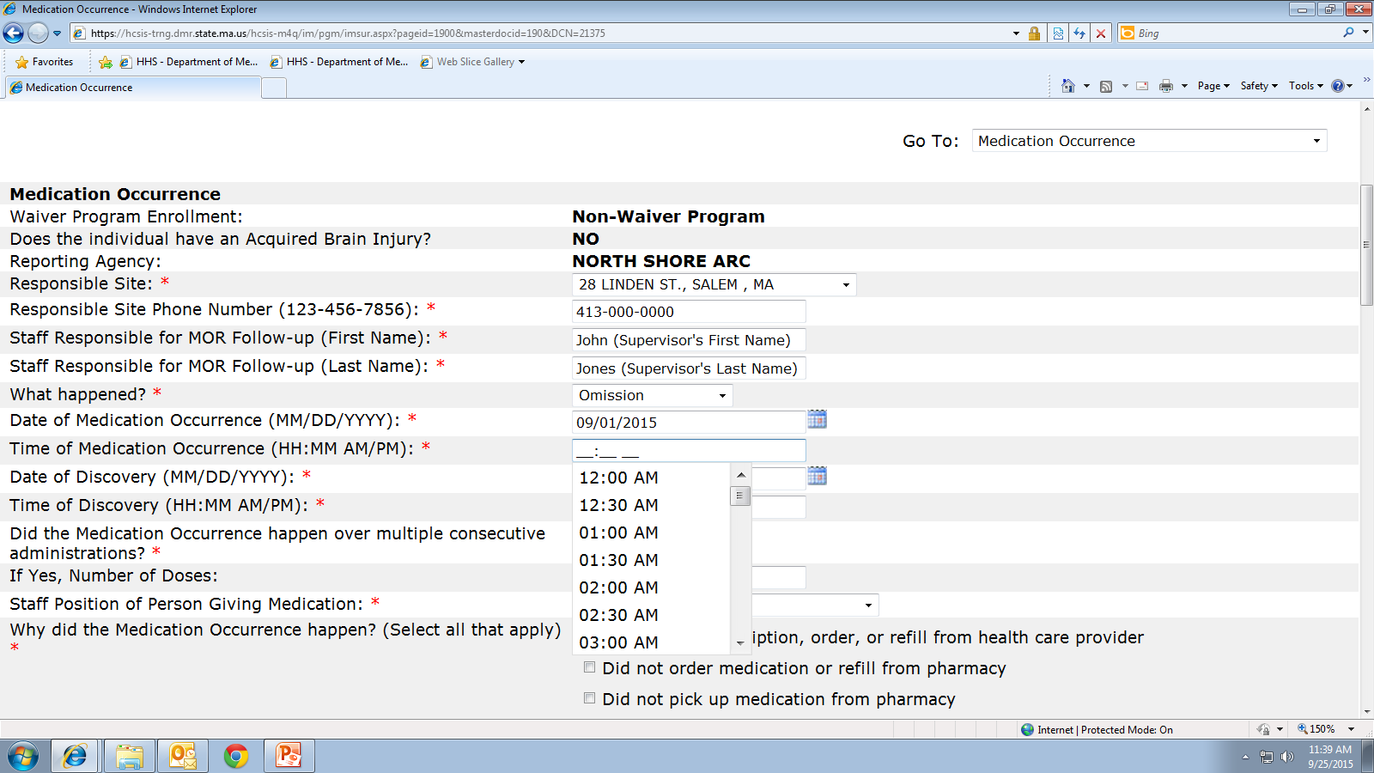
Notes:
Once the date of the MOR is entered, next is the time, from the dropdown, select the time. As you can see on your screen, the times listed in the drop down are every half hour, if this does not correspond with the actual time of the medication occurrence, you can enter the time by typing it in, be sure to include the ‘am’ or ‘pm’.

Slide 22
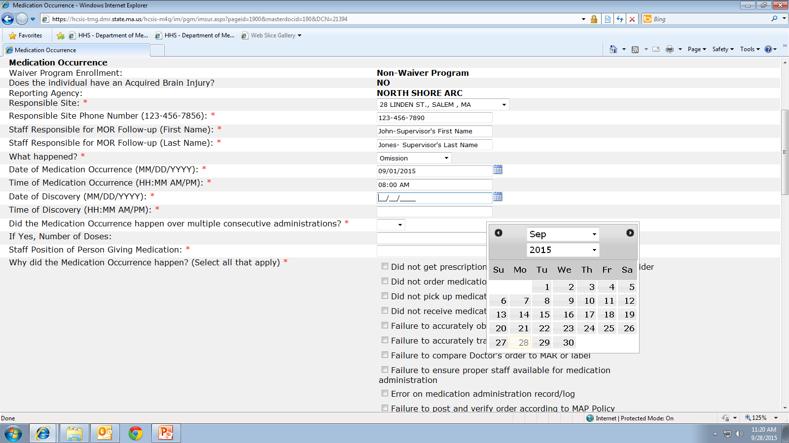
Notes:
Next is the date and time of discovery. Using the same process, select the date and time of discovery.
On the paper HCSIS form these fields, date of occurrence and date of discovery, are reversed compared to what you see online, so be mindful when completing the data entry in HCSIS that your dates make sense, especially if you are entering data from the completed paper form.

Slide 23
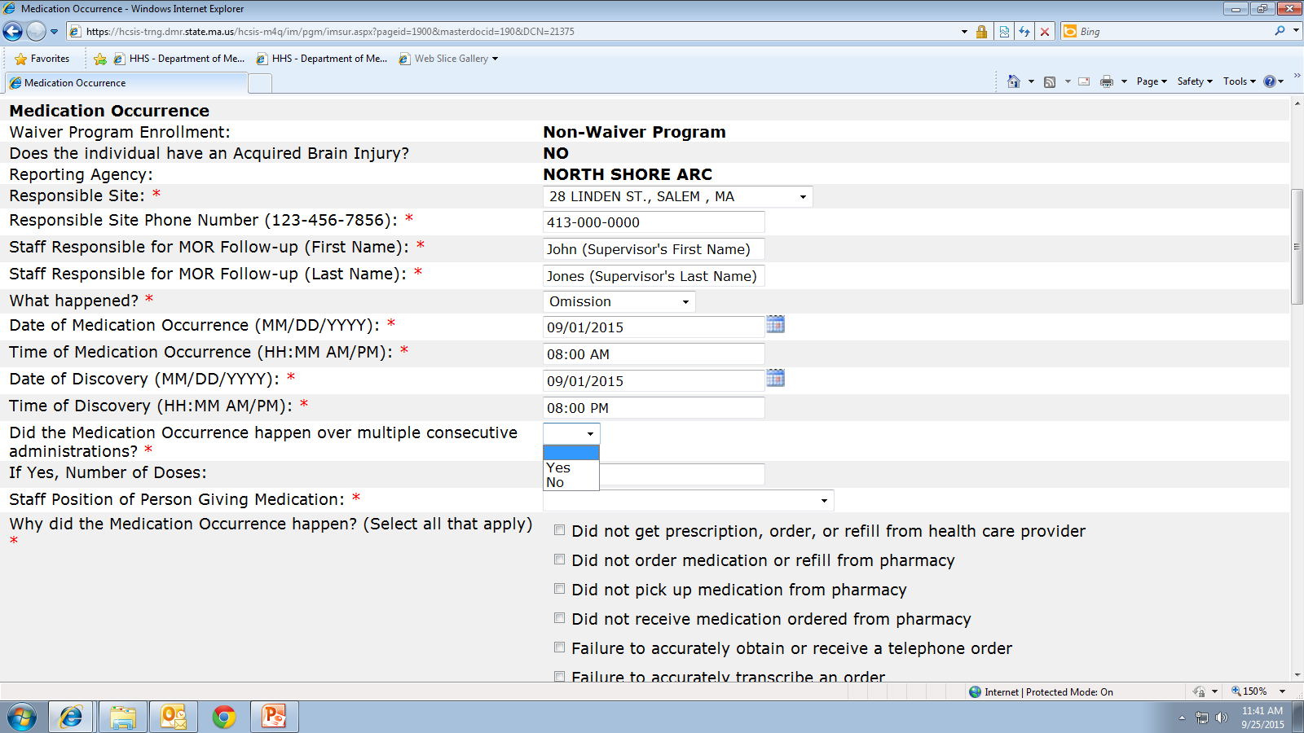
Notes:
Field 10, did the medication occurrence happen over multiple consecutive administrations?
From the drop down select yes or no.
To be considered multiple consecutive there cannot be a break in the occurrences. For example, if a medication is ordered 3 times daily and the 4pm and 8pm doses were missed, this question would be answered ‘yes’

Slide 24
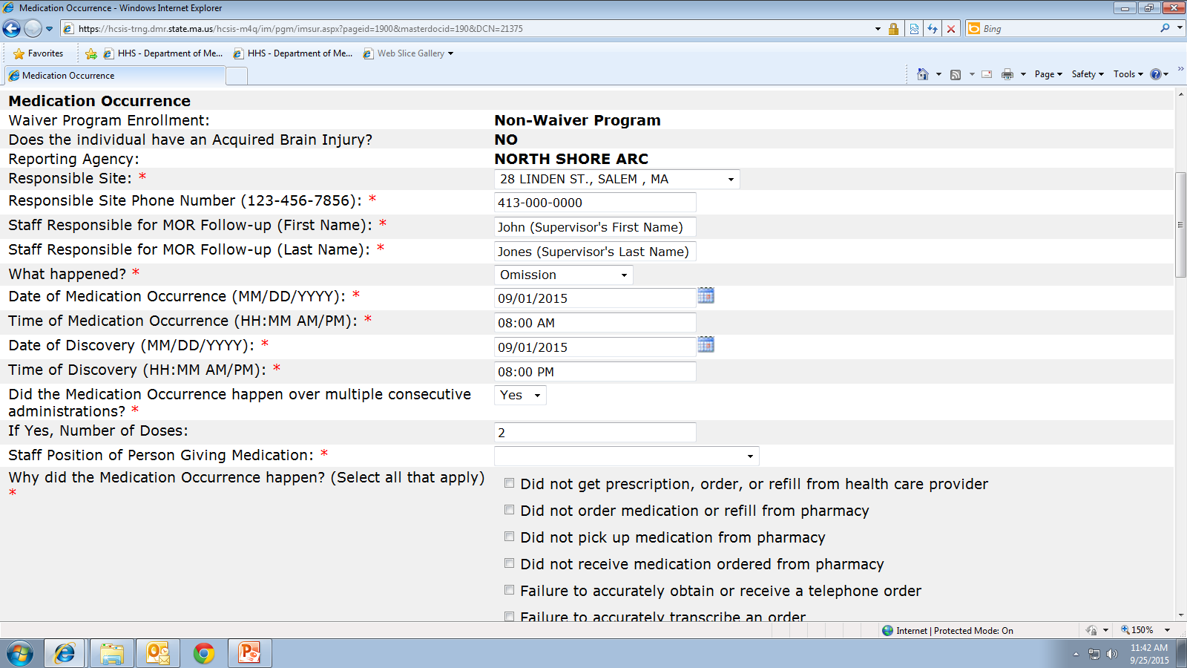
Notes:
If ‘yes’ was selected in field 10, then you must count up the doses missed and enter that number in field 11.
In the example from the previous slide, the 4pm and 8pm doses were missed, so ‘yes’ is selected and then 2 is entered.

Slide 25
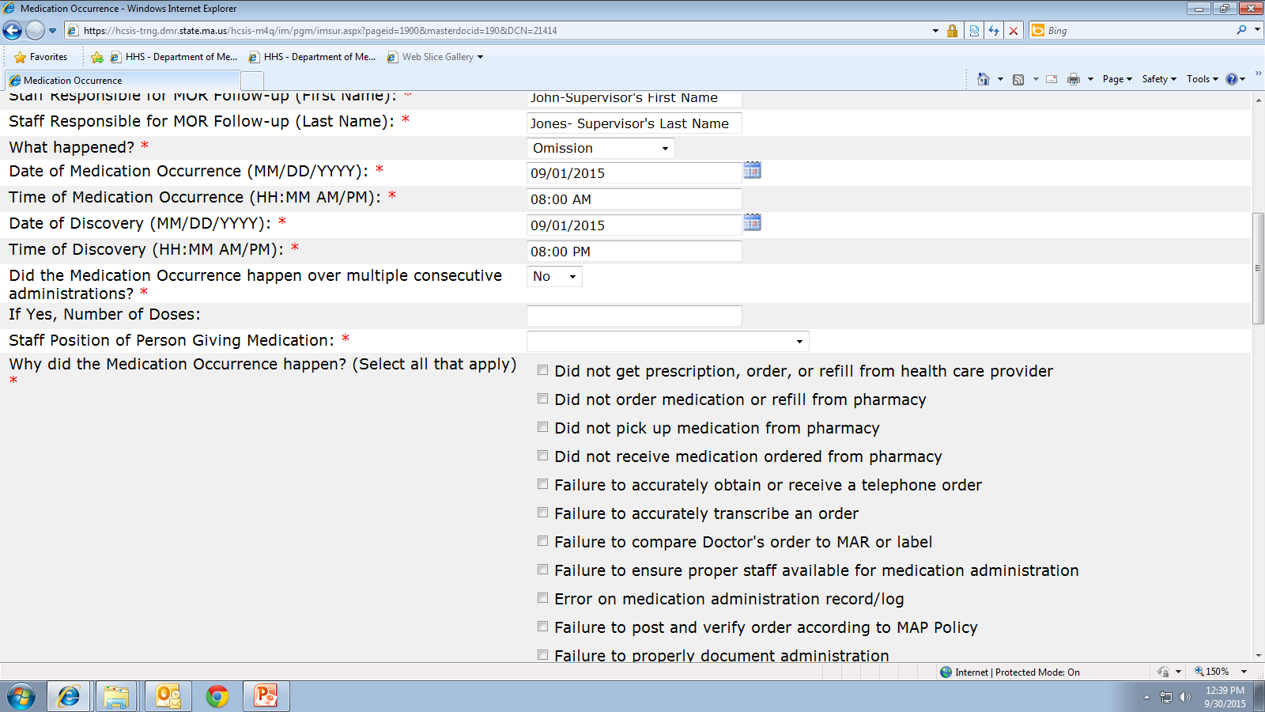
Notes:
If the medication occurrence happened only once, ‘no’ would be selected from the dropdown, and then next field would be left blank. Do not answer ‘no’ and then enter the number 1, if 1 is entered the MOR gets counted twice.

Slide 26
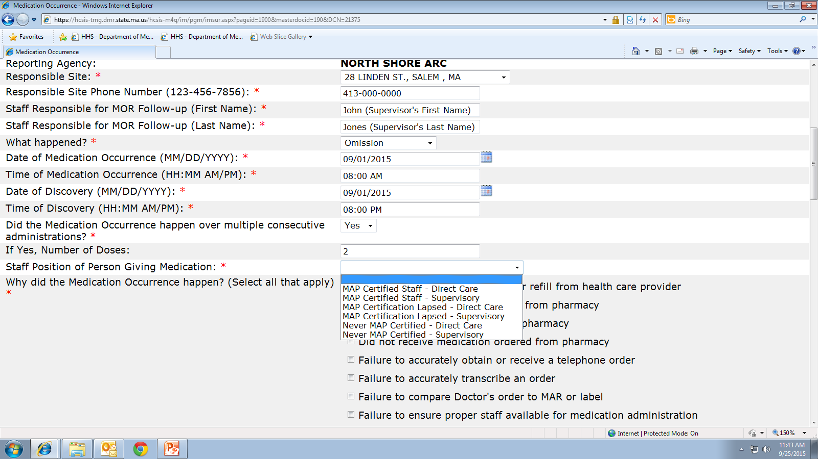
Notes:
Field 12, staff position of person giving medication
Dictionary #1 is a list of staff positions of the person giving medication, from the drop down make a selection.
If medication was omitted because there was no MAP Certified staff on duty or staff called out sick, do not enter “Never MAP Certified-Direct Care.” An example of when this might be selected is if a medication occurrence happens and the staff who made the error was never map certified.
If a MAP Certified staff gave meds and it is noted afterwards their MAP Certification status had expired; unless there was a mistake when meds were given this is a medication issue (and certainly must be addressed internally) but is not considered a medication occurrence.

Slide 27
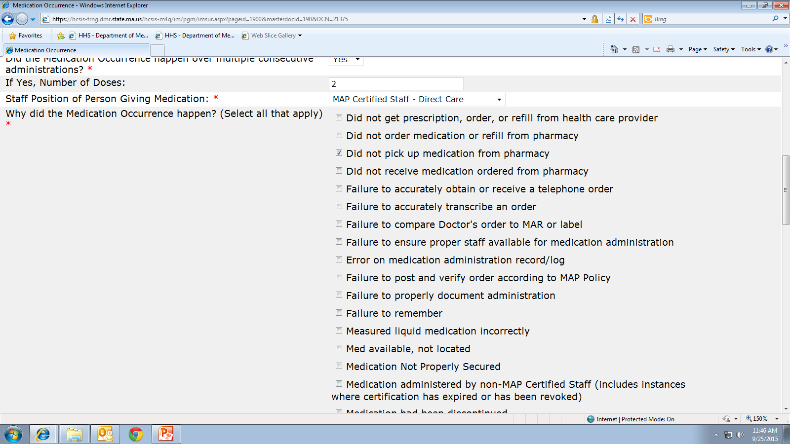
Notes:
Field 13, Dictionary #2 is a list of all the possible reasons/ contributing factors the medication occurrence happened.
You may select as many as apply to the situation….

Slide 28
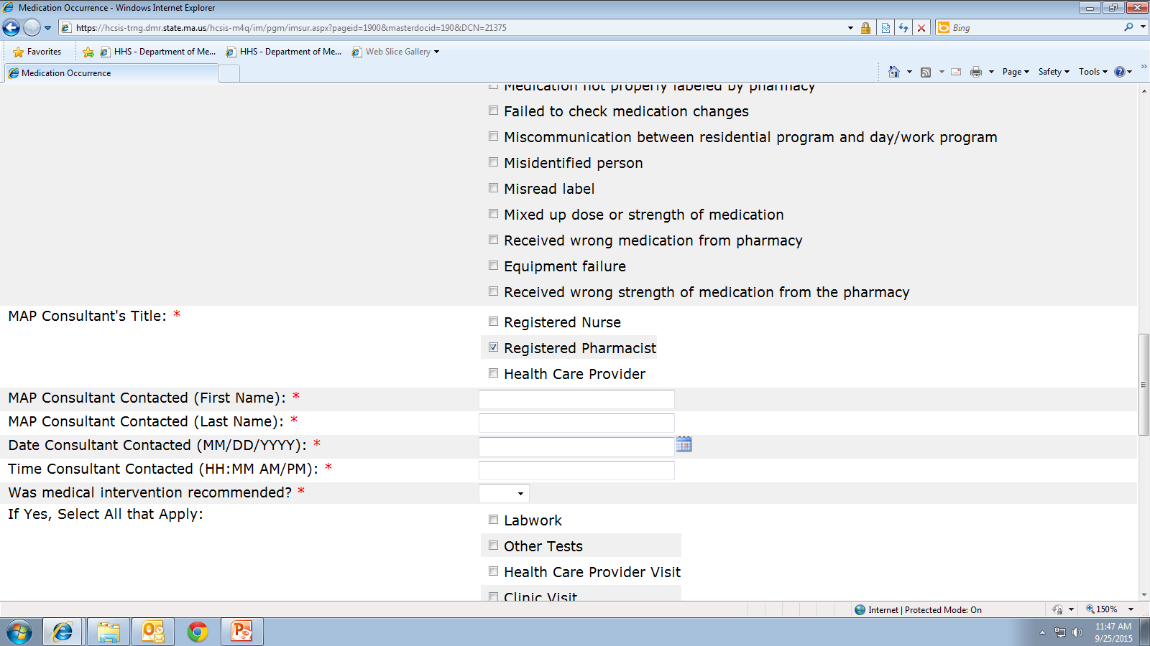
Notes:
Field 14, MAP Consultant title, allows for only 1 selection.
If more than one consultant was contacted please use the “Additional Comments” section for other consultant information. For example, if the Pharmacist was contacted first and the recommendation was to call the HCP, the first consultant contacted (the Pharmacist) is listed in this field and the HCP information, with recommendation, is listed in the comment section.

Slide 29
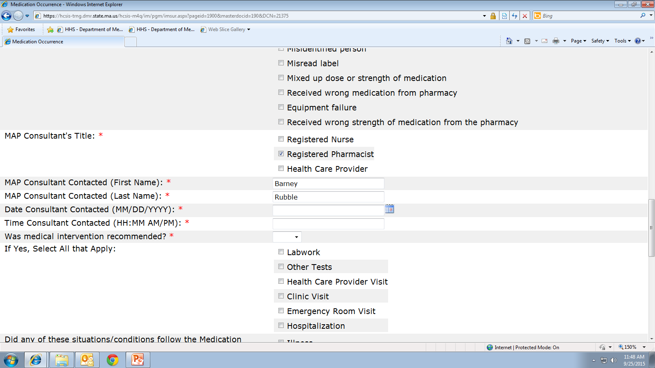
Notes:
Field 15, is the name of the MAP Consultant. A full first and last name must be entered.
If you don’t know the last name of the MAP Consultant, please find out what it is before submitting the mor.
For example, do not list “Lisa” as the first name and “nurse” as last name or “Rick” at “CVS”, if you do, the report will be marked ‘not approved’ and returned for corrections.

Slide 30
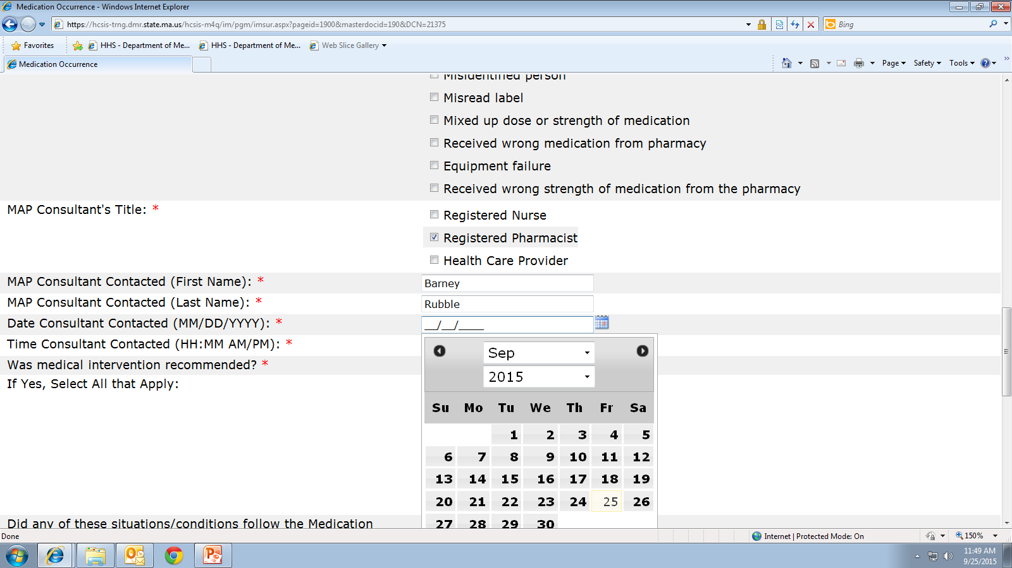
Notes:
Field 16, date the MAP Consultant was contacted. A MAP Consultant must be contacted for every medication occurrence, even if the occurrence is discovered 6 months later .

Slide 31
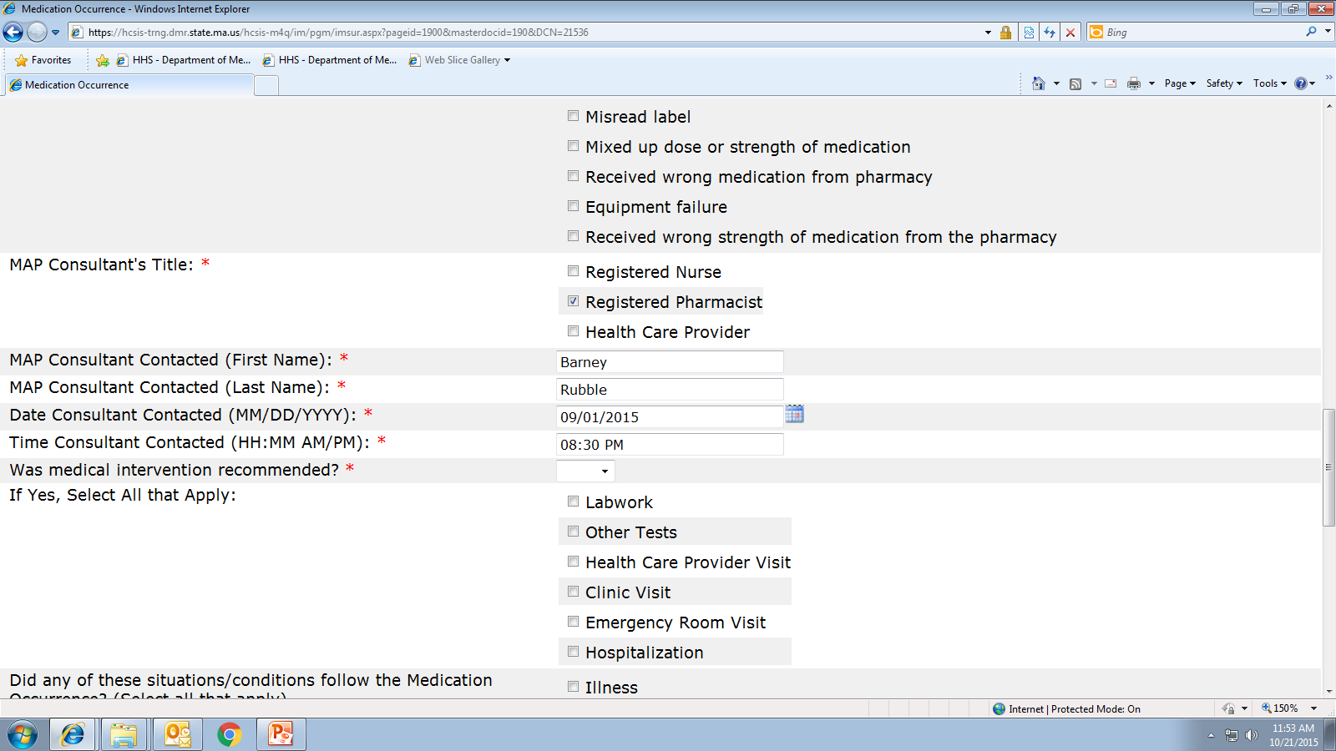
Notes:
Field 17 is the time the MAP Consultant was notified, select from the drop down the appropriate time.
Often we see dates and time of the medication occurrence, discovery and MAP Consultant notification filled out reflecting that the MAP Consultant was notified prior to the date/time of discovery, if we see this, the report will be marked ‘not approved’ and sent back for corrections. Be sure your dates and times make sense.

Slide 32
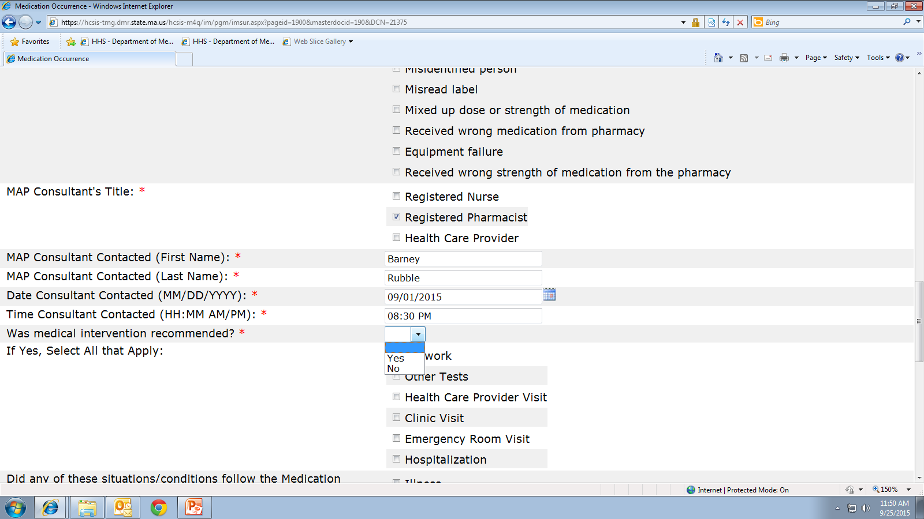
Notes:
Field 18 is asking, did the MAP Consultant recommend any type of medical intervention following the medication occurrence?
Monitoring someone's vitals signs, level of alertness or recommending a dose or frequency change is not considered “medical intervention”
‘Yes’ or ‘No’ must be selected from the drop down.

Slide 33
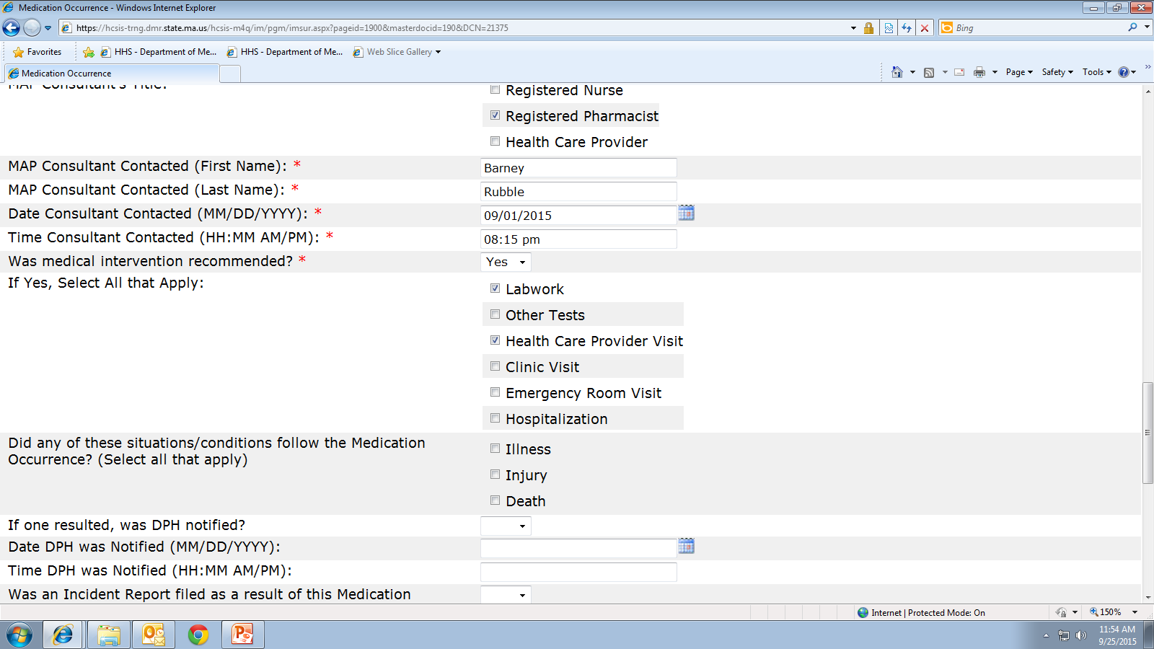
Notes:
If medical intervention was recommended and yes is selected in field 18…then in field 19 select as many interventions as apply.

Slide 34
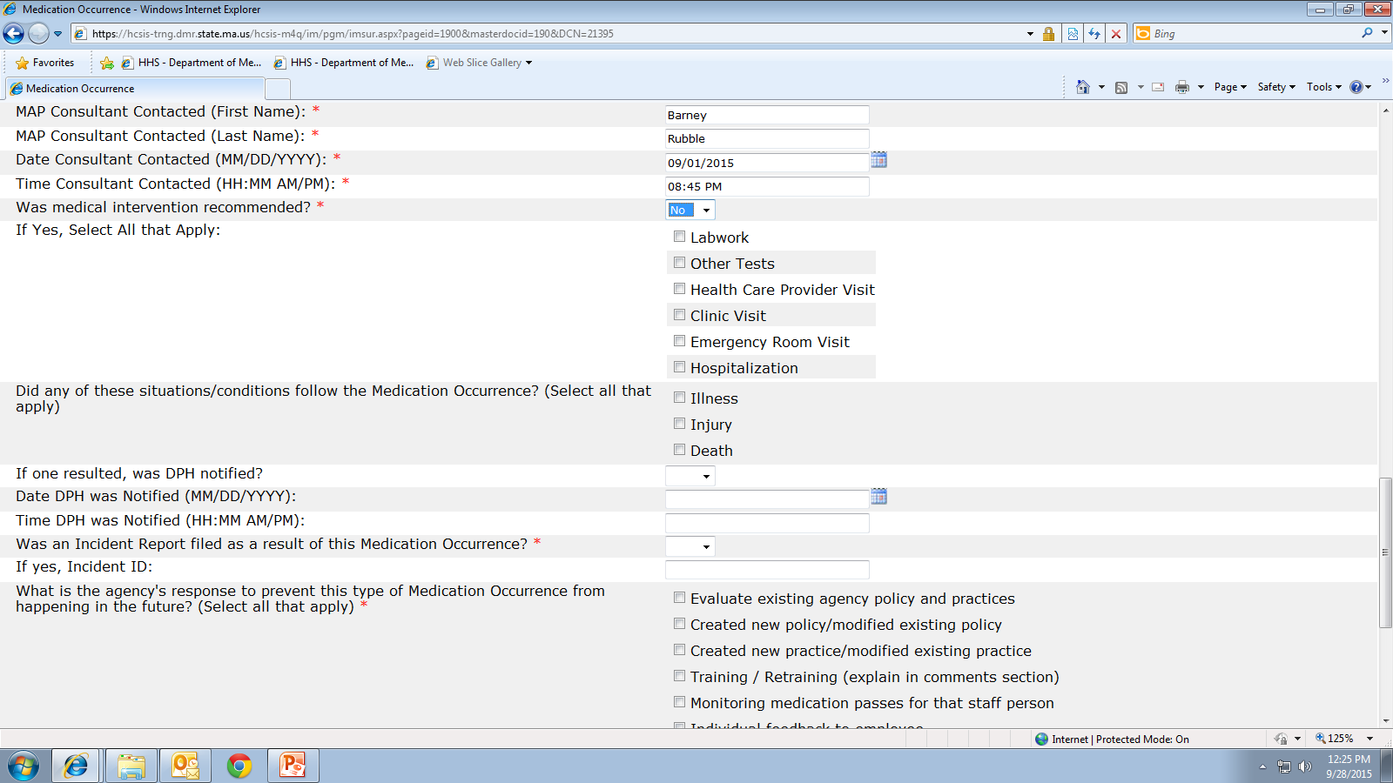
Notes:
If no medical intervention was recommended then ‘no’ is selected in field 18 and field 19 is skipped and left blank.

Slide 35
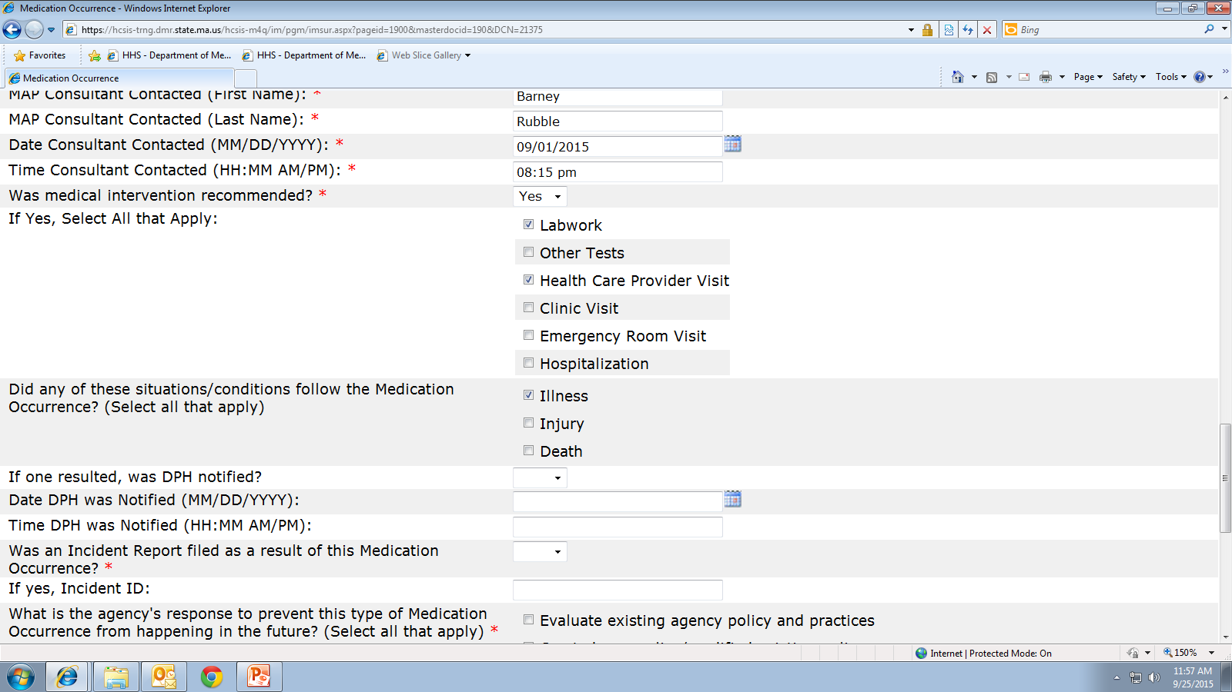
Notes:
Field 20
According to DPH MAP Policy, in addition to medical intervention, DPH must be notified if illness, injury or death follows a medication occurrence.
Selecting yes in field 18, making selections in fields 19 and/or 20 are considered Hotline Medication Occurrences and DPH must be be notified immediately; within 24 hrs.
If the medication occurrence meets hotline criteria, in addition to HCSIS data entry, a DPH MOR paper form must be completed. The Department of Public Health does not have access to HCSIS. The DPH Medication Occurrence Report form is available online using…

Slide 36
www.mass.gov/dph/map
MAP Friendly URL
Notes:
the MAP friendly URL which will bring you to….

Slide 37
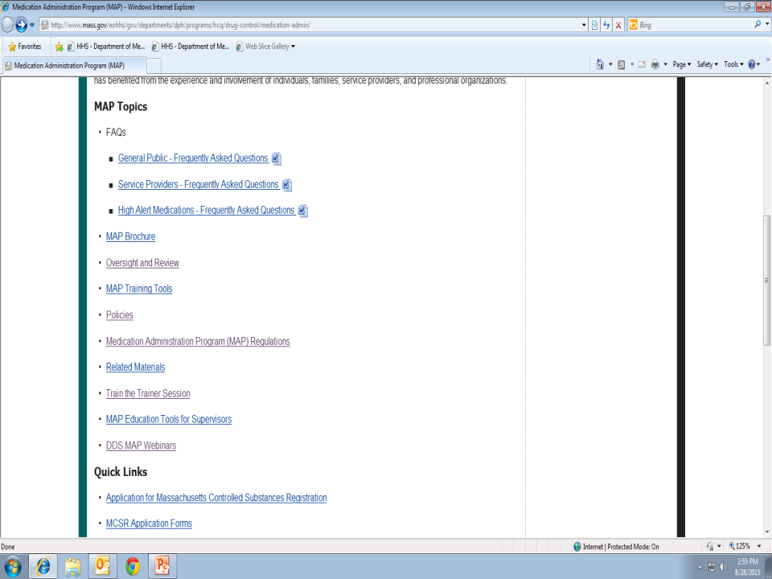
Notes:
This page, once here, click on Policies…

Slide 38
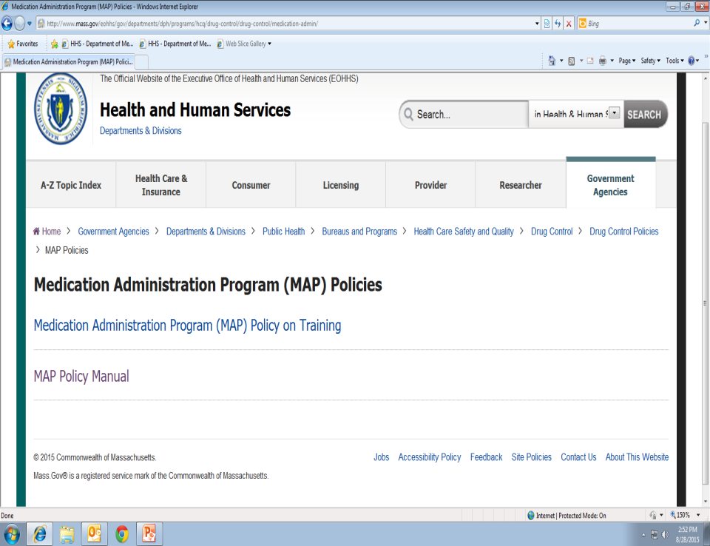
Notes:
Then click on MAP Policy Manual

Slide 39
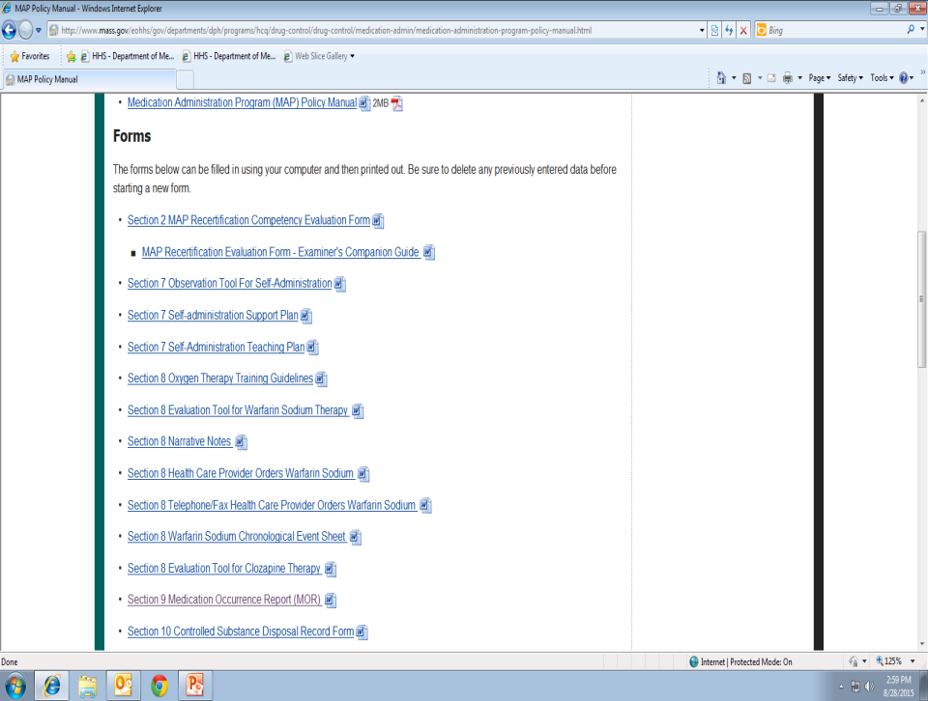
Notes:
Under Forms, click on Medication Occurrence Report

Slide 40
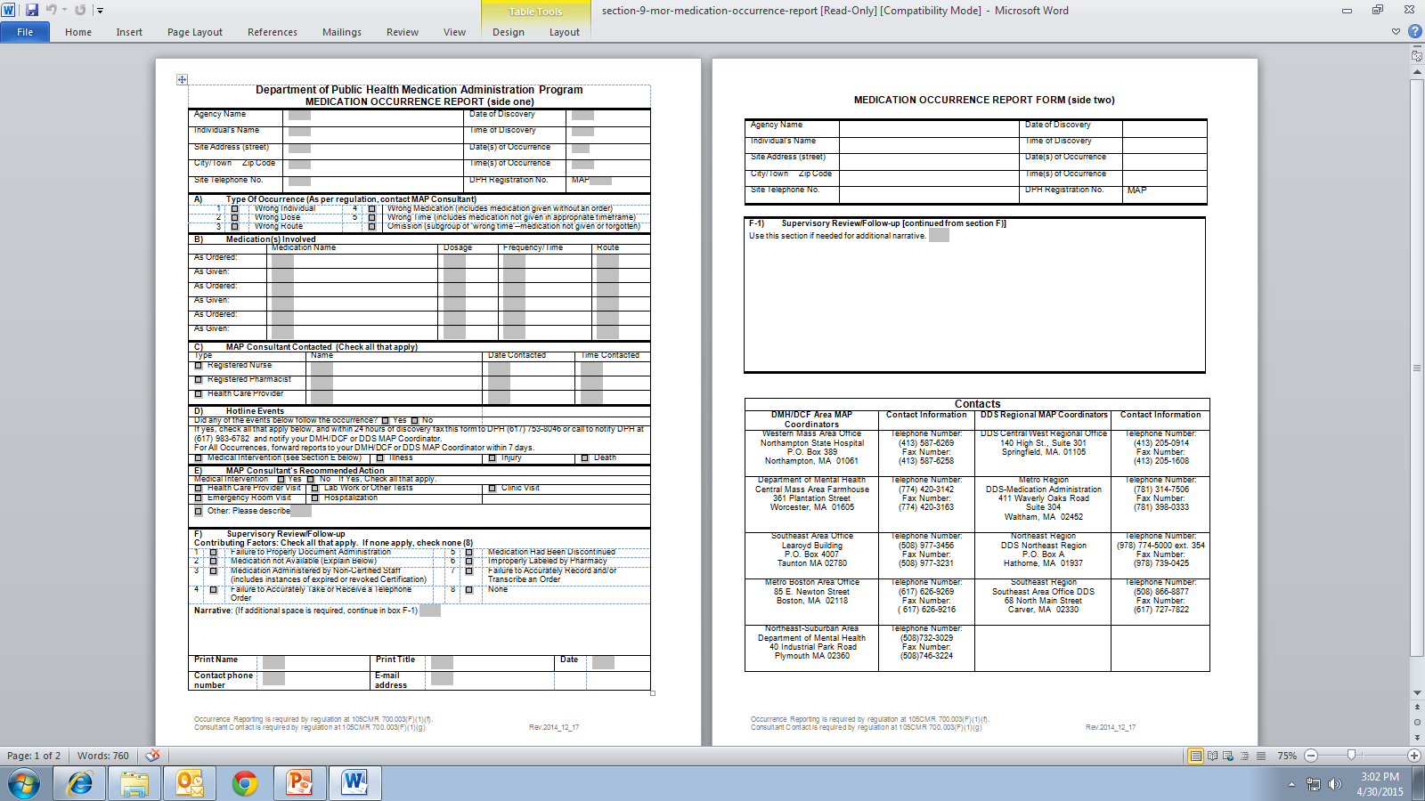
Notes:
Once accessed, print out the form, fill in the information and submit to DPH. The MOR form contains the DPH telephone and fax numbers.

Slide 41
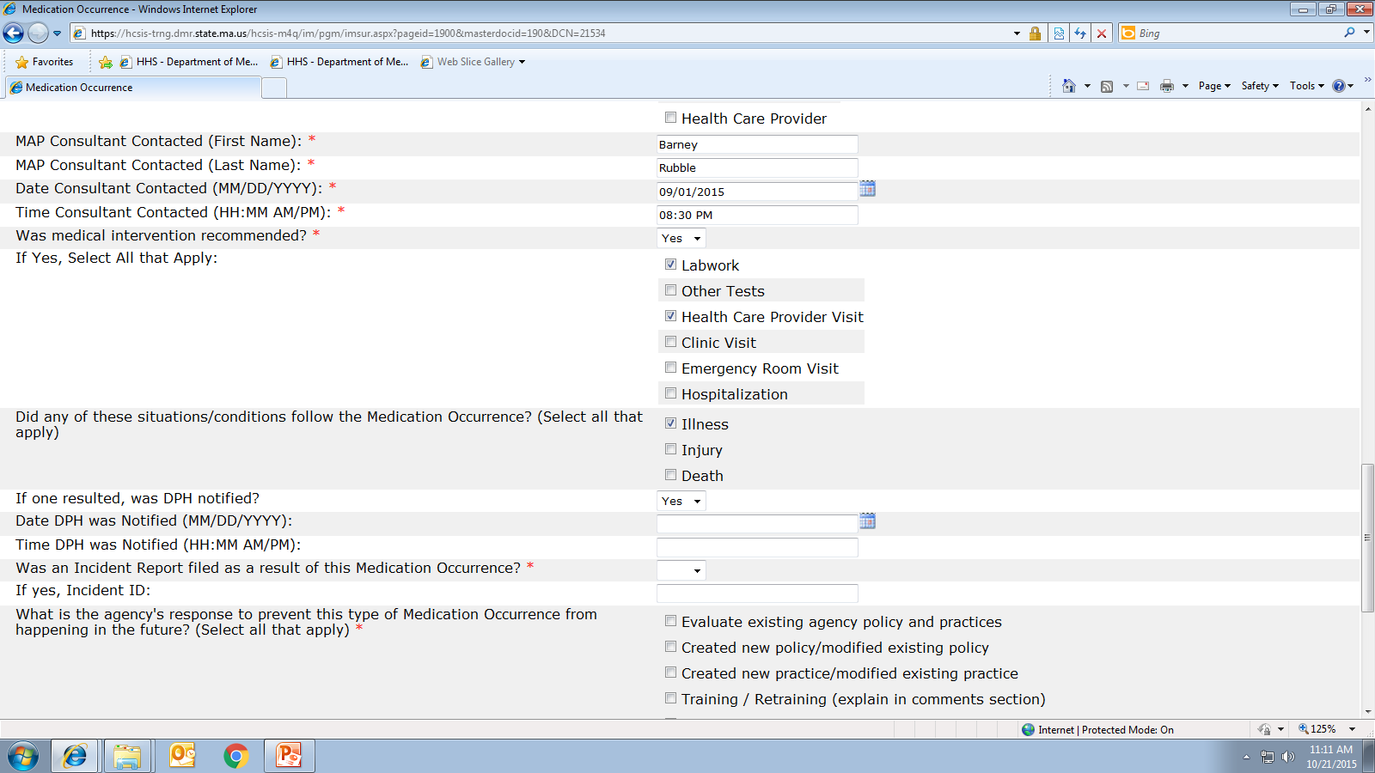
Notes:
If medical intervention was recommended and selections were made in 19 and or 20, DPH must be notified, select yes from the dropdown in field 21.

Slide 42
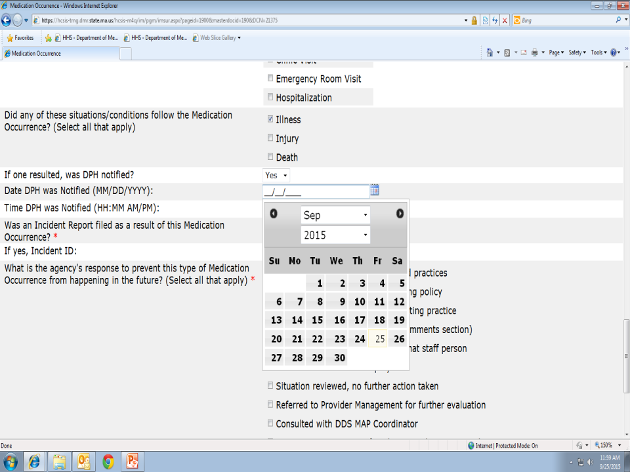
Notes:
Field 22 requires you to select the date DPH was notified.

Slide 43
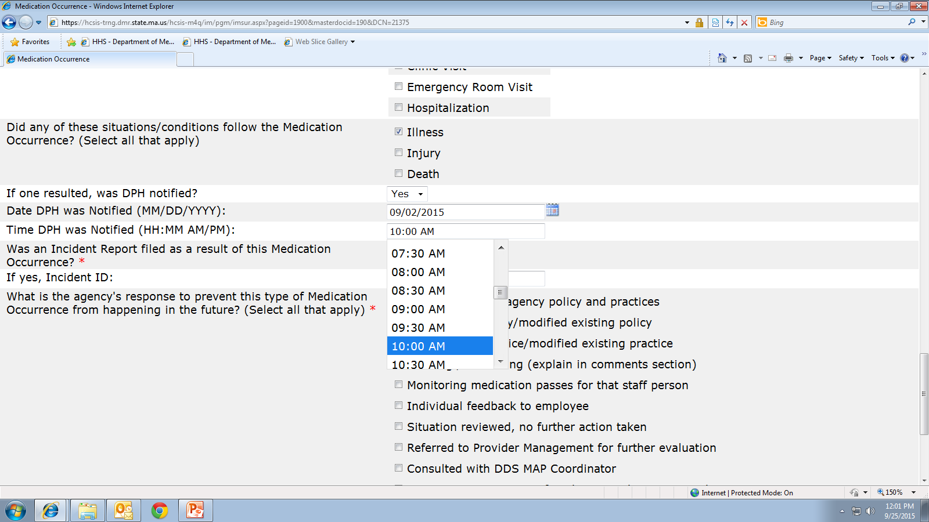
Notes:
Field 23 , select the time DPH was notified.

Slide 44

Notes:
If ‘no’ medical intervention was recommended in field 18, then field 19 is left blank. If illness, injury or death also did not follow the occurrence, they are left blank, therefore, field 21, was DPH notified is left blank also. The only time field 21 is answered is if the medication occurrence meets hotline criteria.

Slide 45
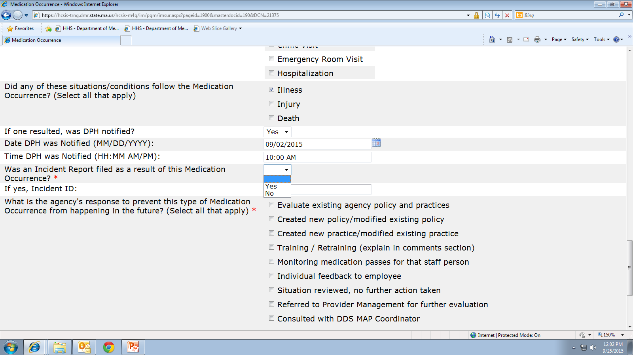
Notes:
Fields 24 and 25, was an Incident report filed as a result of a medication occurrence?
An Incident Report and a Medication Occurrence Report are not the same. Do not select ‘yes’ to #24 and fill in the MOR HCSIS event number for #25. Use this space only if an Incident took place as well as the medication occurrence. From the dropdown select yes or no.

Slide 46
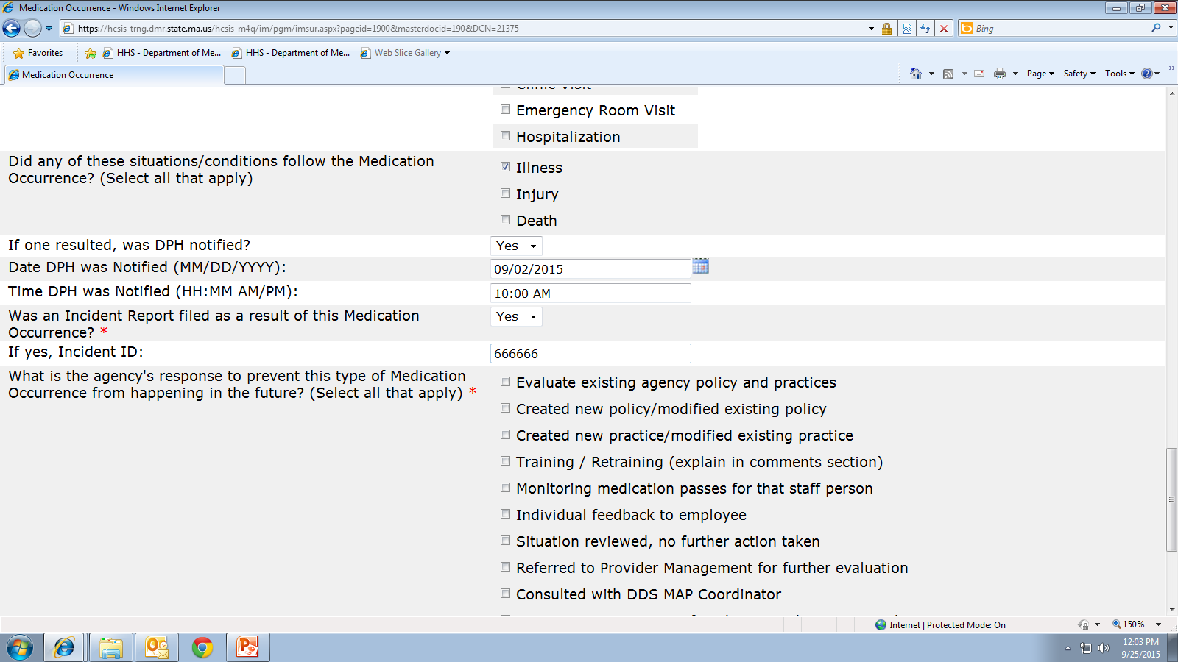
Notes:
If an Incident Report was filed in addition to the MOR report, select yes, then enter the Incident ID number.

Slide 47

Notes:
If no Incident report was filed select no, and leave the next field blank.

Slide 48
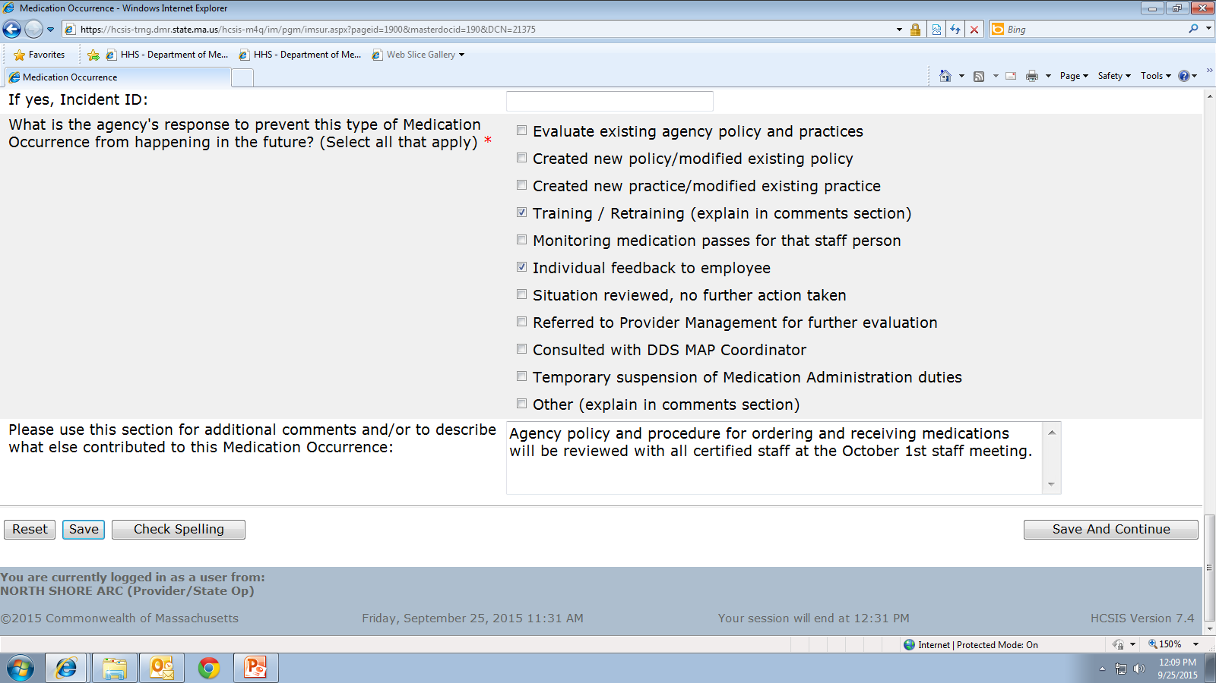
Notes:
Field 26, What is the agency response to prevent this type of medication occurrence from happening in the future?
All medication occurrences require follow up to prevent the occurrence from happening again. Dictionary #3 is a list of agency responses that may be chosen, you can select as many as apply.
If you select training/retraining, you must list the topic and content in the comment section, which is field 27.
This is an example of Training/Retraining selected and in the comment section is a description and timeframe of the retraining.
The comment section, is a chance for you as a Supervisor to enter briefly what is being done to help minimize the chances of other staff making the same mistake. Even though disciplinary action to staff may be necessary and is part of the follow up, that is not what we are looking for in this area, consider the medication occurrence a teachable moment that all staff can learn from, not just the staff who made the error.
If there are references to disciplinary action or the staff name ,or initials, are used here, the event will be marked ‘not approved’ and sent back for edits.

Slide 49
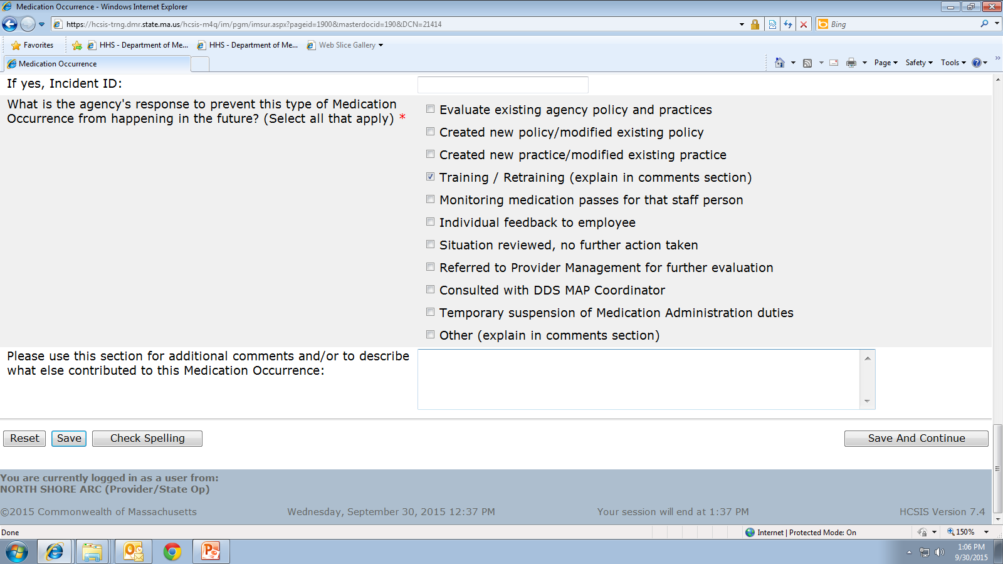
Notes:
This slide shows that Training/Retraining was selected and then the comment section is blank; if you submit a report like this it will be marked not approved asking that you enter the topic and content of the training in the comment section.

Slide 50

Notes:
Once field 27 is completed, you will be at the bottom of page 1, click ‘save and continue’ to move to the next page. At times you may be in the middle of data entry and get called away, if that is the case, scroll to the bottom of the page and click the ‘save’ button at the bottom left of the screen to save any work that you have already completed. To come back to the report at a later time follow the same steps listed at the beginning of this webinar, by clicking on QM, then IM, then Event Data Entry, enter the individuals name and click the search button, this will bring you to….

Slide 51
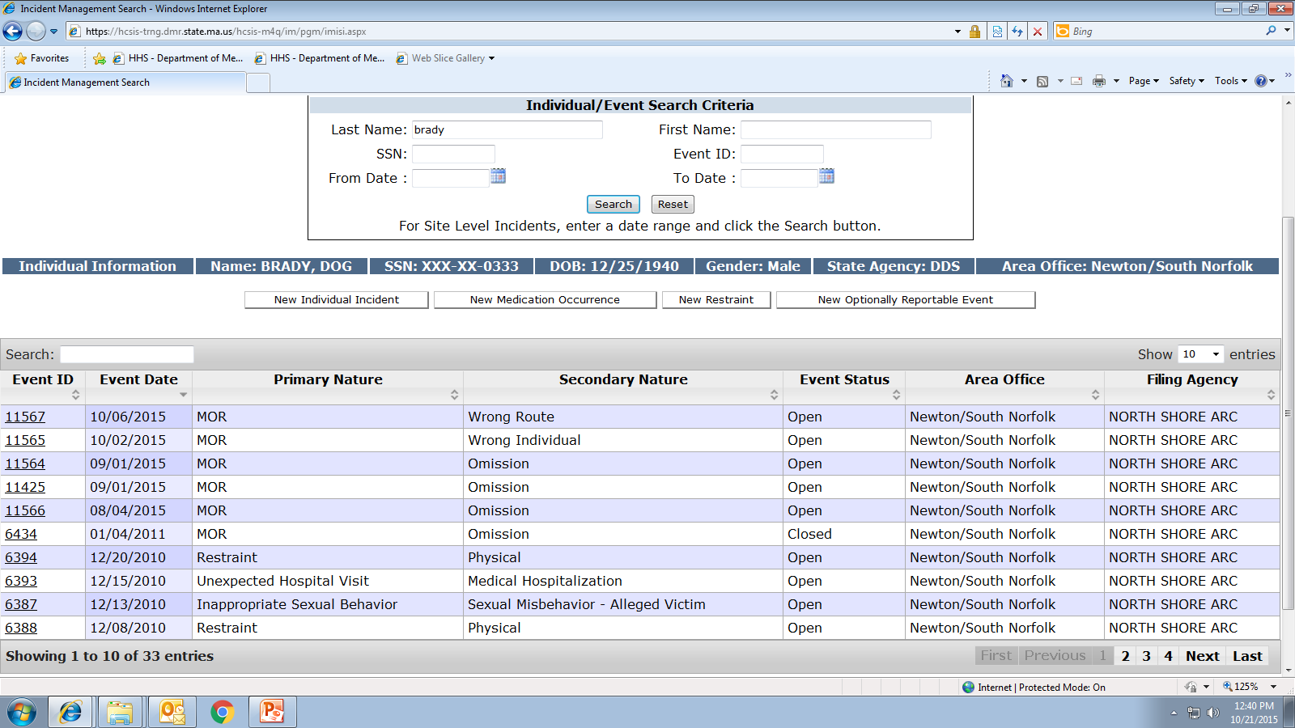
Notes:
Incident Management Screen. To locate the event, enter the event ID# in the event ID box and click the search button as seen at the top of your screen or click on the specific event ID as indicated on the left of your screen. Please note, when searching for an event, depending on how it was ‘saved’ in the system, it may show up in the event ID column, if it not there, you either have to know the event number to search for it or you can perform a ‘general’ search for all outstanding reports. I will show you how to perform a general search in a few more slides.
Once you click on the event number or type it in, it will bring you to…

Slide 52
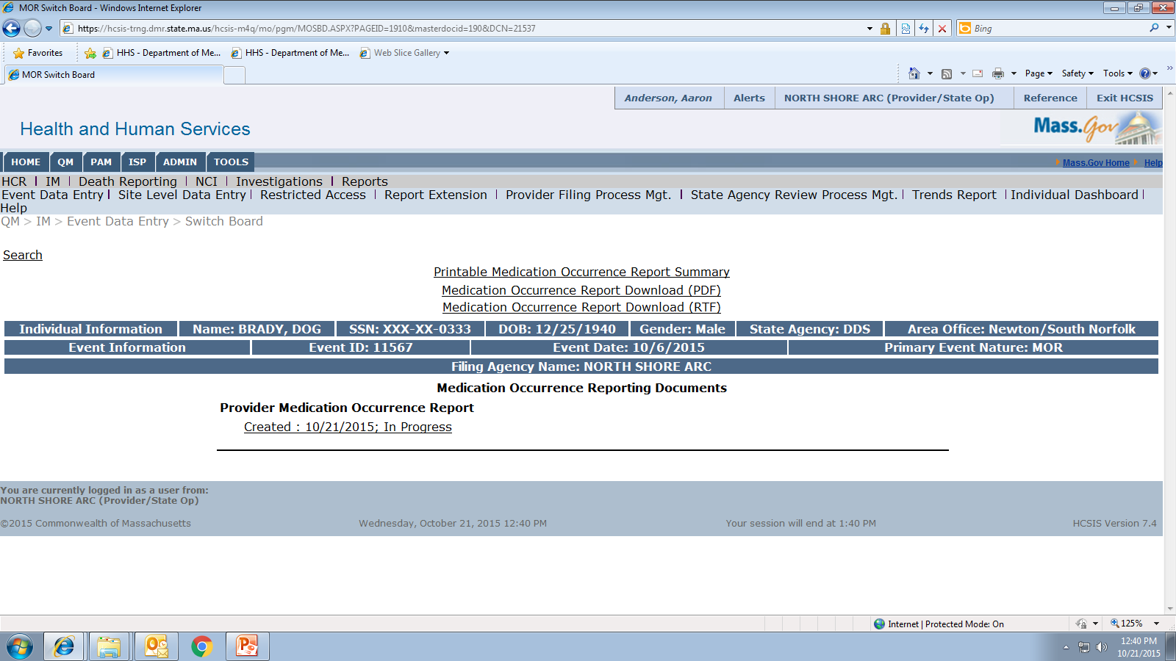
Notes:
This screen, click on the ‘created…in progress’ link to open the event.

Slide 53
Notes:
Back to the bottom of page one, if satisfied with the data entered so far, before moving to the next page click the ‘save and continue’ button to move on to page 2 or

Slide 54
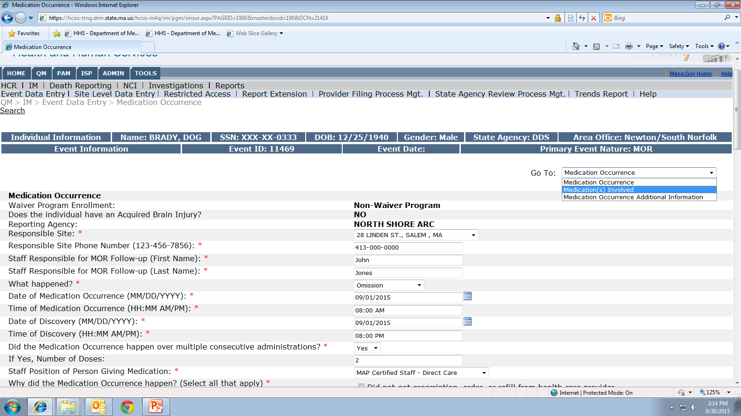
Notes:
From the“Go to” dropdown at the top of the page select ‘Medications Involved’, to move on to pg 2, be sure if you use the ‘go to’ menu to move on to the next page that you clicked on ‘save’ first.

Slide 55
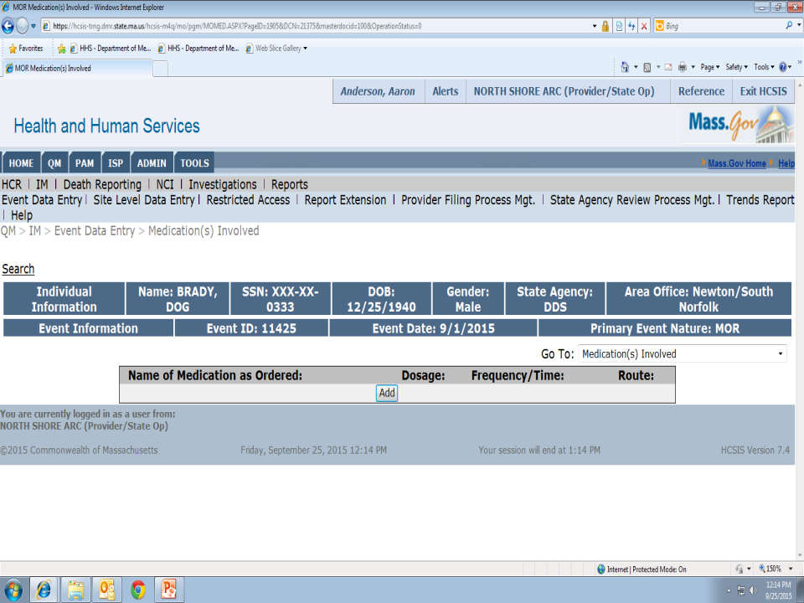
Notes:
Fields 28-35 are the Medications Involved in the MOR screens and seem to be the source of much data entry issues.
A medication occurrence must involve a medication. Do not list medications that were given correctly; only medications given or not given in error belong on this report.
To start the process, click the add button…

Slide 56
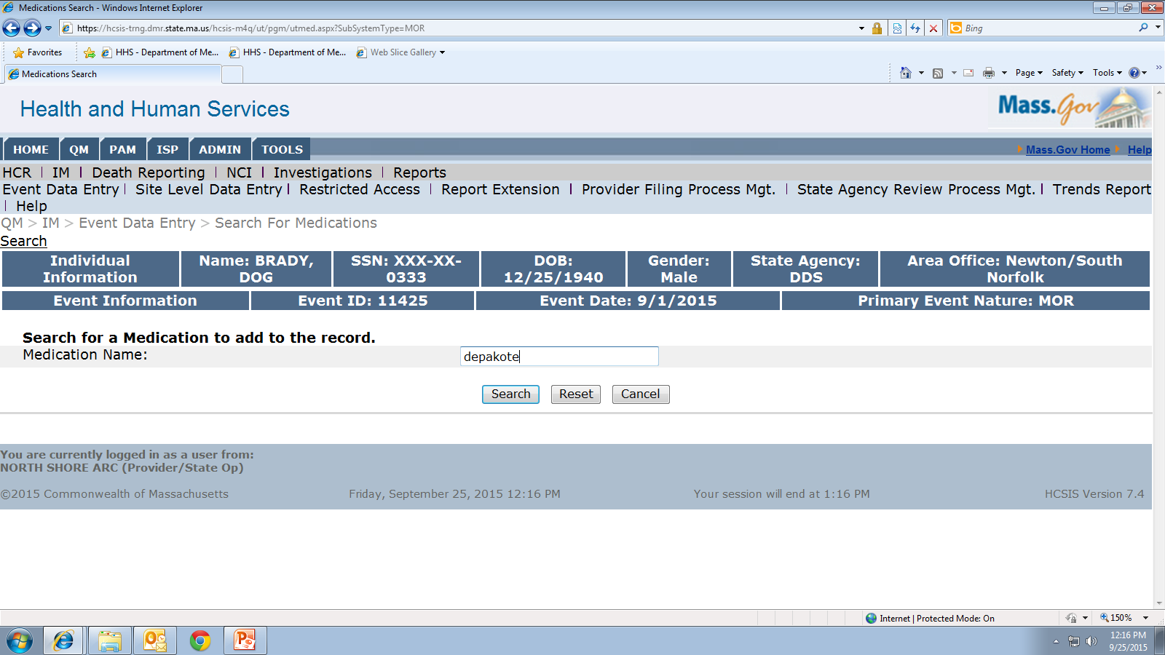
Notes:
Type in the medication name involved in the occurrence and click the search button…. The computer should recognize both the generic and brand name of the medication but if you have trouble with one, try the other

Slide 57
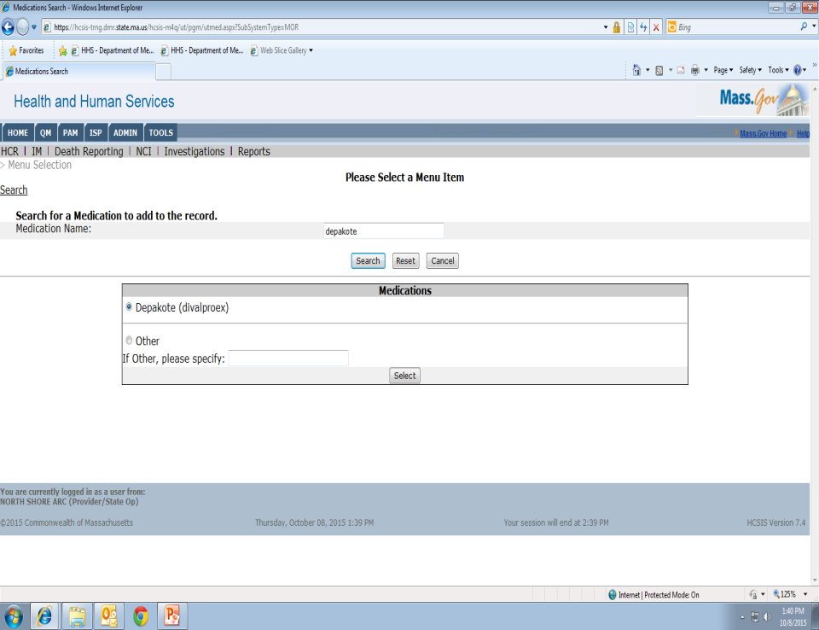
Notes:
Choose the medication and click the select button..

Slide 58
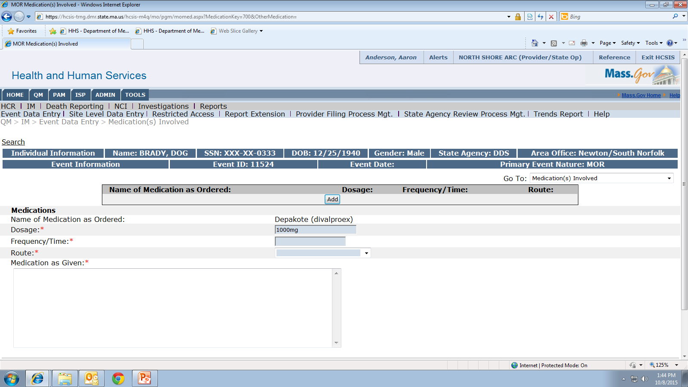
Notes:
After the medication is selected, enter the dose of the medication as written in the HCP order.

Slide 59
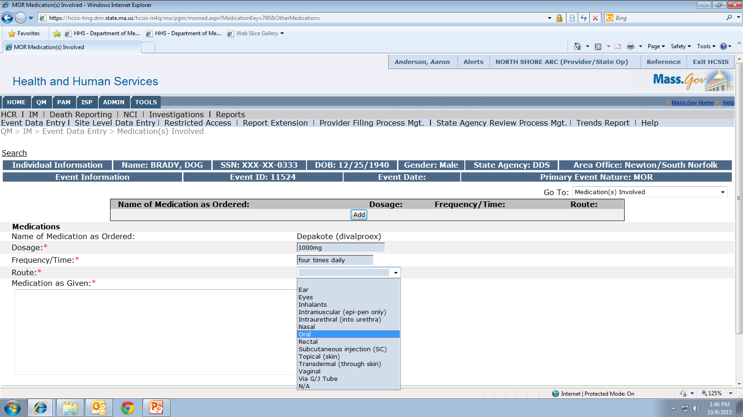
Notes:
Fields 30 and 31, frequency and route; be sure to enter only the information as written in the HCP order.
For example, if the HCP writes an order for a medication to be given “four times daily” and the scheduled times on the MAR are 8am 12pm 4pm and 8pm, field #30 would be entered as “four times daily” NOT the times listed on the mar. This is important information to the MAP Coordinator in the review process, it helps us to determine if a medication occurrence actually took place.
From the dropdown, select the route.

Slide 60
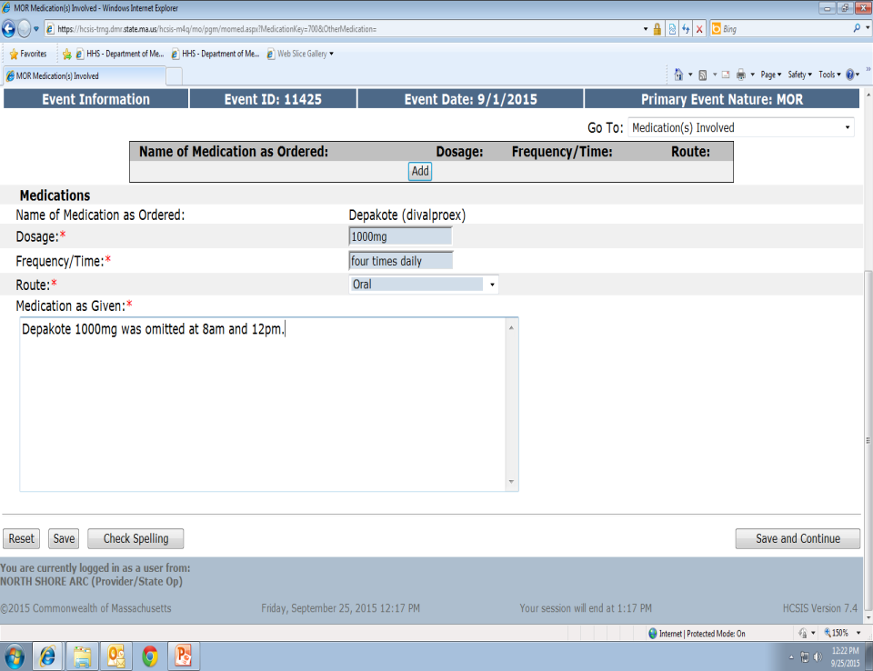
Notes:
Fields 32-35 are the Medications as Given fields, enter how the medication was given in error, do not enter a repeat of how the medication is supposed to be given. As a reviewer, I should be able to look the medications as ordered field compared to the medications as given field and know exactly what happened.

Slide 61
Notes:
If more than one medication was involved in the occurrence, click save, then the add button to add another medication

Slide 62
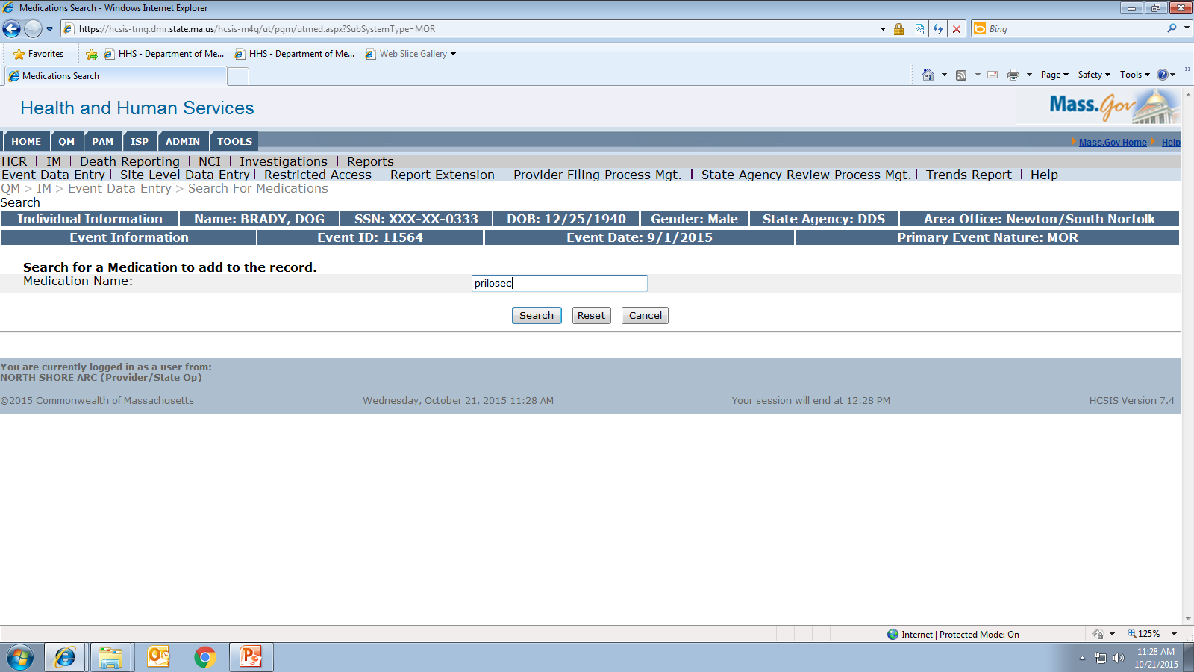
Notes:
Type in the medication name and click the search button.

Slide 63
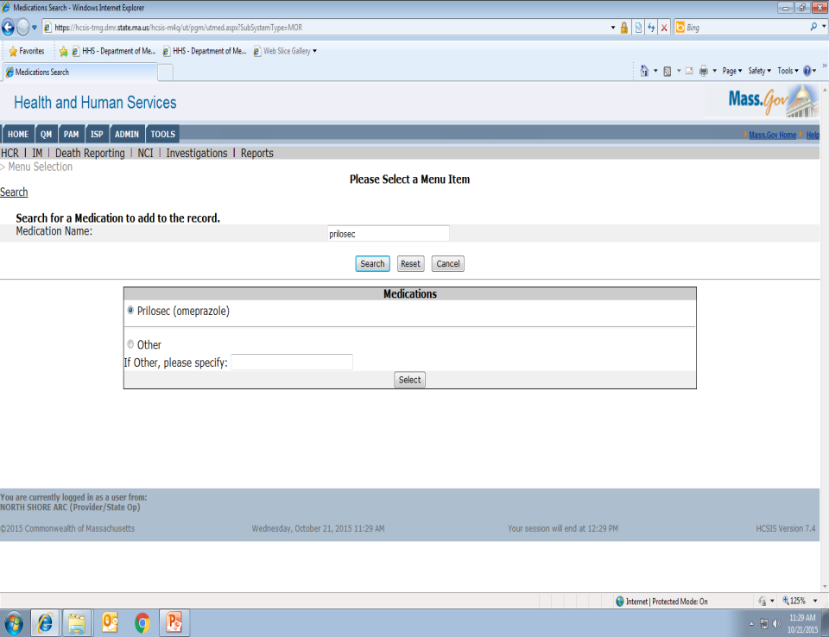
Notes:
Click on the medication and then the select button

Slide 64
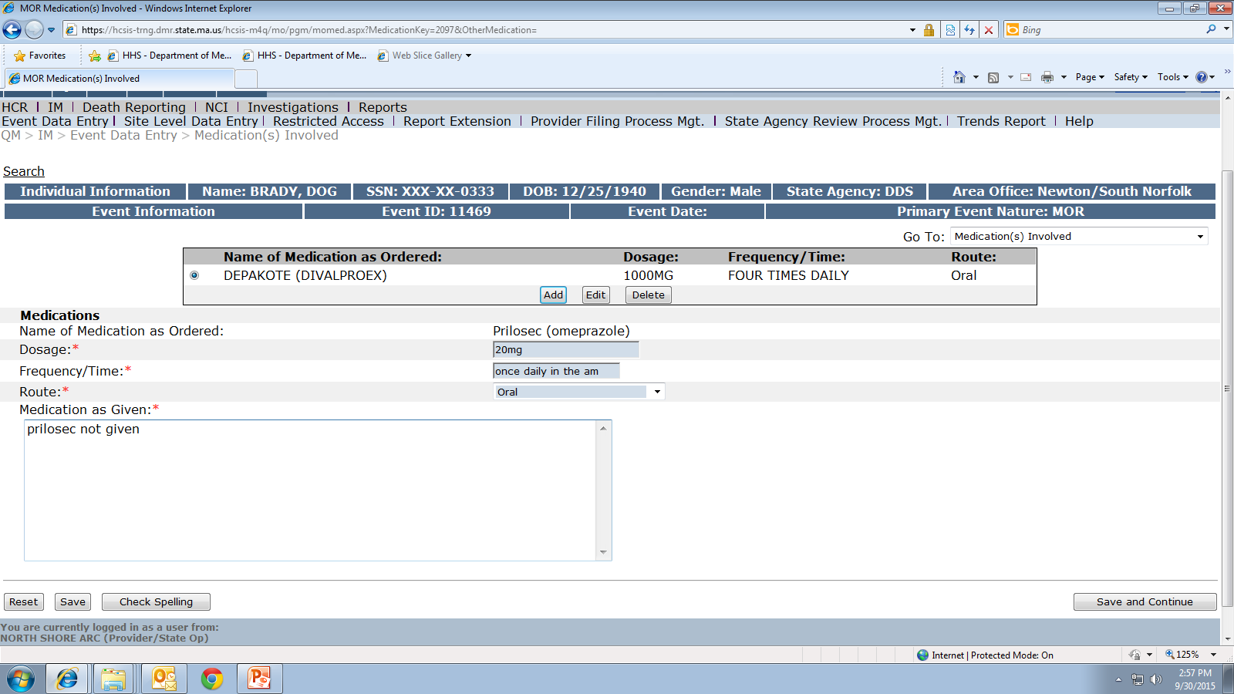
Notes:
Complete the medications as ordered and as given fields. As you can see on the screen, in addition to the depakote, prilosec has been added.

Slide 65

Notes:
You can add as many medications as were involved in the medication occurrence. If you make an error with the data entry, as long as the report has not been finalized, you can make changes to these fields. Start by clicking on the medication you want to change, on the screen the depakote is selected, then you can either delete it to start over or click the edit button to makes changes to what is already there. If you do make changes, be sure after each change is made to click the save button, for example, if 3 separate changes are made, you need to click save 3 times, once after each change.

Slide 66

Notes:
When all of the medications involved in the medication occurrence are entered, click the ‘save and continue’ button to move to page 3 or click ‘save’ then select from the “Go to” dropdown, ‘medication occurrence additional information’.

Slide 67

Notes:
Fields 36-44 are used for statewide data collection, these fields give a broad view to some possible factors that contributed to the medication occurrence.
Field 36 is used to collect data of the average # of meds a person receives. From the dropdown select how many meds the individual usually receives at the time of the medication occurrence.

Slide 68

Notes:
Field 37: was there a recent change in the medication order? Select yes or no. If yes, enter the date of the medication order change. Also, if yes is selected, it would be a good time to review with staff the system in place of alerting all staff to new or changed medication orders. If no, leave the next field blank.

Slide 69

Notes:
Field 39 was the med occurrence connected to one staff?
Select yes or no. If yes…..

Slide 70

Notes:
in fields 40a and 40b, the staff’s name is listed. When the report is submitted to a DDS MAP Coordinator for review, the staff name does not appear but is important for internal agency tracking.
Field 41 if the staff is a regular staff (meaning they routinely work at the site) do they normally pass meds as part of their duties?
From the dropdown, select, ‘yes’, ‘no agency relief staff’ or ‘no contracted relief staff’

Slide 71

Notes:
Field 42, does this staff regularly administer medications as part of their routine responsibility? Again a yes or no is selected.

Slide 72

Notes:
Field 43, was the staff who made the occurrence working their regular shift? From the dropdown select, ‘yes’ , ‘no Different Shift’ or ‘no Overtime Shift’

Slide 73

Notes:
Field 44, was the staff working at a routine site?
Select yes, no or n/a

Slide 74

Notes:
Your almost done…
before hitting the Finalize button, click save and then review the whole report. Be sure the dates and times of occurrence, discovery and MAP Consultant notification are in sequence. Do the “Medications as Ordered” and “Medications as Given” fields make sense? Will the reviewer, who has no preconceived knowledge of the event, be able to understand exactly what happened? If not, edit the report before sending!
When completed, click finalize!

Slide 75

Notes:
Once finalized, you are able to view the date the event was created and the date it was finalized, this event was created and finalized on the same date.

Slide 76
Review Status
Do not assume a MOR is complete once submitted!
  Review Status
    Approved
    Not Approved
Notes:
Do not assume that once you have submitted the report that you are done! Be sure to go back and review the status of the report. In general, approximately 50% of all MOR reports are marked ‘not approved’ by the MAP Coordinator and sent back for edits.

Slide 77
Not Approved
If marked ‘Not Approved’
  Locate “MAP Review” for reason
    Go back into the event
    Click ‘edit’
    After edits are made, click ‘save and continue’ at the bottom of each page
    Finalize
  Review Status
Notes:
If the report is marked ‘Not Approved’ by the MAP Coordinator, you will need to locate the reason why it was not approved, make appropriate edits, ‘save’ after each edit is made, and then Finalize. Again, be sure to review the status of the report, you are not finished until you see the MOR marked ‘Approved’ by the MAP Coordinator.
To complete this process….

Slide 78

Notes:
From the HCSIS Home Screen…click the Alerts button

Slide 79

Notes:
All of your ‘Alerts’ will show on your screen, you may have more than one page. Check the approval status, as you can see the last event has been marked ‘approved’ however the top 3 events have all been marked not approved. Click on an event.

Slide 80

Notes:
To view the report, click on ‘Printable Medication Occurrence Report Summary’. This will allow you to view the entire report….

Slide 81

Notes:
….scroll to the very end to locate the MAP Coordinator review. This MOR is marked Not Approved requesting the MOR be edited to reflect a wrong dose, not an omission.

Slide 82

Notes:
Go back to the previous screen, this time click on the Created… In Progress link to open the event.

Slide 83

Notes:
Make the edits that were requested, in this case the omission needs to be changed to wrong dose

Slide 84

Notes:
After making the edit, click the save button at the bottom left of the screen, then the save and continue button to move to the next page

Slide 85

Notes:
Even though no changes were requested on the second page, click save and continue before moving on to the last page

Slide 86

Notes:
Click save and then finalize,

Slide 87

Notes:
This MOR was edited and re-finalized.

Slide 88

Notes:
This is an example of an event that was marked ‘Not Approved’ by the MAP Coordinator, it was sent back, edits were made and is now ready, again, for the MAP Coordinator’s review.

Slide 89

Notes:
A report will continue to be returned until all corrections are made.
The report on your screen was initially sent in May and returned as ‘not approved’ by the MAP Coordinator days later.
It was 7 months before edits were made and it was resubmitted.

Slide 90


Notes:
This is an example of what I like to see, the report was submitted, all information was entered accurately and the report was approved!

Slide 91

Notes:
Be sure to note the message on the alerts screen, it states “Please be aware alerts will be automatically deleted depending on the alert message (between 7 to 60 days). Consult the Process Management screens an Reports to manage all outstanding tasks”. This means that an alert will not stay on your screen indefinitely waiting for you to address it. Eventually it will be dropped from your screen, however it still needs to be addressed. To locate it, you will have to perform a search. To accomplish this..

Slide 92

Notes:
from the home screen, go to QM

Slide 93

Notes:
Then click on IM

Slide 94

Notes:
Then…. Provider Filing Process Management

Slide 95

Notes:
It will bring you to this screen….using the calendar icons, fill in a date range.

Slide 96

Notes:
From the drop down make a selection of reports to search. If you select all events, all outstanding events will appear. To narrow the search, select Medication Occurrences Only and only outstanding medication occurrences will appear. Then click the search button.

Slide 97


Notes:
This screen shows all outstanding events for the year 2009, as you can see there are no outstanding mors, however there are other outstanding reports to be addressed.
The “Next Milestone” column tells you the report status.
‘Re-finalize’ the report means it was not approved; edits are required then it must be resubmitted for review and approval.
‘Finalize’ means a report was started by the Provider; however, it was never “finalized” and submitted for review.

Slide 98
HCSIS Resource Information
http://mass.gov/dds
Notes:
Follow these steps to access online HCSIS resource information..

Slide 99

Notes:
From the HCSIS home page, click the http://mass.gov/dds link..

Slide 100

Notes:
Once there, under Key Initiatives, click on HCSIS

Slide 101

Notes:
Click on Medication Occurrence Report (MOR) Information and it will bring you to this screen..

Slide 102

Notes:
On this page there are several links with additional information, including: the Dictionaries page, a one pg MOR Form, the mor form in a PDF format, a set of instructions on how to fill out a Medication Occurrence Report, Frequently Asked Questions and last is a link to a Quick Guide which includes some screen shots for data entry.

Slide 103
Apply What You’ve Learned
Notes:
Ok, lets see if you are able to identify the category of the MOR submitted for review!….

Slide 104

Notes:
If reviewing this MOR, Ativan was ordered once daily PRN and it continued to be given after the medication had been discontinued, how would you classify the occurrence?

Slide 105
Wrong Medication
Notes:
…yes, it’s a wrong medication

Slide 106

Notes:
If you were reviewing this MOR: a medication is ordered once daily in the am and it was administered three times that day, what would you classify it as…

Slide 107
Wrong Time
Notes:
…you’re right, its wrong time

Slide 108

Notes:
In this example the medication is ordered twice daily hold for a systolic blood pressure of less than 100 or diastolic less than 50. The blood pressure was 86/59 and the medication was administered……what would you classify this as?

Slide 109
Wrong Time
Notes:
…you’re right, its wrong time again

Slide 110

Notes:
How about this one, 400mg of a medication was ordered and 200mg was administered…

Slide 111
Wrong Dose
Notes:
…yes, it’s a wrong dose

Slide 112
Wrong Individual
If medication was not ordered for individual
  “Medication as Ordered”
    Are entered as ‘N/A’
      Click on ‘Other’
        Type in ‘N/A’
Notes:
Many times MORs are returned as ‘not approved’ due to an error in data entry regarding “wrong individual”. If the individual received medications not ordered for him or her the medications as ordered field must state N/A because these meds were not ordered for this person. To accomplish this…..

Slide 113

Notes:
On the Medication Involved screen, type in ‘other’ in the medication search bar, then click the search button

Slide 114

Notes:
Click on ‘other’ , type in n/a and then click select

Slide 115

Notes:
Complete the medications as ordered and as given fields. As you can see on the screen, the medications as ordered fields all state n/a, since this medication is not ordered for this person, then the medications as given field contains the medication name and dose that was administered in error. If another medication was involved, click the add button and repeat the process.

Slide 116

Notes:
If you were reviewing this MOR what would you classify it as? The meds as ordered fields all state n/a and then the meds as given field has 2 medications listed…

Slide 117

Notes:
What about this MOR? There are 3 meds as ordered/meds as given fields completed….

Slide 118
Wrong
Individual
Notes:
…your right, they are both a wrong individual and both examples of data entry are acceptable.

Slide 119

Notes:
What type of medication occurrence is this?

Slide 120
Omission
Notes:
…correct, it’s an omission

Slide 121

Notes:
This is an example of four omitted medications during the same med pass, notice that each medications as given field tells me the med was not given.

Slide 122

Notes:
What category of mor is this? A blood pressure is ordered 2x a wk and it was not taken. Your right, this is not a medication occurrence because it did not involve a medication! A medication occurrence must involve a medication. Do not use a medication occurrence report to document a missed feeding or treatment, unless the feeding or treatment involved a medication. This report had to be deleted as it does not meet the criteria for a medication occurrence. If you realize you started a report in error, please contact your map coordinator with the event ID number requesting the event be deleted and the reason why.

Slide 123

Notes:
Sometimes a single medication occurrence fits into more than one category. This is an example of more than one category of medication occurrence happening during the same med pass. On the screen the wrong dose of Toprol was given and the Lipitor was omitted completely. Since only one category of MOR may be chosen either omission or wrong dose may be selected.

Slide 124
Submit MORs
Within 7 business days of discovery
  MAP Coordinator
If a Hotline MOR, within 24 hours of discovery
  DPH Clinical Reviewer
  MAP Coordinator
Notes:
Remember, DPH MAP Policy states that MORs must be reported within 7 days of discovery. If it’s a Hotline MOR the reporting requirement is within 24hrs of discovery

Slide 125
DDS MAP Coordinators
Carolyn Whittemore RN
DDS Central/West
carolyn.whittemore@state.ma.us
413-205-0914
Fax 413 205 1608
Gina Hunt RN
DDS Northeast
gina.hunt@state.ma.us
978-774-5000 ext 354
Fax 978-739-0425
Notes:
If you have questions, please contact your regional DDS MAP Coordinator, I am in the Central/West Region, Gina Hunt is in the Northeast Region…

Slide 126
DDS MAP Coordinators
Mary Despres RN
DDS Metro
mary.despres@state.ma.us
781-314-7506
Fax 781-398-0333
Susan Canuel RN
DDS Southeast
susan.canuel@state.ma.us
508-866-8812
Fax 508-866-7946
Notes:
Mary Despres is in the Metro Region and Susan Canuel is in the Southeast Region.

