Slide 1

Trainer Basics
Massachusetts Medication Administration Program
Notes:
Welcome to the Massachusetts Medication Administration Program, MAP Trainer Basics webinar.
I’m Gina Hunt, a Department of Developmental Services MAP Coordinator and I’m your webinar presenter.
DDS in partner with The Center for Developmental Disabilities Evaluation and Research, known as CDDER, using the curriculum, ‘Responsibilities in Action’ as the framework, converted the in-person MAP Certification training to an online learning course.
The goals of this webinar are to provide reviews of:
MAP Certification training requirements
Online MAP Certification pre-course preparation, facilitation tips, post course responsibilities and
Resources to help you navigate the state-contracted test vendor website, D&S Diversified Technologies, known as D&S DT.

Slide 2
Quick reference
Online Resources
Slides 3 and 112
MAP Certification Training Requirements
Slides 4-9
Service Provider/Trainer Support Decisions Prior to Training
Slides 10-22
Trainer Pre-course Preparation
Slides 23-61
Trainer Responsibilities on Course Start Date and During Course
Slides 62-86
Trainer Post-course Responsibilities
Slides 98-103
Course Time Extension
Slides 104-105
Certification Test
Slides 106-110
Pretest Components
Slides 87-97
Notes:
On your screen is a quick reference guide to locate the various topics and corresponding sections of this webinar.

Slide 3
Online Resources
https://mapmass.com/
MAP Training Resources & Support
https://hdmaster.com/
Test Master Universe TMU©
ma.tmuniverse.com
Notes:
There are 2 websites you’ll want to bookmark as favorites.
The mapmass site is the location of the online MAP Certification course and all MAP Training Resources and Support.
The hdmaster site is the location of Test Master Universe, known as TMUⒸ, the secure section of the D&S DT test vendor site,
TMUⒸ is also accessible via the direct link seen on your screen.

Slide 4
certification Training Requirements
Standardized curriculum and Resource Packet
Medication Administration video
Training at least 16 Course hours
Successful pretest completion
Notes:
As a reminder, MAP Certification training requirements include:
use of the Massachusetts standardized curriculum, ‘Responsibilities in Action’, known as ‘RIA’, together with a Resource Packet
viewing the medication administration demonstration video and
a minimum 16-hour course length that includes successful pretest completion
Use of the online course meets all training specifications as listed on your screen.

Slide 5

Standardized Curriculum
Notes:
The online Certification training provides your student group with a consistent, standardized method of ‘RIA’ instruction.

Slide 6
Resource packet
Unit 6
Unit 7
Transcription Practice Materials
Medication Administration Practice Materials
Notes:
The required Resource Packet includes materials needed for transcription practice and medication administration practice.

Slide 7
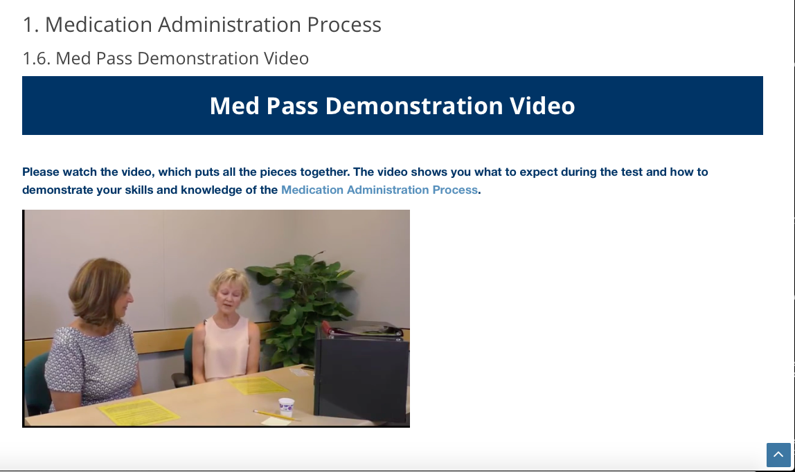
Notes:
The Med Pass Demonstration Video requirement is incorporated into Unit 7 of the online course.
It shows staff how to demonstrate the 3 Checks of the 5 Rights of the Medication Administration Process.

Slide 8

Course Time
REQUIREMENT
Minimum 16-hours
9 Units
Unit Quizzes
  Minimum 80% score
Notes:
Access to the online Certification course is through a MAP Trainer.
The course is MAP Trainer led, self-paced, self-study and meets the minimum 16-hour course requirement.
The goal is that your student group will complete the 9 units and corresponding unit quizzes within 2 weeks of the training start date.
Each 10-question, multiple choice unit quiz must be passed with a minimum score of 80% to move to the next unit.
The 2-week time frame was established as a guideline for completion when staff are not provided with dedicated work time compensation.
You’re encouraged to schedule virtual meetings to connect with your student group (using Zoom or WebEx) prior to the start of training, throughout the training (if you’d like) and at the end of the training as a ‘wrap-up’ session.

Slide 9
Pretest components
Knowledge
Transcription
Medication Administration Demonstration
Notes:
In addition to the completion of the 9 Units, each student must successfully complete the 3 pretest components.

Slide 10

Service Provider Support
Supporting Staff for Online Learning
Notes:
Students participating in the online MAP Certification course require levels of support not only from you, the MAP Trainer but also from the Service Provider.
It’s strongly recommended that you and your employer discuss student supports needed prior to the course start date.
Such supports include, but are not limited to, dedicated time, learning environment, equipment, and materials to complete the course.
There’s a document titled, ‘Supporting Staff for Online Learning’ developed for Service Provider senior level staff to review and implement well before the course start date to ensure students have a successful online experience.
Details of the document are reviewed in the next few slides.

Slide 11

Logistical Support
Dedicated:
time for students to complete training
workspace to complete training, e.g., an office, if needed
Service Provider Designee:
available to answer technical questions
help to share video viewing link
equipment (e.g., computer, laptop) and
Notes:
Someone within the Service Provider organizational structure should be designated and available to answer technical questions.
Students may need assistance with posting medication administration demonstration videos on a file-sharing site like YouTube or Google Drive and sharing that viewing link with you.

Slide 12
Training Program Models
Two 8-hour days
  Day 1 Units 1-6 and complete Unit 6 Skill Check
  Day 2 Units 7-9 and complete Unit 7 Skill Check and Pretests
Three 6-hour days
  Day 1 Units 1-5
  Day 2 Unit 6-7 and complete Unit 6 and 7 Skill Check
  Day 3 Units 8 and 9 and Pretests
Four 4-hour days
  Day 1 Units 1-4
  Day 2 Units 5-6 and complete Unit 6 Skill Check
  Day 3 Unit 7 and complete Unit 7 Skill Check
  Day 4 Units 8-9 and Pretests
Notes:
It's your discretion as a Trainer to extend the two-week time frame if needed for a student to complete the course and on the flip side, to shorten the course time frame, especially if staff are being compensated over a shortened dedicated time frame to complete the course during specific work hours.
Note the Training Program Model suggestions on your screen.
It is Service Provider discretion to choose how to compensate staff to complete the training as a condition of their employment.

Slide 13
Tech Support
Students need:
  access to computer or laptop with Internet connection
  video capabilities to record themselves performing a medication administration demonstration
  a camera enabled on a device (smart phone, tablet, or computer) with Internet connection that allows student to participate in WebEx or Zoom Trainer session(s)
Notes:
Access to a computer or laptop with an internet connection is needed to complete the course, pretest components and participate in video conference Trainer sessions.
Video capability is necessary to complete the medication administration demonstration video assignment and the corresponding pretest.

Slide 14
Tech Support
The course is compatible with any standard web browser; it runs best on:
  Safari
  Chrome
  Firefox, and
  newer versions of Internet Explorer.
For best experience and optimum security, it is recommended that students update their internet browsers before starting course.
Notes:
The course was designed to run optimally on computers or laptops.
The course may also be completed on a mobile app with a tablet or smart phone; however, your students may experience some difficulties with missing images, knowledge check activities, and skill assignments.
If using a tablet or phone, it’s recommended that access to the course be through an updated web browser; such as Safari or Chrome.

Slide 15
Guest ROLE
May move around course unrestricted
MAP Trainer Administration Block is hidden
Dedication Tool is hidden
No access to real student data or reports
Notes:
If your IT department would like to view the course in order to assure that devices being used by your student group are compatible, please contact CDDER.

Slide 16

Resource Packet
OPTIONS
Long Term Pharmacy Solutions
Service Provider Assembly
Resource Packet contents found at:
Training blister packs must be provided for students; images of blister packs may not be used.
https://mapmass.com
Available through LTPS at $10 per packet.
Email Carolyn Dunn at cdunn@ltps.us
include ‘Resource Packet’ in subject line and your mailing address
call LTPS if no email response in 48 hours at 978-458-4000 x135
Notes:
One Resource Packet is required for each student.
Packets may be obtained from Long Term Pharmacy Solutions or you may assemble them.
You have the option of including a hard copy of ‘Responsibilities in Action’ as part of the Resource Packet.

Slide 17
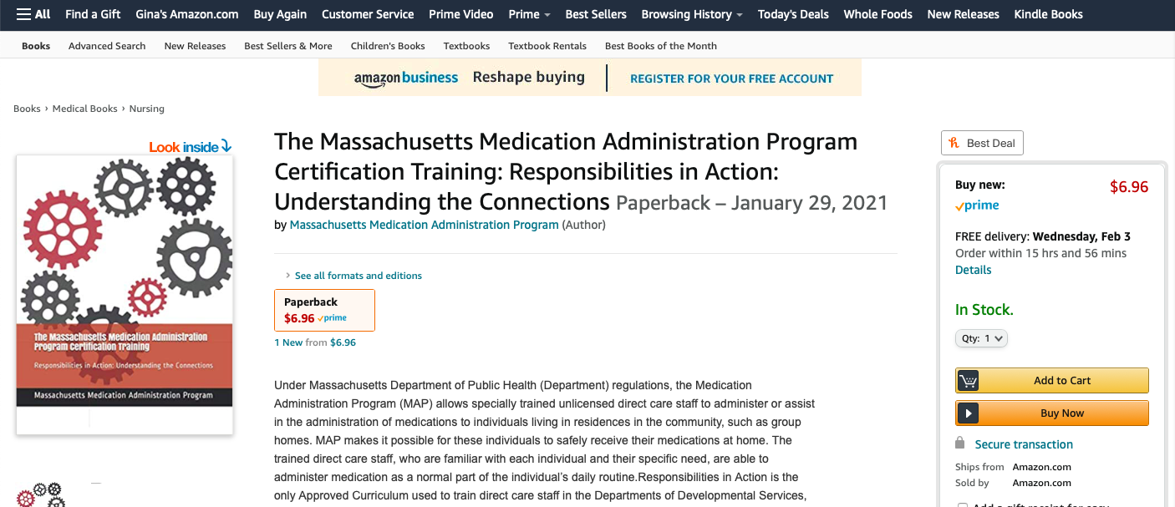
Notes:
It is not required that a hard copy be provided, however if a student prefers, one may be purchased on Amazon; available at $6.96 per bound copy.
All costs are for printing. No money is collected by the Commonwealth of Massachusetts for any purchases.
Other options are to download the curriculum from the mapmass website or have the curriculum printed by a printing service.

Slide 18
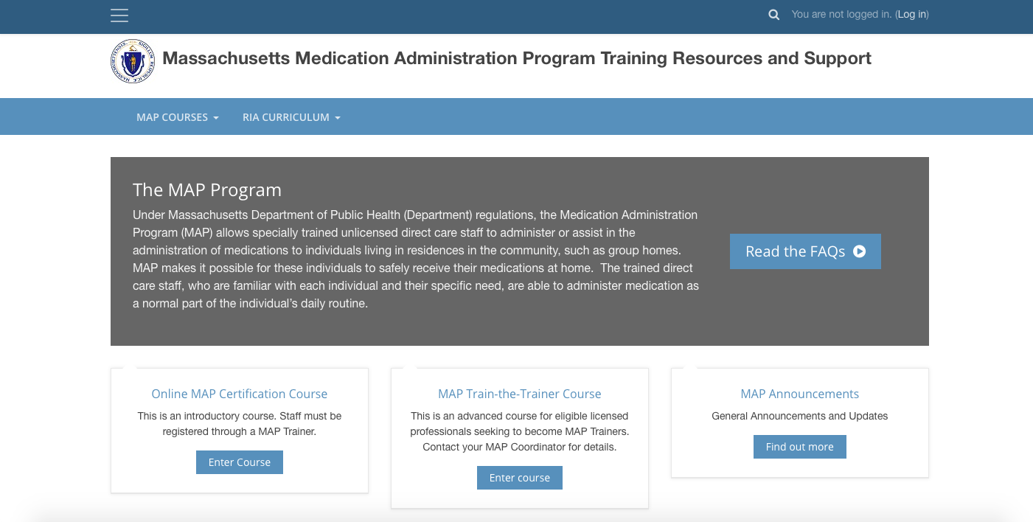
www.mapmass.com
Notes:
This is the public homepage of the mapmass website.
No username or password is required to access some of the resources and support.
Once there, scroll down the page…

Slide 19
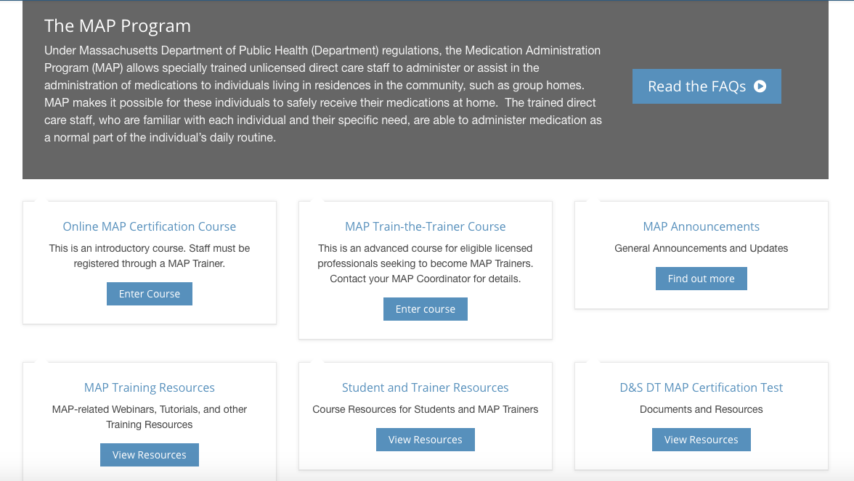
Notes:
…click on ‘Student and Trainer Resources’

Slide 20
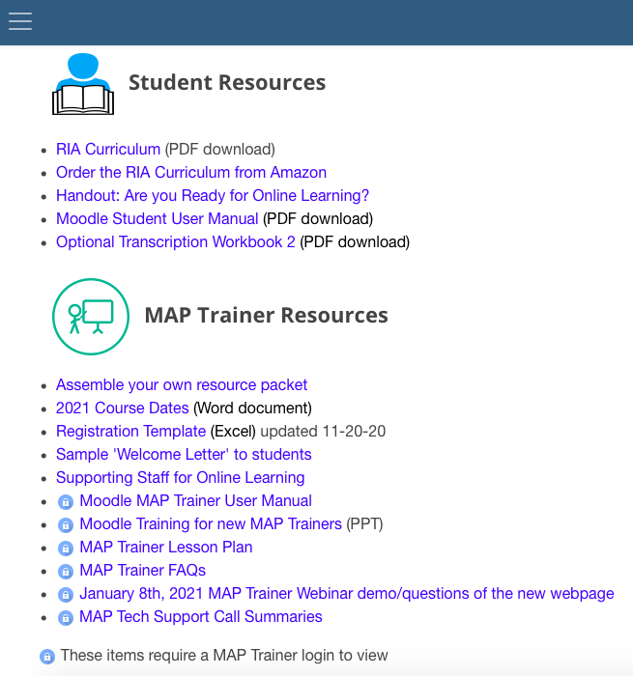
Notes:
This brings you to an entire page dedicated to MAP Certification Student and Trainer Resources.

Slide 21
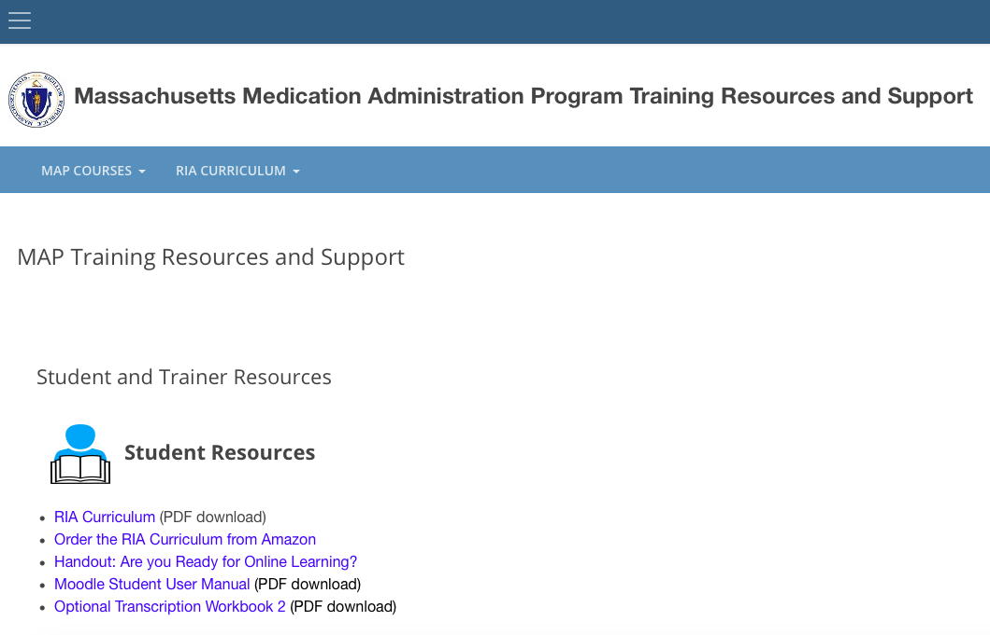
Notes:
The Student section includes:
options for accessing the Curriculum
the handout, ‘Are you Ready for Online Learning?’
the ‘Moodle Student User Manual’ and
an optional Transcription Workbook 2.
You could copy the path or the links of the various resources on this page and include them in correspondence with your student group in preparation for the course.

Slide 22
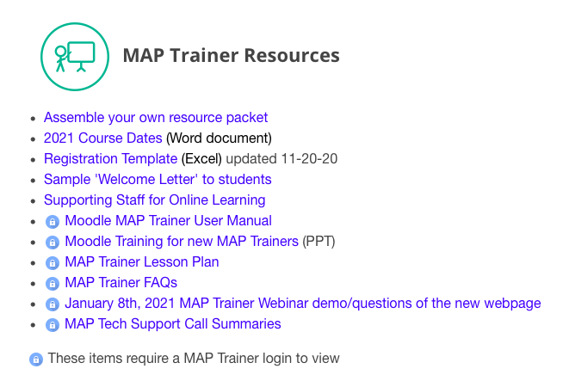
Notes:
The Trainer section includes a link to materials if you choose to assemble the Resource Packets, as well as upcoming course dates, the registration template, a sample ‘Welcome Letter’ to students (that may be modified), if you choose to use it and the ‘Supporting Staff for Online Learning’ document for Providers.
In addition, there are a series of items that compliment this webinar that require MAP Trainer login to view.

Slide 23
PRE-COURSE Preparation
Choose Course Start Date
Resource Packets:
Assemble or Order
https://mapmass.com/
Notes:
If you plan to assemble the Resource Packets, you’ll want to have them ready well before the course start date.
Whether assembled yourself or ordered from LTPS:
you can consider having Supervisors distribute the packets to their staff registered for the online course
distribute from a central location, or
have the packets mailed directly to each student's home.
As you prepare for training, first choose a pre-determined course start date.

Slide 24

Getting Started
Schedule
Moodle Calendar
Begin First and Third Thursdays every month
Online MAP Certification Course
Notes:
The ‘RIA’ course schedule is set to open the first and third Thursdays of every month.
Predetermined dates allow Service Providers and MAP Trainers to plan for set start times to ready themselves to provide logistical and tech support and for a student to have enough time to obtain the Resource Packet.

Slide 25

WHO TO Register
Staff seeking MAP Certification
Notes:
After you’ve chosen a start date, you’ll register only staff seeking MAP Certification.
There is no minimum or maximum recommended class size however, the class size should coincide with your availability to follow your students’ progress through the course, provide feedback, monitor activities and quizzes, answer questions, grade activities and pretest submissions as well as provide 1:1 virtual sessions, if needed.

Slide 26
PRE-Course
PREPARATION
Contact
Contact your student group by email
Welcome
Use sample ‘Welcome Letter’; modify as needed
Share
Share student document:
‘Are You Ready for Online Learning?'
Notes:
Two weeks before the course begins, use the resources available online to assist you in additional pre-course preparation.
Send your student group an email. Include the online welcome letter as the body of the email; modify as needed and include the ‘Are You Ready for Online Learning?’ document.
This not only provides the student with necessary course information, but it also serves as a check of each student's email, ensuring its accuracy.

Slide 27

Email Address CRITERIA
Ensure email used to register student is
up-to-date,
one that student uses, checks regularly and
will be checking at least daily during course.
Notes:
Ensuring that each student's email address is correct, current and one that they regularly check is critical to successful login on the day the course opens.
All information regarding the course is sent to that email including username and password.
You’re responsible for verifying email addresses and the spelling of student names prior to submitting your roster.
A student's email does not have to be their work email.

Slide 28
PRE-COURSE PREPARATION
Roster
Required one week prior to training start date
Information required:
First name
Middle initial
Last name
Date of Birth
Telephone number
Email address
Notes:
For each staff to be registered for your training you’ll collect the required information as listed on your screen.

Slide 29
Registration Template
Email Completed Roster
CDDER@umassmed.edu
One Week Prior to Start Date
Online Roster Due Date
Registration Template
Notes:
The student information collected is entered on a registration template.
Once the template is complete, you’ll email your student roster to CDDER one week prior to the course start date

Slide 30
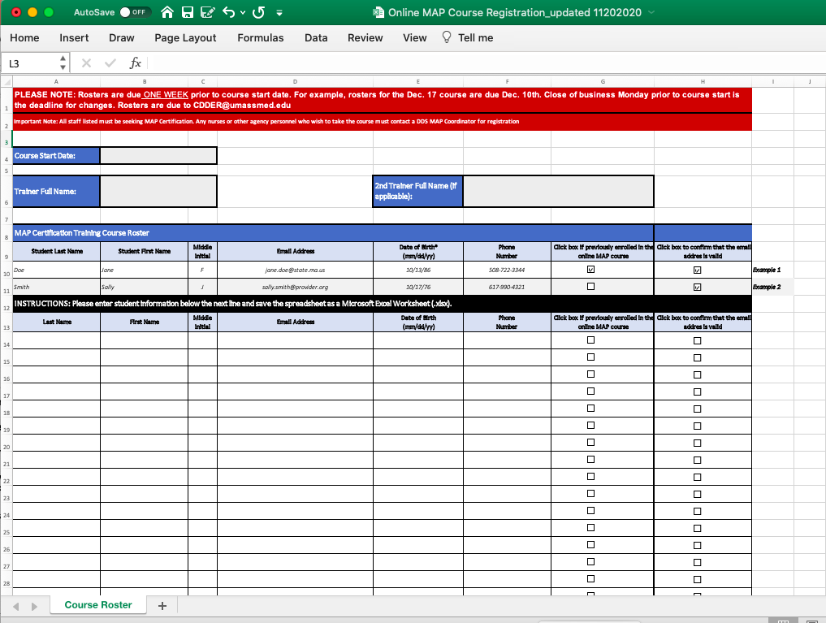
Notes:
The registration template used to create your student roster is standardized and titled, ‘RIA Online Course Registration’.
You’ll download the template from the MAP Trainer Resources link and enter the required student information.
Notice there’s a reminder on the template in red regarding when and to whom to submit the roster for registration.
If there’s a person where you work responsible for data entry of student information who will be emailing the roster to CDDER instead of you, notice the ‘Trainer Full name’ field on the form to connect you to your student group.
If you co-train with another MAP Trainer, the roster submitted to CDDER should include the names of both MAP Trainers.
In addition, Co-Trainers should divide the student group and share the responsibility of creating a TMU© record for each student.

Slide 31
ROSTER RECEIPT CONFIRMATION
Email roster to CDDER@umassmed.edu
CDDER confirms receipt of roster via one confirmation email to Trainer
CDDER will follow up with Trainer, if issues
No second confirmation email is sent
Notes:
Expect to receive one confirmation email from CDDER when your roster is received.
CDDER will follow up with you directly if there are any issues.
No second confirmation email is sent.

Slide 32
Online course schedule start dates and roster due dates
Course Start Date | Rosters due by
Thursday, January 7, 2021 | Thursday, December 31, 2020
Thursday, January 21, 2021 | Thursday, January 14, 2021
Thursday, February 4, 2021 | Thursday, January 28, 2021
Thursday, February 18, 2021 | Thursday, February 11, 2021
Thursday, March 4, 2021 | Thursday, February 25, 2021
Thursday, March 18, 2021 | Thursday, March 11, 2021
Thursday, April 1, 2021 | Thursday, March 25, 2021
Thursday, April 15, 2021 | Thursday, April 8, 2021
Thursday, May 6, 2021 | Thursday, April 29, 2021
Thursday, May 20, 2021 | Thursday, May 13, 2021
Thursday, June 3, 2021 | Thursday, May 27, 2021
Thursday, June 17, 2021 | Thursday, June 10, 2021
Notes:
You’ll find roster due dates on the ‘Course Dates Schedule’ located at the mapmass website on the MAP Trainer Resources page.

Slide 33
DEADLINE FOR ROSTER CHANGES
Close of business Monday prior to start date
Notes:
The deadline for roster changes is the close of business on the Monday prior to the course start date.
Although no additions or deletions are permitted after close of business Monday; small corrections are allowed; such as minor corrections in a name or email.

Slide 34

Student User Manual
MAP Trainer User Manual
Moodle User Manuals
Notes:
Moodle is a ‘Learning Management System’, an ‘LMS’, for creating and sharing educational materials for online learning.
Moodle is the LMS used for the online MAP Certification course.
To help access, navigate and use the features throughout the course, Moodle User Manuals are available on the ‘Student and Trainer Resources’ page at the mapmass website and within the course itself.
If you did not include the Student User Manual in the initial email to your student group, you can consider sending it separately as the course date nears.

Slide 35
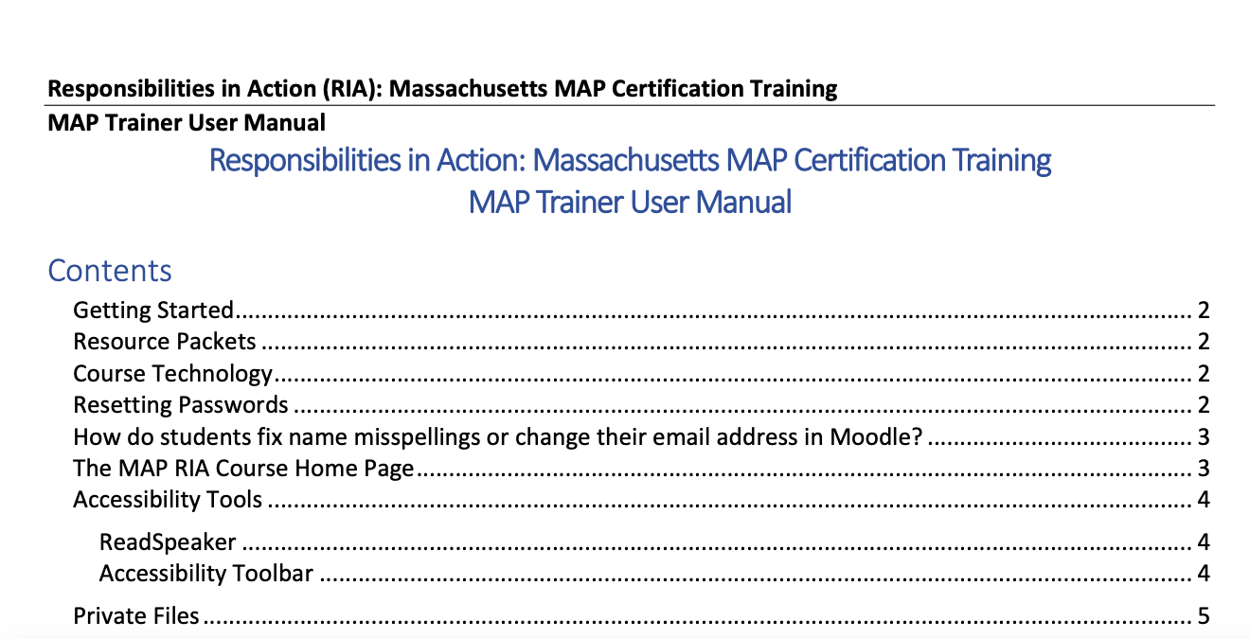
MAP Trainer User Manual
Notes:
It’s strongly recommended that you have a copy of the ‘MAP Trainer User Manual’ readily available for your reference.

Slide 36
Independent Websites
Moodle Online MAP Certification Course
via https://mapmass.com/
TestMaster Universe (TMU©)
via https://ma.tmuniverse.com/
Notes:
For Trainers and students to complete the online course and the MAP Certification test process that follows, know that the two websites you’ll be using are independent of one another.
Mapmass is specific to online learning.
TMUⒸ is specific to testing.

Slide 37
Contact Information
Moodle Online MAP Certification Course
Questions: CDDER@umass.edu
TestMaster Universe (TMU©)
Questions: D&S DT 877-851-2355
Notes:
If you have questions about the online Certification course, email CDDER.
If you have questions about Test Master Universe, contact D&S DT and ask for a Massachusetts team member.

Slide 38
TMU© ma.tmuniverse.com
Create Student TMU© Records Prior to Training
Notes:
Prior to or just after the start of your training, you’ll create a TMUⒸ record for each student on your roster.

Slide 39
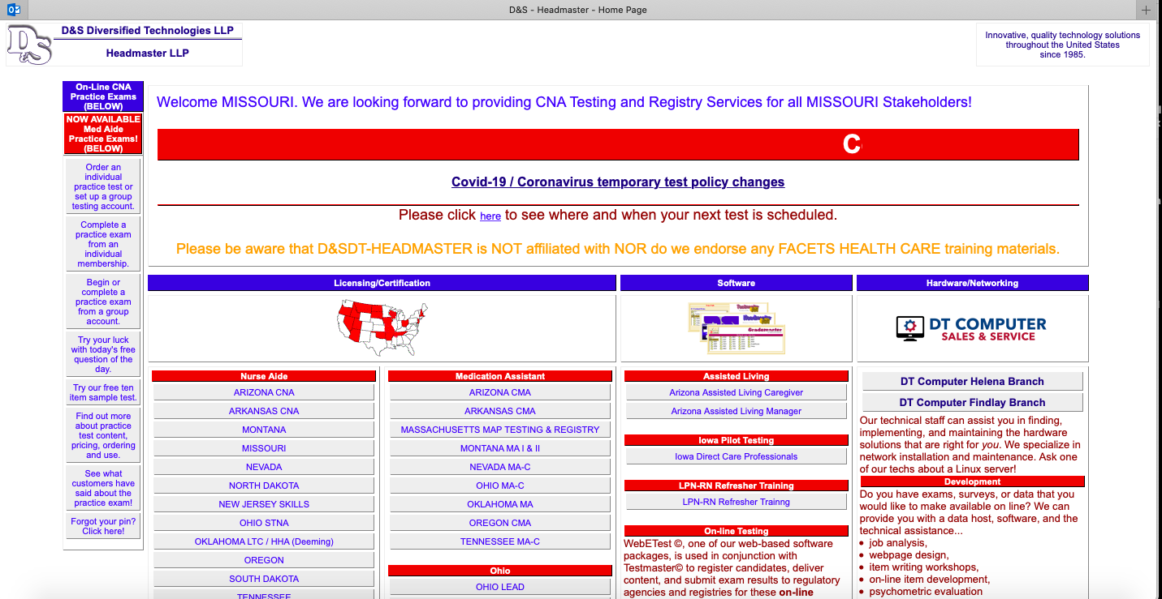
Notes:
To access TMUⒸ, go to the hdmaster website and click on ‘Massachusetts MAP Testing and Registry’.

Slide 40
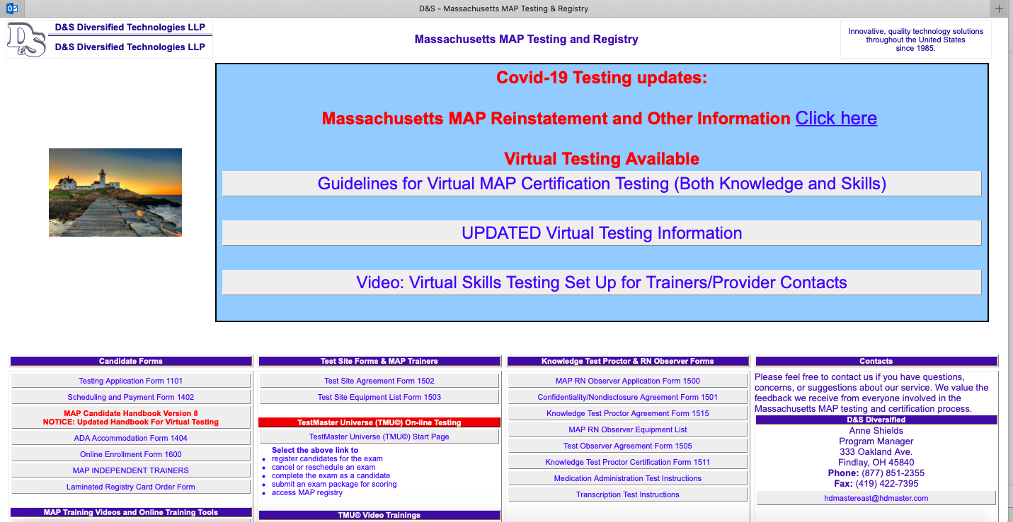
Notes:
This will bring you to the Massachusetts home page.
Click on ‘Test Master Universe TMU© start page’.

Slide 41
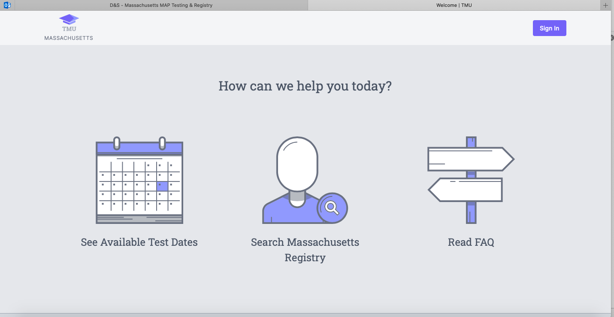
ma.tmuniverse.com
Notes:
This brings you to the TMUⒸ homepage.
TMUⒸ is also accessible via the direct link seen on your screen.
On the homepage there’s a calendar for upcoming test dates, the option to search the public Massachusetts Registry or to read the Frequently Asked Questions (FAQs).
Click ‘Sign in’

Slide 42
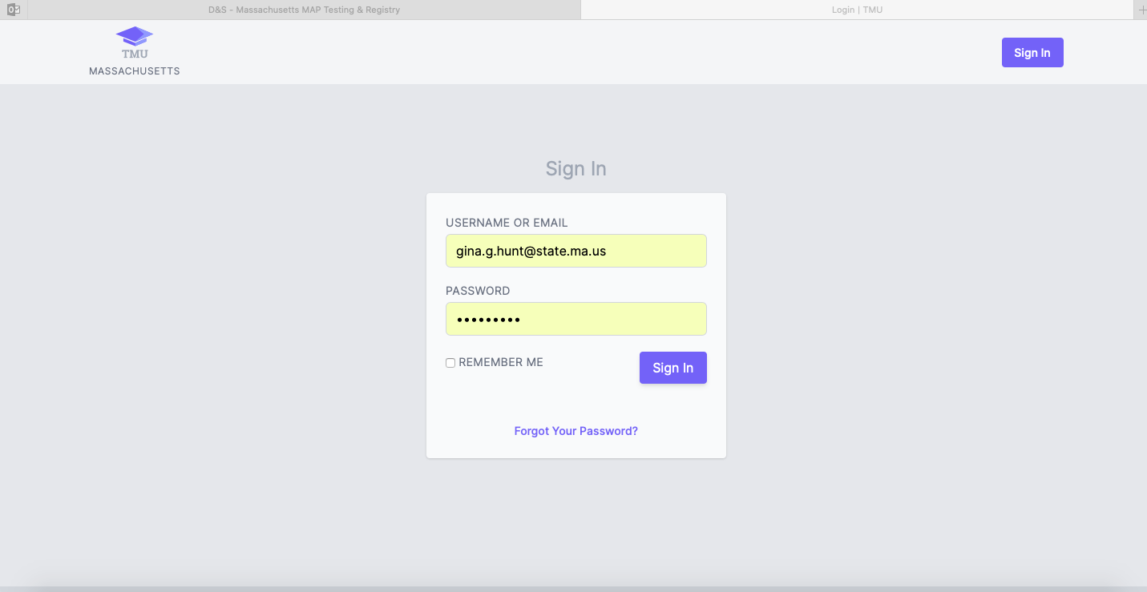
Notes:
Enter your username or email and password and click ‘Sign In’ again.

Slide 43
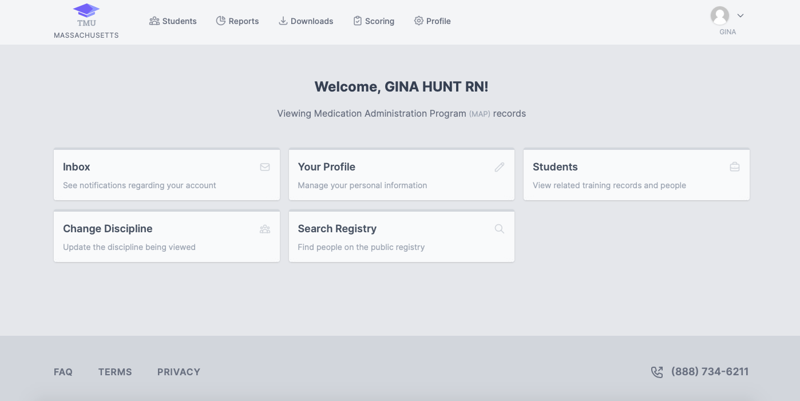
Notes:
On your dashboard, click ‘Students’, at the top of the page or below.

Slide 44
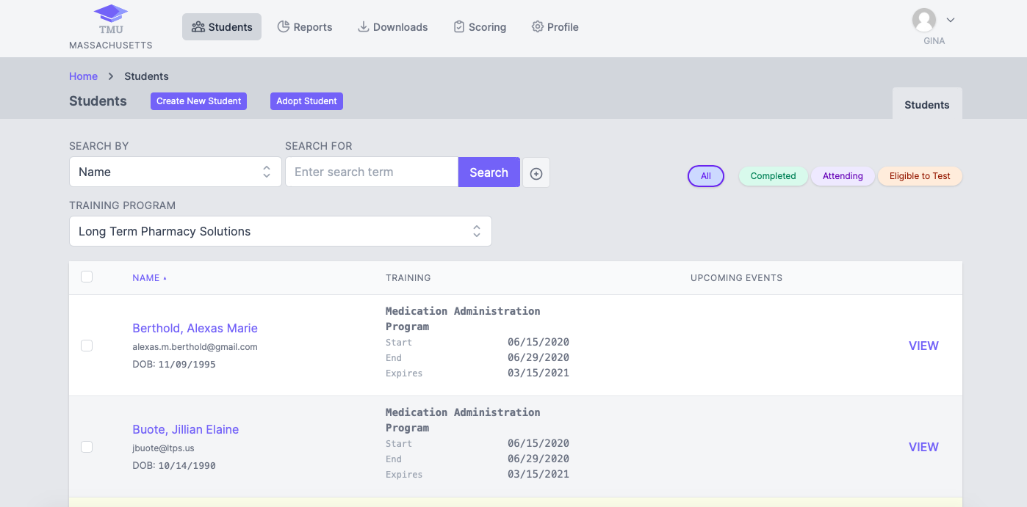

Notes:
Click ‘Create New Student’.

Slide 45
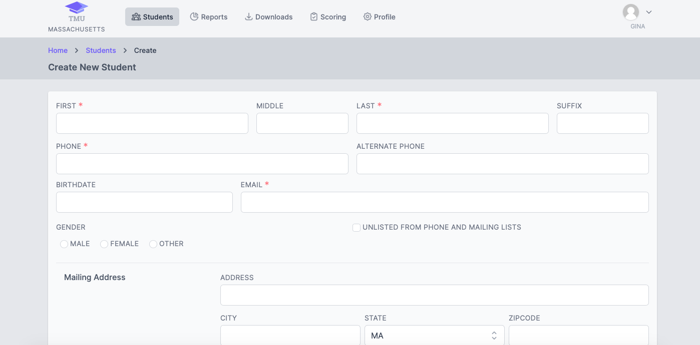
Notes:
Essential information comprising a student profile is denoted by red asterisks and includes but is not limited to, the student's name, phone number, email address and your training start date, etc. Much of this is the same information you collected prior to submitting your roster to CDDER.
The data may be entered by you or a Service Provider contact; you will each use your own login information.
If there’s a person where you work that will be responsible for entering student demographics into TMUⒸ (typically someone from Human Resources or from the Training Department) they must obtain their own login information by emailing D&S DT. This type of access, provided to a non-MAP Trainer, limits access within TMUⒸ to only entering a student’s demographics prior to a training.

Slide 46
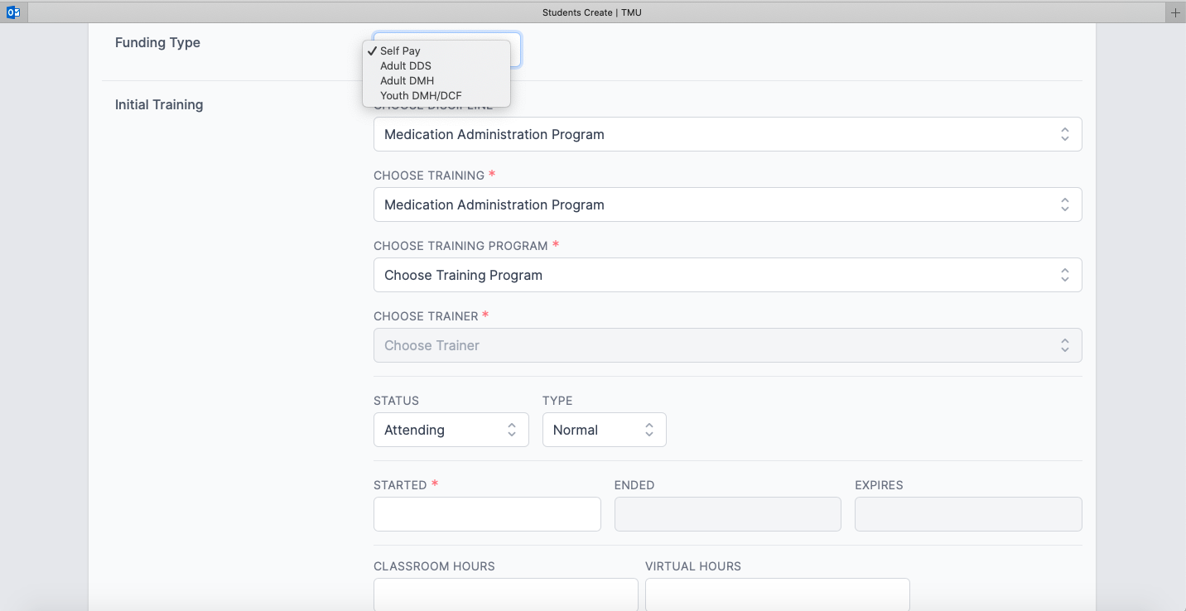
Notes:
Scrolling down the screen you’ll select the funding source by choosing from the menu that correlates with the Commonwealth State Agency that will be funding the student’s test attempts.
The possible funding sources for students employed by a Service Provider are DDS, MRC, DMH or DCF. One State Agency will fund three knowledge tests, three medication administration tests and three transcription tests; students are allowed only one funding source for a total of nine funded attempts, if needed.
Nine funded attempts from each funding source are not allowed.
The funding source ‘Self-pay' is selected if the student is receiving their Certification training from an Independent MAP Trainer and the student is not employed by a DDS, MRC, DMH or DCF Service Provider or the DDS, MRC, DMH or DCF funded attempts have been exhausted.

Slide 47
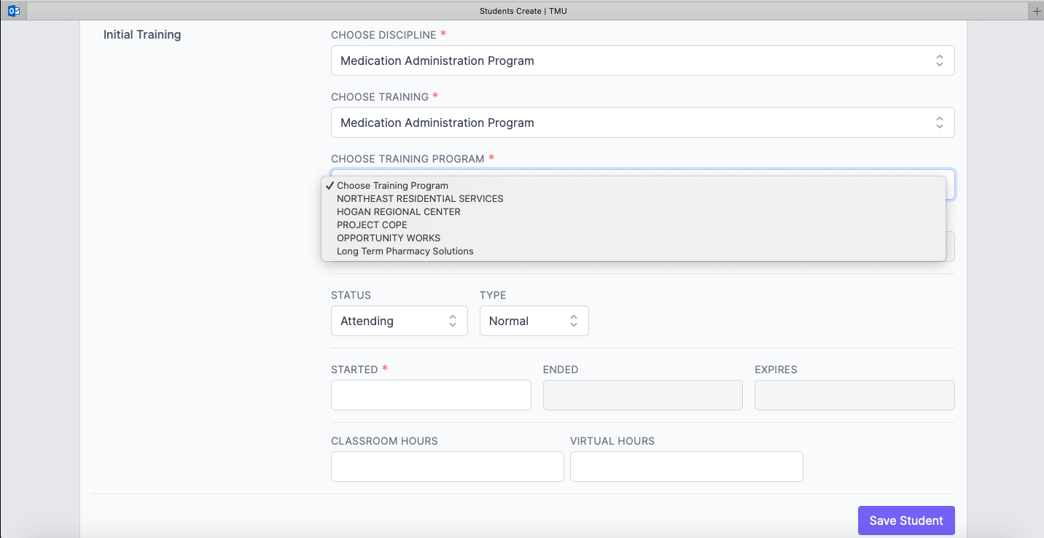
Notes:
The required fields, ‘Choose Discipline’ and ’Choose Training’ default to ‘Medication Administration Program’.
The ‘Training Program’ field identifies the name of the Service Provider for whom the MAP Trainer is conducting the training.
If you’ll be training students that work for different Service Providers, you must contact D&S DT to have each different Service Provider added to your list of Training Programs. When choosing from the menu, you’ll choose the name of the Service Provider that employs the student that you’re training.
If you’re an Independent MAP Trainer, not employed by a Service Provider, and are training non-funded (i.e., self-pay) students, you must contact D&S DT to have the selection of ‘non sponsored/Independent MAP Trainer’ added as a ‘Training Program’ choice.

Slide 48
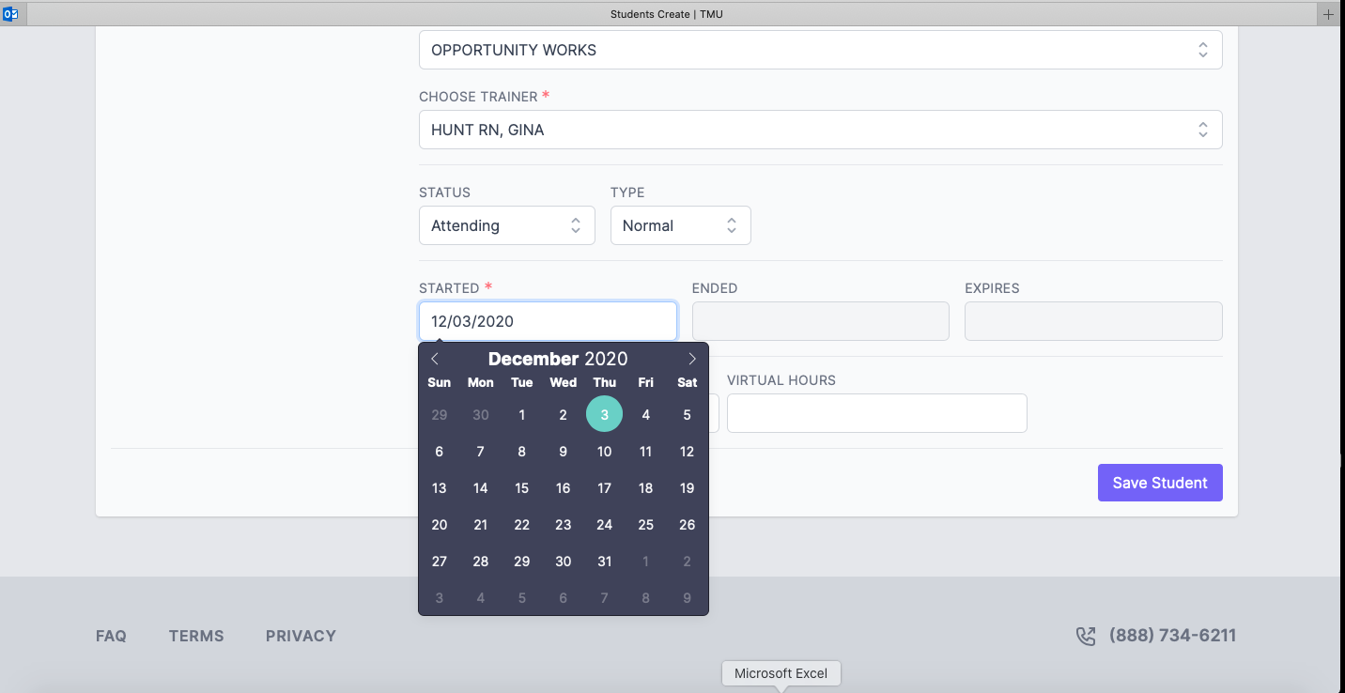
Notes:
Next, the MAP Trainer name is selected from the menu tying the student to the MAP Trainer, followed by entering the course start date.
Once the required information is entered, the MAP Trainer or Service Provider contact will click ‘Save Student’.

Slide 49
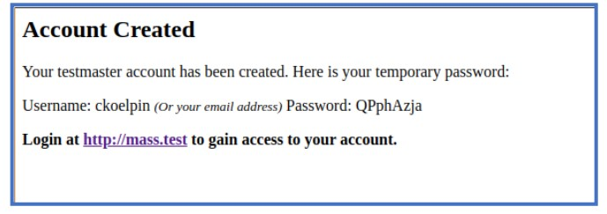
Student TMU© Account Created
Automatic
  Email and
  Text message
    to Student
Notes:
After the record is saved, the student will automatically receive an email and a text message from D&S DT with their login information to access TMU©.
When the student logs in for the first time, they’ll be prompted to complete their student profile, including their date of birth, address, social security number, etc.
At the conclusion of the course, each student will again access TMUⒸ to complete the Knowledge and Transcription pretests.
Remind your student group to review their TMUⒸ record and make any necessary changes as this is the information the testing company will use when verifying the student’s identity during the Certification Test process. The name entered in TMUⒸ must match the name on the ID that the student will be using when testing with D&S DT.

Slide 50
Contact(s) and Notification
Call D&S DT
  Request to be added to Service Provider contact list
  D&S DT will ask for
    your name
    phone number
    email address
  D&S DT will add you to Service Provider Contact List
  You must ‘select’ yourself as a contact in each student record
MAP Trainer
Student’s Supervisor
Notes:
Contact D&S DT if you would like to receive the same notifications via email or text that the student receives regarding the training, pretests and/or test scheduling.
After your information is added to the Service Provider contact list, you must then go to each student TMU© record and select yourself from the list as a contact.

Slide 51
TMU© ma.tmuniverse.com
Print a Training Roster
Notes:
Once initial student information is entered, you may print a roster.

Slide 52
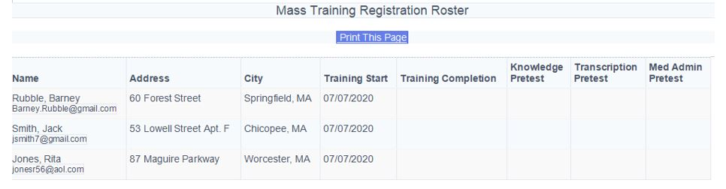
Student Roster TMU©
Notes:
The ‘Mass Training Registration Roster’ feature in TMUⒸ provides you with an overview of your students for a specific training start date.
This can be helpful as you track pretest completion dates.

Slide 53
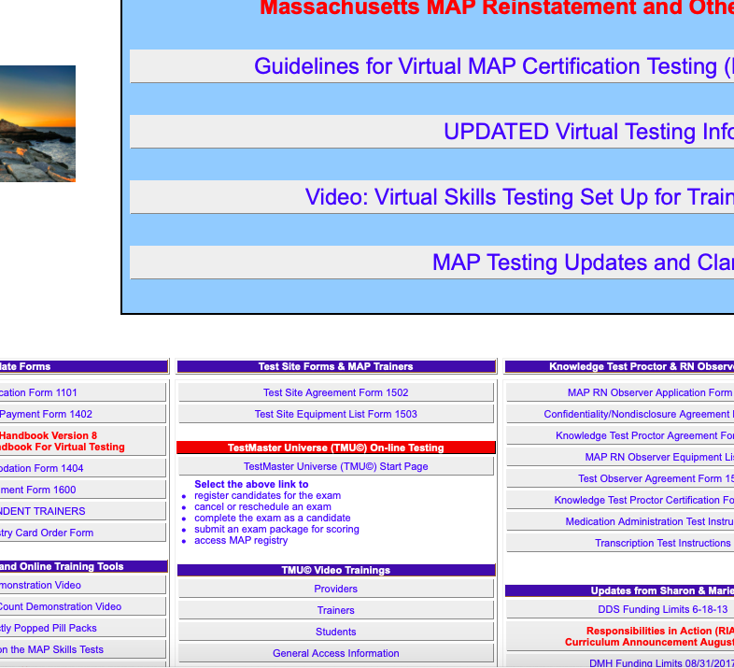
Test Master Universe TMU©
General Access Information
How to:
Introductory TMU© Video Trainings
Providers
Sign in
Retrieve Forgotten Password
View Registry
Trainers
Students
Notes:
For assistance in navigating the various features of the TMUⒸ site, D&S DT developed sets of tutorials to assist Providers, Trainers and Students.
To view the tutorials, go to the Massachusetts homepage of the hdmaster website and click the category of your choice under ‘TMUⒸ video trainings’.

Slide 54

TMU© 5.0 Trainer tutorials
How to
  enter a student
  complete a student
  complete a group of students
  grade a transcription pretest
  complete a pretest date
  request employment verification
  schedule a student
  run reports
Notes:
The selection of Trainer Tutorial topics to choose from, include everything from how to enter a student to create their TMUⒸ record, to how to run reports.

Slide 55
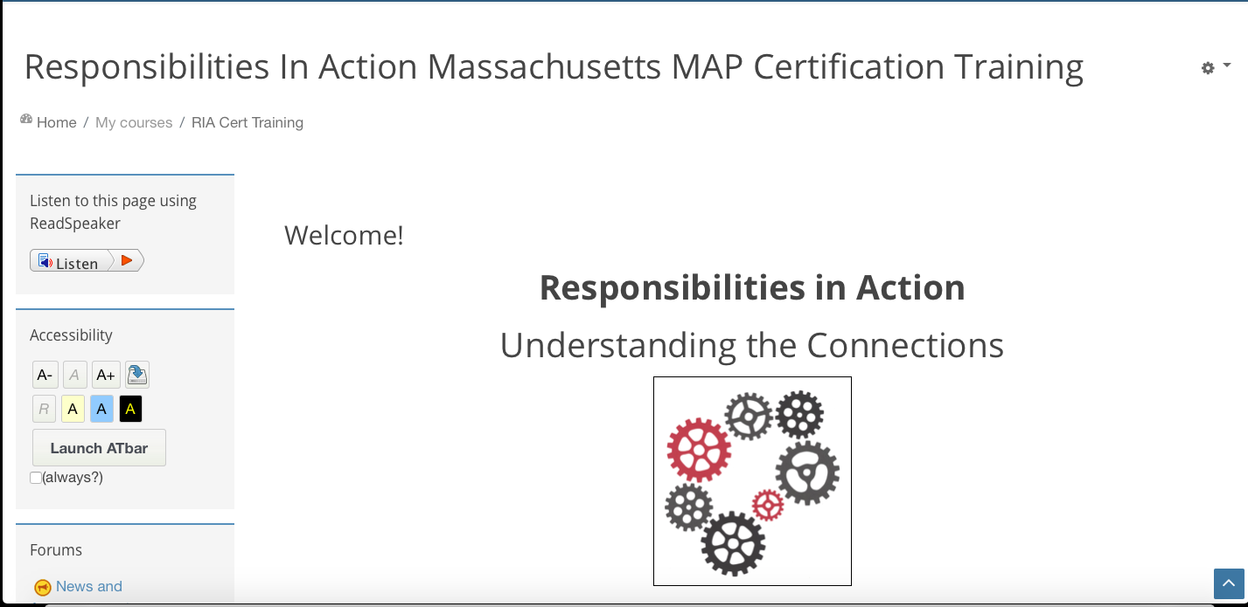
Notes:
Student access to the online course is initiated by CDDER once your roster is submitted.

Slide 56
Moodle Communication features
Announcements
Discussions
Chat
Notes:
Communication features within the course include:
Announcements
Discussions and
Chat
The Announcements feature is a one-way form of communication by you to your student group.
The Discussions feature is a two-way form of communication. Either you or a student can post a discussion topic, question or comment. You or the student can reply to the group as a whole or directly to the person who posted the comment.
There is also a chat box feature, which is private between you and the student.
If you prefer, you can also communicate with staff by text, email or during predetermined virtual sessions.

Slide 57

Virtual meetings
Trainer Discretion
  Before
  Middle
  End
Notes:
If you choose to establish predetermined virtual meeting dates and times to meet with your student group throughout the course, consider including the dates and times in your initial email to the student.
Whether you meet virtually or not is at your discretion.
It’s your choice regarding the number of times you prefer to connect with staff throughout the course.
Consider virtual sessions 1 or 2 days before the course opens or the day the course opens, another around the completion of Unit 5, which is considered the halfway point and then a 'Wrap Up' session near the conclusion of the 2-week time frame or just after.

Slide 58
INITIAL session topics
Meet your student group
Ensure each student has Resource Packet
Progress shared with Supervisors, if applicable
Notes:
An initial video conferencing session provides an opportunity to:
meet your student group,
confirm that each student has a Resource Packet
let them know that their progress throughout the course will be shared with their Supervisors, if applicable
explain they should have or will be receiving an email and text from D&S DT to complete their TMUⒸ student record and
any additional topics you think would be helpful such as the best way to contact you as questions arise.
​

Slide 59
ONLINE course access
Trainer Access
  Opens the afternoon the day before course start date
Student Access
    ‘Welcome Email’ with link to online course site sent from
      Admin User (via Massachusetts Medication Administration Program Training Resources and Support).noreply@neindex.org with information used to login with
        Unique username and
        Temporary password by 9am on course start date
Notes:
You’ll have access to your student group by noon on the Wednesday before the course opens so that if you prefer, you can set up discussion forums, schedule a virtual meeting to show them what the course homepage will look like by sharing your screen, etc.
Students will receive an email from ‘Massachusetts Medication Administration Program Training Resources and Support’ with their unique username and temporary password possibly beginning on the Wednesday afternoon before the course opens.
The goal is that all students will have received this email by the time the course starts at 9am on Thursday. If not received, students can e-mail CDDER for help.

Slide 60
Student Login Tips
Type exactly or copy and paste password from ‘Welcome Email’
If an error message is received on first attempt, try a second time
If still unable to log in, contact CDDER at CDDER@umassmed.edu
If no ‘Welcome Email’ is received, check spam folder
If not in spam folder, contact CDDER at CDDER@umassmed.edu
Access course at www.mapmass.com
Notes:
You could consider sending an email to all students the day before the course opens that includes the Student Tips for login as shown on your screen.

Slide 61

CDDER Tech Support
Monday-Friday
8:00am-4:00pm
CDDER@umassmed.edu
Notes:
Even if a student does not plan to start the course on the day it opens, you should encourage them to check for their ‘Welcome email’ and to log in.
Until the student logs in, they will not receive any announcements or discussions that you post in Moodle.
CDDER is available for tech support M-F, 8am – 4pm via email.
Students are encouraged to attempt their first login before 4pm on Friday so that CDDER tech support can troubleshoot issues before the weekend.

Slide 62
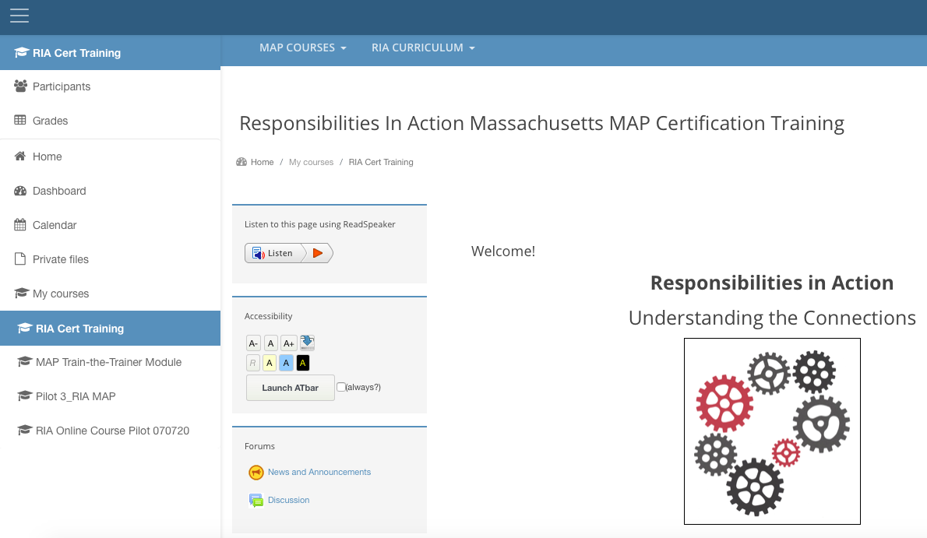
TRAINER Responsibility
Course START DATE
Check Participant List
Notes:
On the course start date, check the Participant List. To do so, from your dashboard, click on ‘Participants’ to access your student group.

Slide 63
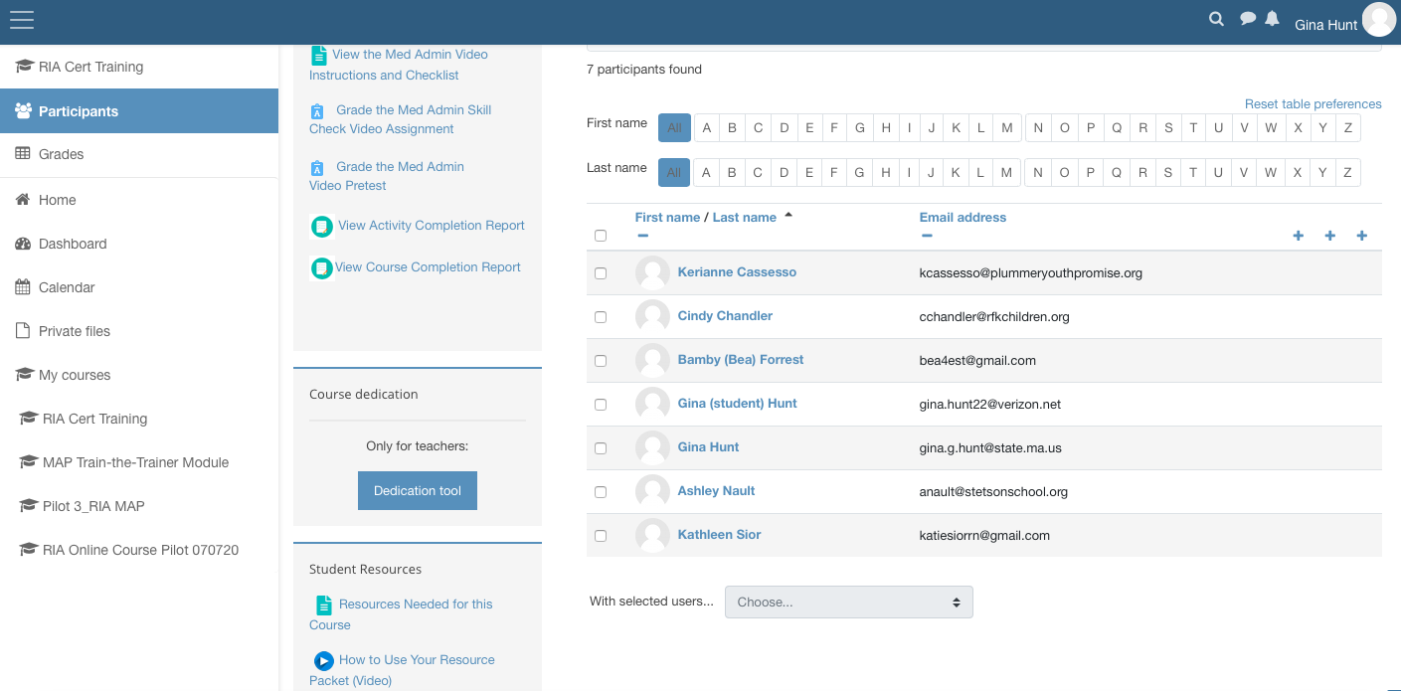
Participant list
Notes:
Review the list to ensure only your students are listed and that names of others are not on your roster.
If you notice issues, please contact CDDER.

Slide 64
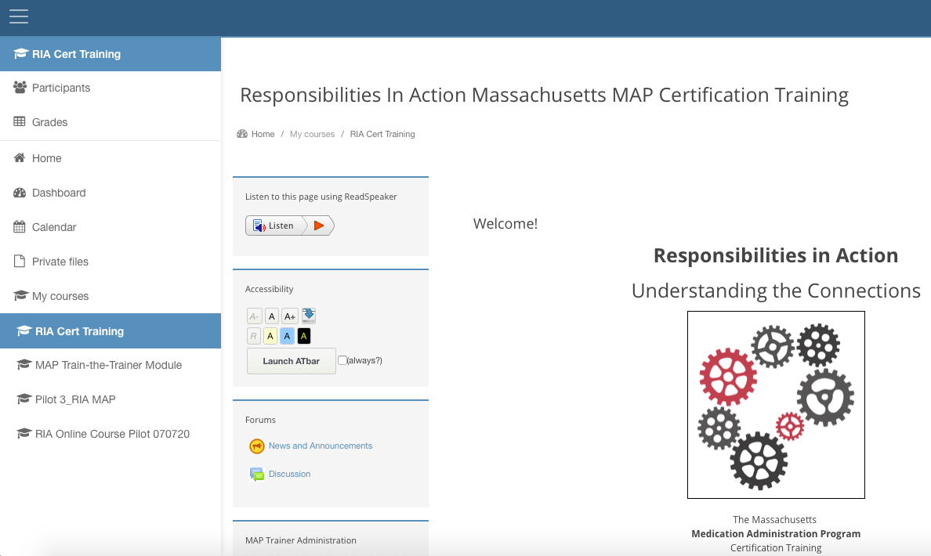
TRAINER Responsibility
Course START DATE
Create Welcome Announcement
Notes:
On the start date, consider creating a Welcome Announcement for your student group.

Slide 65
Welcome announcement suggestions
Time Management
Average Time per Unit
Contact Information
Notes:
In your announcement consider providing students with the average length of time they’ll be spending in each unit to help pace themselves for success and how you prefer to be contacted if there are questions, etc.

Slide 66
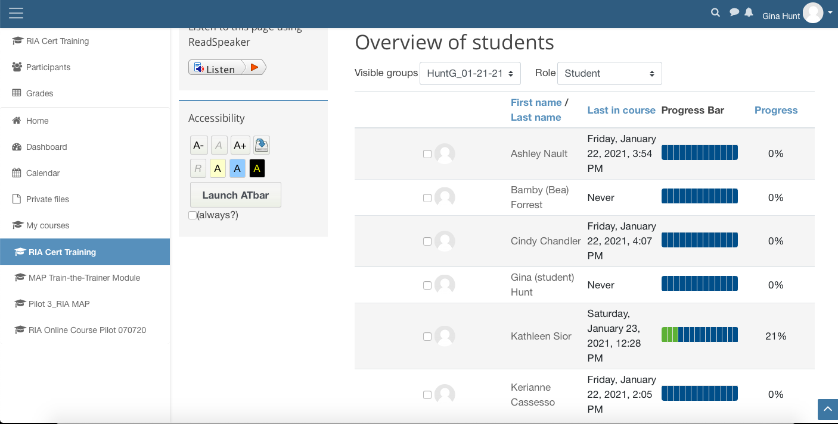
TRAINER Responsibility
Course START DATE
Progress Bar
Notes:
You’ll also begin to monitor student progress using the Progress Bar.
As each student moves through the course, the bar changes from blue to green.

Slide 67
TRAINER Responsibility
Course START DATE
Overview of Students
Notes:
Connect with staff who show as 'never' on the Progress Bar to help direct issues with username or password to CDDER or to see if they have not yet had the opportunity to log in due to other commitments.

Slide 68

Time Management
Day 1
  Course Overview and Navigation
    4 minutes
  Introduction
    20 minutes
  Unit 1 ‘Working at a MAP Registered Program’
    40 minutes
  Unit 2 ‘Observing and Reporting’
    57 minutes
Notes:
The next set of slides are suggested daily announcements if the course model you’ve chosen is the 2-week time frame. If you’ve chosen one of the other models, you can modify the announcements to meet your needs and be as creative as you wish.
In general, it’s recommended that your student group review at least 2 Units per day through Unit 5 as well as the Summarization of Concepts in Units 1-5 plus the Preview of Units 6-9.
Day 1 should include logging into the course at a minimum. Ideally your students will have enough time on Day 1, to review how to navigate the course, read the introduction, Units 1, 2 and successfully complete the corresponding quizzes.
The times listed are based on the average student time spent in each section.
The time spent in the Units does not include the time spent taking the quizzes.

Slide 69

Time Management
Day 2
  Unit 3 ‘Medications’
    79 minutes
  Unit 4 ‘Interacting with a Health Care Provider’
    61 minutes
Notes:
On Day 2, encourage students to complete Units 3 and 4 as well as the corresponding quizzes.

Slide 70
Time Management
Day 3
  Unit 5 ‘Obtaining, Storing and Securing Medication’
    57 minutes
  Halfway point
  Virtual meeting regarding what is coming
Notes:
On Day 3, encourage students to complete Unit 5 and the corresponding quiz.

Slide 71
Halfway There
Summarization of Concepts in
  Units 1-5 and
  Preview of Units 6-9
    10 minutes
Notes:
Following Unit 5 there is a mini summarization of concepts that were covered in Units 1-5 with a preview of Units 6-9.
You may want to consider a virtual meeting at this halfway point.

Slide 72
HALFWAY session topics
Unit 6
Unit 7
Optional
Skills Practice
Transcription Practice
Skill Check Assignment
Skill Check Assignment
Medication Administration Practice
Virtual Sessions
Medication Administration
Transcription
Notes:
Scheduling a video conferencing session following Unit 5 and before the remaining units allows you to:
Re-connect with your student group and congratulate them for completing half of the course!
Impress upon them that Units 6-9 take much more time than the first half of the course and in addition require them to submit 2 assignments for grading.
Explain that they will be using their Resource Packet in Units 6 and 7; perhaps go through the materials and show them how they’ll be used.
At your discretion offer dates of skills (transcription and medication administration) practice as a group or individual 1:1 virtual sessions and any additional topics you think would be helpful.
​

Slide 73
Time Management
Day 4 and 5
  Unit 6 ‘Recording Information’
    91 minutes
  Resource Packet
      Transcription Practice time
        69 minutes
      Skill Check Instructions
        9 minutes
        Submit transcription assignment
Notes:
In addition to general content, Unit 6 includes transcription practice, submitting a Skill Check transcription assignment for grading and will take your student group longer.
Remember the time listed for the Unit 6 content does not include the time used to take the quiz.

Slide 74
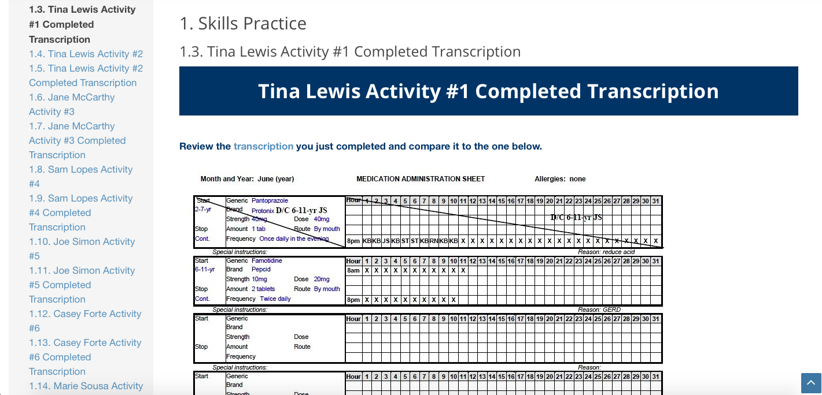
Unit 6
Transcription Skill Practice
    DC one medication
    Transcribe new medication(s)
Notes:
Transcription practice is built into the online course.
In this section, your students will independently complete multiple transcription activities.
You can ask that students take a picture of their completed med sheets and submit for your review and feedback or again, you can offer an optional transcription virtual group session; either is at your discretion.

Slide 75
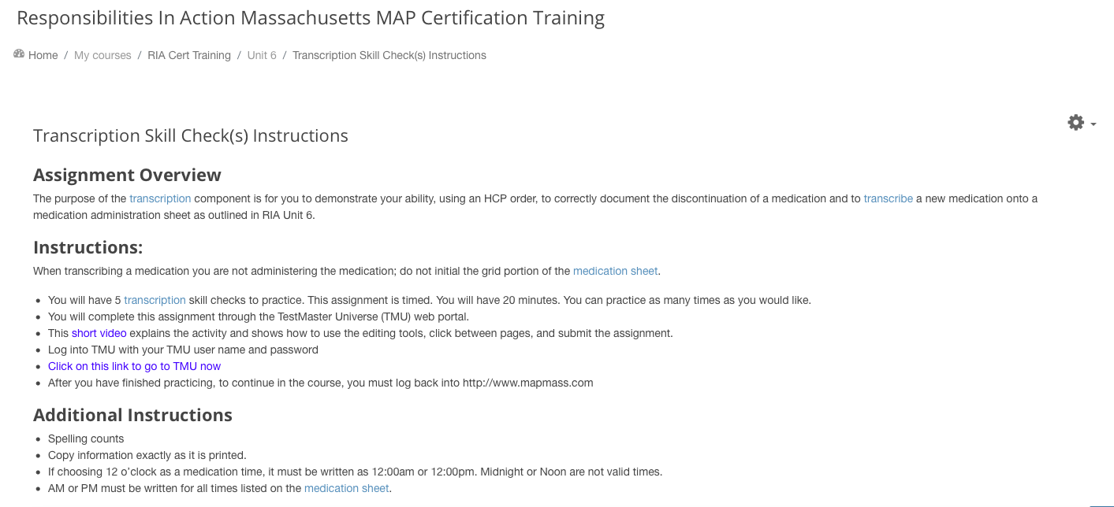
Transcription skill check assignment
Instructions
Notes:
After student practice is completed, there are detailed instructions for the transcription skill check assignment.
At this point, students should have mastered how to transcribe.
The assignment was incorporated not only because the med sheet is completed using a computer, but it also sets staff up for success to complete a transcription pretest, after which the assignment is modeled.
After a student reviews the instructions, the assignment is accessed via a link in Moodle to TMUⒸ.
When the link is clicked, it brings the student to…

Slide 76
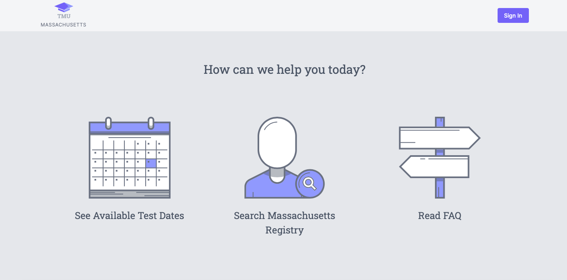
PRACTICE TRANSCRIPTION
Student logs in to TMU©
Notes:
…this page.
A student will log in to TMUⒸ using their username and login received from D&S DT.
The skill check transcription assignment is timed. Students have 20 minutes to DC one medication and transcribe a new medication.
The goal is for a student to complete one practice transcription with 100% accuracy.

Slide 77
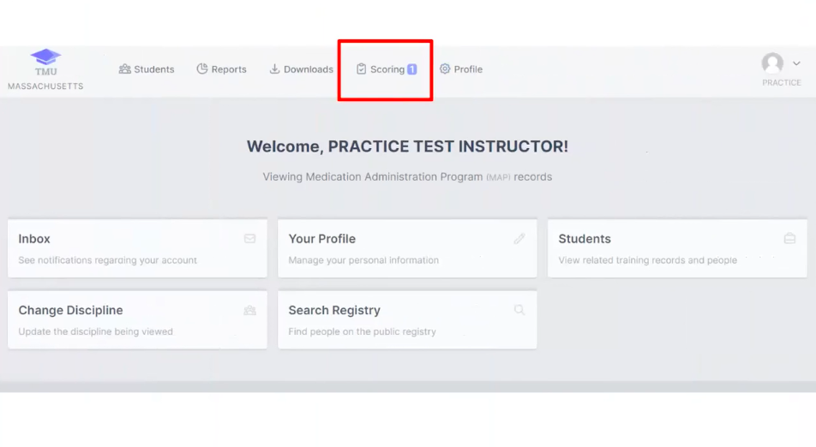
Practice Transcription
Trainer logs in to TMU ©
  ‘Scoring’
Notes:
When your student submits the assignment, you’ll receive an automatic notification on your TMUⒸ dashboard.
The number you see next to ‘scoring’, indicates the number of assignments that need to be graded.

Slide 78
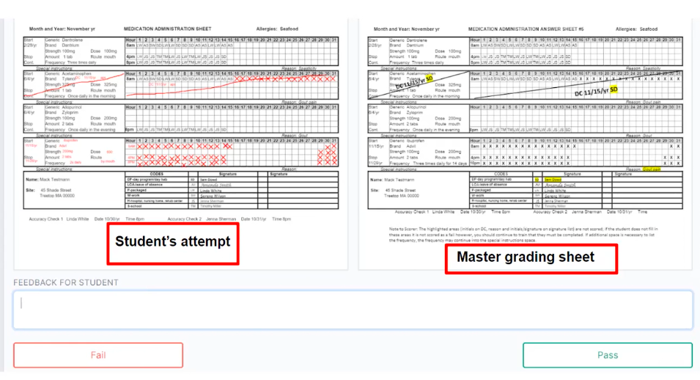
Practice Transcription
Trainer logs in to TMU ©
Notes:
Regarding the transcription skill check, a student may pass or fail and still proceed through the course.
The purpose of the Unit 6 Transcription skill check is for students to practice using the computer in preparation for the transcription pretest.

Slide 79
Time Management
Day 6 and 7
  Unit 7 ‘Administering Medications’
    Part 1
      61 minutes
    Part 2
      87 minutes
    Resource Packet
      Practice time
      Medication administration demonstration video instructions
        6 minutes
        Submit medication administration demonstration video assignment
Notes:
In addition to general content, Unit 7 includes medication administration practice using the Resource Packet contents, submitting the medication administration demonstration Skill Check assignment and will take your student group longer.
The times listed do not include medication administration practice time, time used to complete the med pass video demonstration or again time spent taking the quiz.

Slide 80
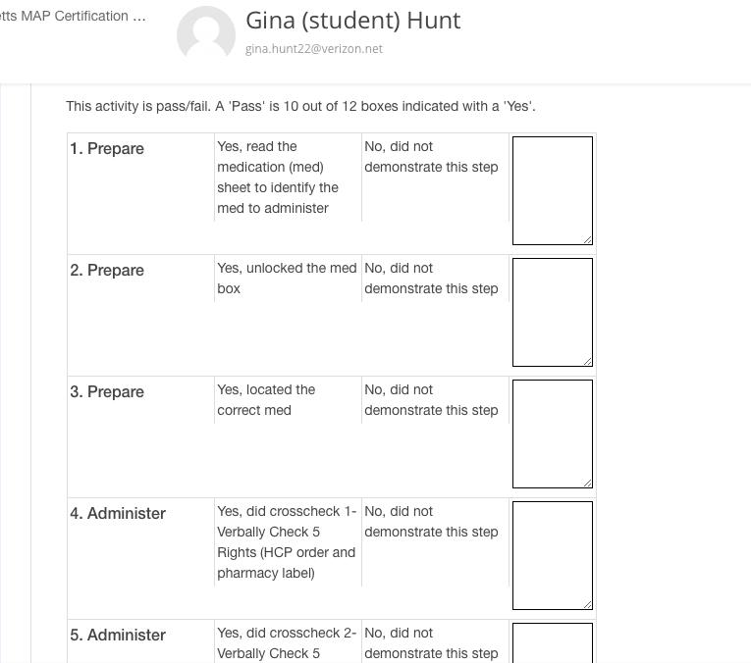
Medication administration
Demonstration
Skill check assignment
Scoring Rubric Tool
Completed for each Student
10 of 12 Boxes is ‘Passing’
Notes:
The Skill Check assignment in Unit 7 is a video submission to you of a med pass demonstration by each student in your group.
After viewing each video, you’ll score each assignment by completing the embedded rubric on the grading screen by simply clicking Yes or No on each step of the medication administration process and providing feedback. Moodle automatically scores your selections as ‘pass’ or ‘fail’.
Although at this point in the course, this is a Skill Check assignment, if the student successfully demonstrates the medication administration process, the demonstration may be ‘counted’ as completion of the med administration pretest and the date of the successful med pass entered into the student TMUⒸ record.
For pretest purposes, a passing score is equivalent to 10 of 12 boxes on the list as seen on your screen being checked as ‘yes’; with the understanding that for the Certification test with D&S DT, a passing score is 100% accuracy.
It’s important that students continue to practice med administration between completion of the course and their test date.
If a student does not successfully demonstrate how to pass a med safely on their first attempt, they must practice and then resubmit another video.
It’s important for you to know that if a student does not pass on their first attempt, they may continue through the course content while practicing in between.

Slide 81
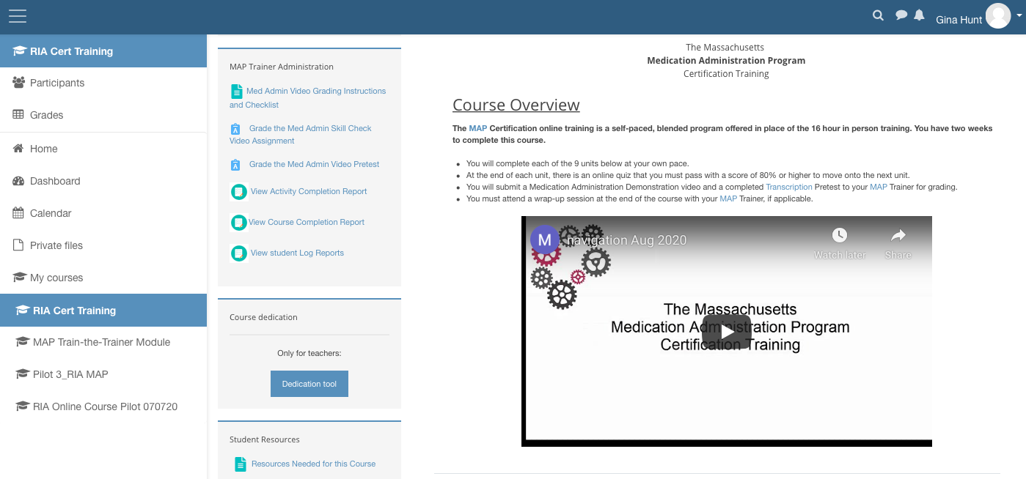
Med ADMIN Grading instructions
Notes:
To view how to use the scoring rubric, on your course homepage, in the MAP Trainer Administration block, click the selection, ‘Grade the Med Admin Video Grading Instructions and Checklist’.

Slide 82
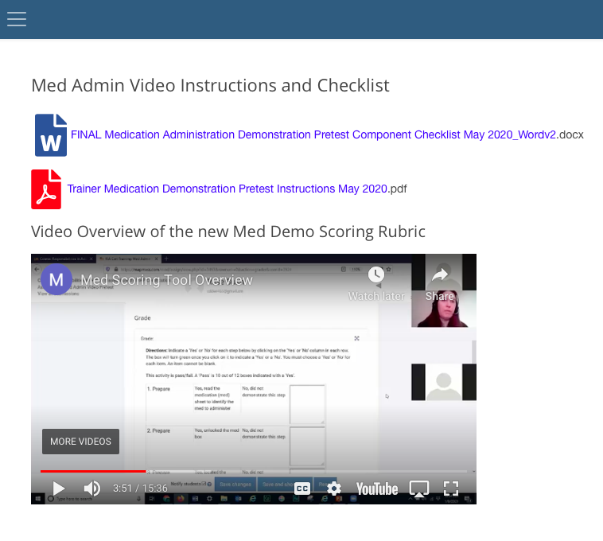
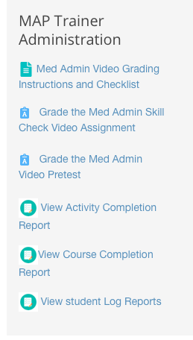
How to grade using Scoring rubric
Notes:
This brings you to a video demonstration of how the scoring rubric works.

Slide 83
Medication administration demonstration
Video submission or
Video conferencing session
Notes:
In place of video submissions, you may watch each student demonstrate the medication administration process via a video conferencing session.
A student may redemonstrate medication administration as many times as needed.
Regardless of how you see the demonstration, you will use the rubric for grading in Moodle and enter the date passed into each student TMUⒸ record.
If you prefer to print a paper checklist for grading, it is available as shown on your screen.

Slide 84
Time Management
Day 8
  Unit 8 ‘Chain of Custody’
    Part 1
      76 minutes
    Part 2
      24 minutes
Notes:
Unit 8 has 2 parts, with the average minutes spent in each listed on your screen.

Slide 85
Time Management
Day 9
  Unit 9 ‘Medication Occurrences’
    41 minutes
Notes:
The average time for students to complete the entire course content is 13 hours.
This does not include quiz time, practice time or time spent reviewing either a hard copy of RIA or an online copy or any time spent during Trainer Virtual sessions.

Slide 86
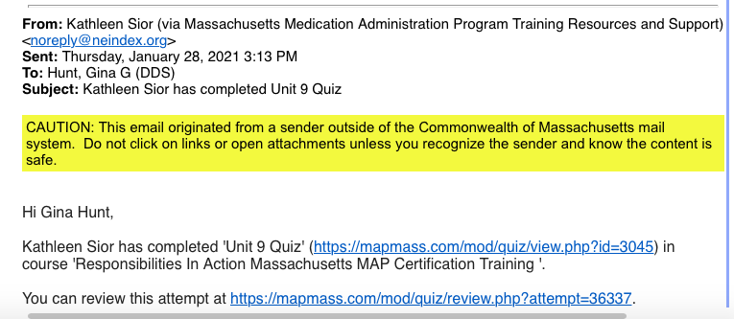
Trainer email notification
Notes:
When a Student submits the Unit 9 Quiz, you will receive an email notification.
If the student chooses to retake the Unit 9 quiz, you’ll receive additional email notifications for as many times it’s retaken.
This is helpful for tracking students as they near completion of the content.

Slide 87
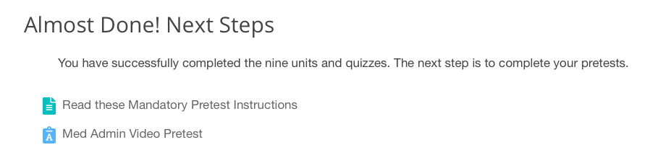
Next steps
Notes:
After completing Unit 9 and passing the corresponding quiz, a student will see this ‘Almost Done! Next Steps’ message open on their dashboard indicating they are now eligible to take the three pretest components.
When they click on ‘Read these Mandatory Pretest Instructions’ it brings them to…

Slide 88
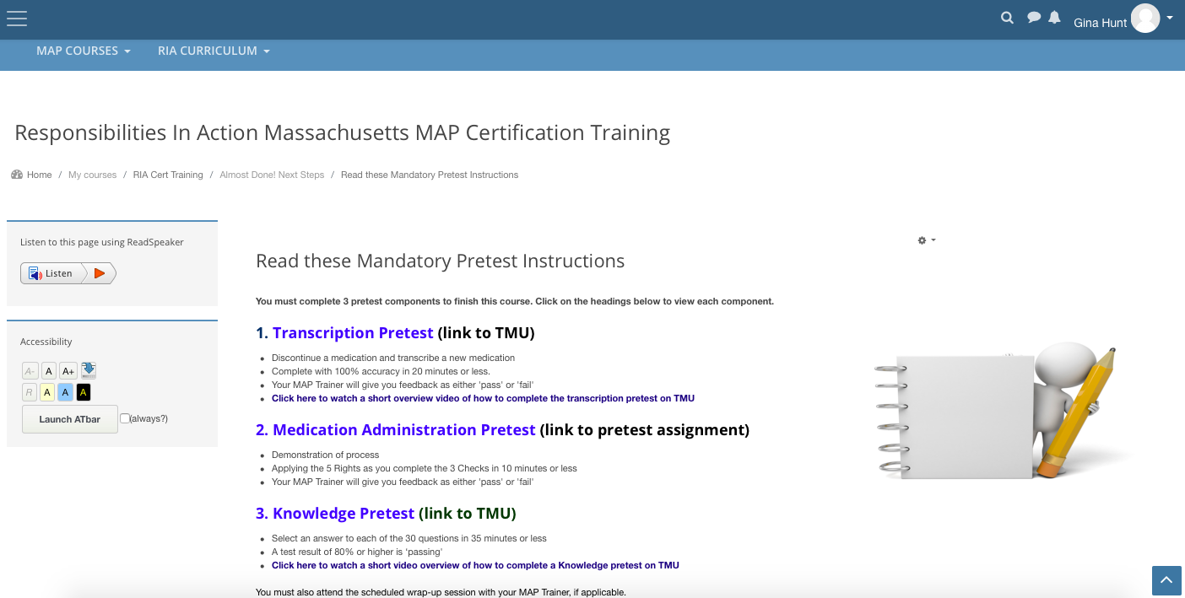
pretest instructions
Notes:
…instructions for each of the three Pretest Components.
From Moodle each student may view D&S DT tutorials regarding the Knowledge and Transcription pretests as well as access both pretests via links to the TMUⒸ homepage.

Slide 89

TMU© 5.0 STUDENT tutorials
How to
  take a pretest
  navigate and use tool bar during Transcription Pretest
  request employment verification
  pay fees
  schedule a test
  access test results
Notes:
Remember, in addition to links within Moodle, you can direct your student group to access the tutorials on the D&S DT Massachusetts homepage.
You’ll find the tutorials helpful as well.

Slide 90
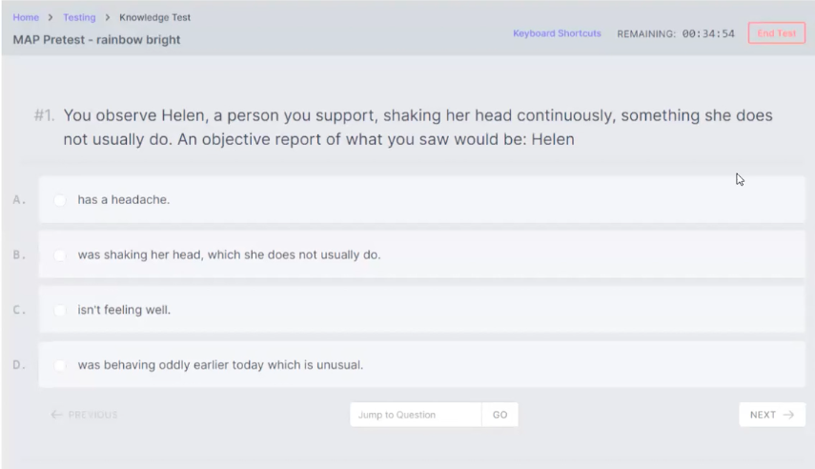
Knowledge Pretest
TMU©
30 Multiple-Choice Questions
35 minutes or less
80% or higher is passing
Notes:
The Knowledge pretest is 30 multiple choice questions based on content from the RIA curriculum.
The test must be completed within 35 minutes with a score of 80% or higher.

Slide 91
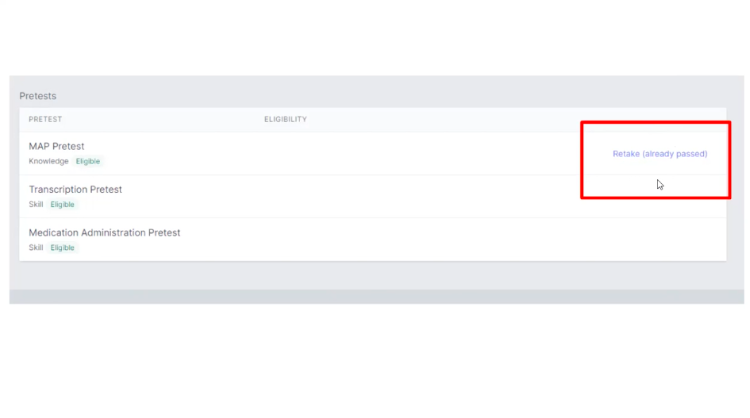
pretest
Notes:
The Knowledge pretest may be retaken by the student as many times as they choose.
Each test attempt provides a new set of test questions.
The student is only required to pass this component once to meet the Knowledge pretest requirement.

Slide 92
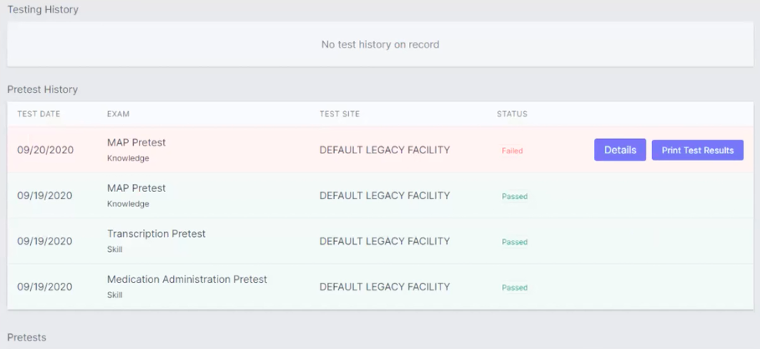
pretest
Notes:
Once a test is taken, TMU© grades the test automatically as pass or fail and updates the student’s record indicating that the Knowledge component of the pretest is completed.

Slide 93
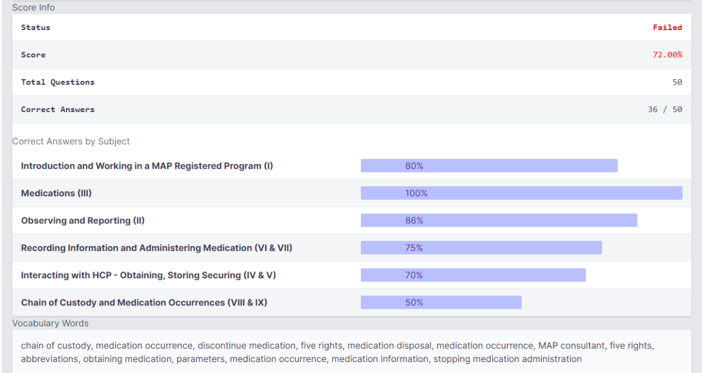
pretest
Notes:
For each test taken, the student can view the details of their score.
Each unit of the curriculum is given a score and vocabulary words are listed which were part of test questions that were missed.
When you access the students’ TMUⒸ record, you will also see the Knowledge pretest result and the date passed.
If at any time you question the veracity of a student’s test results, you can request that the student retake the Knowledge pretest under supervision.
Students are encouraged to use this pretest as a study tool. There are over 200 questions in the database.
The Knowledge pretest mimics the Certification Knowledge test that the student will take with D&S DT.

Slide 94
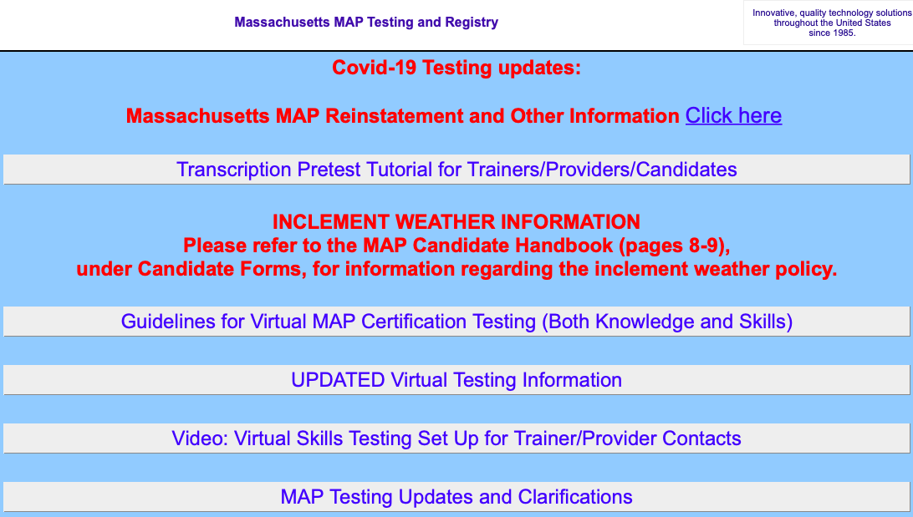
TMU© 5.0 Transcription Pretest tutorial
How to
  Access
  Use Tools
Notes:
On the D&S DT Massachusetts homepage there is a Transcription pretest tutorial.
Eventually as this ‘Blue Box’ is updated with more current MAP information, it will be removed.
Know that the same tutorial is in both the student and trainer tutorial sections.

Slide 95
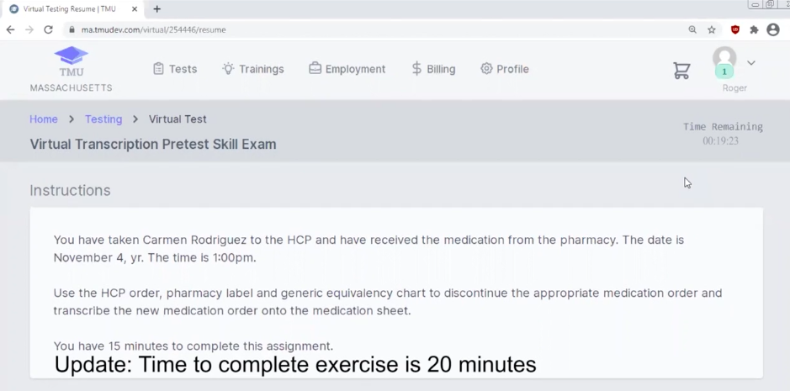
Transcription pretest
TMU©
DC Medication
Transcribe Medication
20 minutes or less
100% accuracy
Notes:
Each student must pass one Transcription pretest modeled after the Unit 6 Skill Check Assignment.
When you enter the training end date, the Unit 6 Practice Transcription will change to allow students to take the Transcription pretest.
A passing Unit 6 practice Skill check assignment is NOT a substitute for a passing Transcription pretest.
You will know a transcription pretest was submitted and is pending grading by the ‘scoring’ selection on your TMU© homepage as mentioned earlier.
Students may retake the transcription pretest as many times as needed to pass with 100% accuracy.

Slide 96

TMU© trainer tutorial
Notes:
Take advantage of the 'How to Grade a Transcription Pretest’ tutorial on the hdmaster website.
It displays how the transcription submitted by the student is positioned next to the corresponding master grading sheet you will use for grading.
You will first provide feedback to the student, score the transcription as ‘pass’ or ‘fail’, then the date will automatically populate in TMU©.
If a student submits a paper transcription, the pretest pass date is manually input into TMU© by the Trainer.

Slide 97
Medication Administration demonstration Pretest
Notes:
The Medication Administration pretest component is a video demonstration of the medication administration process recorded independently by each student and uploaded to you for viewing.
Successful completion is a student demonstration verbalizing their knowledge as they complete the 3 Checks, comparing the 5 Rights between the HCP order, the pharmacy label and the medication sheet in 10 minutes or less.
If the student submitted a med pass demonstration in the Unit 7 Skill Check Assignment and using the Rubric Tool, the student scored 10 of 12 boxes correct, that same assignment may be used as the med administration demo pretest.
If the Unit 7 assignment was not successful, the student must upload another video or provide a demonstration via a 1:1 Virtual session for you to view.
The Rubric Tool must reflect at least 10 of 12 boxes checked to ‘pass’ the pretest component.
You will enter the date passed in the student’s TMUⒸ record.

Slide 98
Post-course wrap-up session topics
Remaining Student Responsibilities
D&S DT Candidate Handbook
Certification Test Preparation
Notes:
A virtual ‘Wrap Up Session’ with your student group provides an opportunity to:
congratulate those who have completed the course,
review remaining responsibilities such as completing the pretests ASAP
review how to prepare for each test component
remind students to read the D&S DT Candidate Handbook and
review instructions for scheduling D&S DT Knowledge and Skills tests
​

Slide 99
Student responsibilities
Finish
Finish 9 Units and Quizzes
Submit
Submit Skill Check Assignments
Complete
Complete Pretests
Notes:
If throughout the course you’ve used the TMU© roster to track pretest completion, check in with staff to ensure they understand that the final course steps include successfully completing the 3 pretests to be eligible to take the Certification Tests.

Slide 100
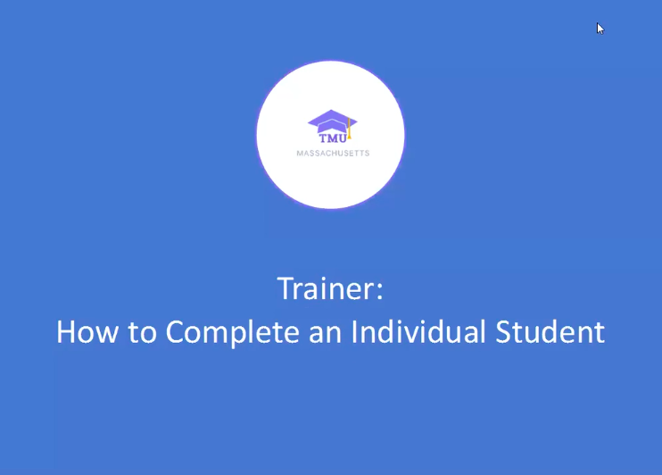
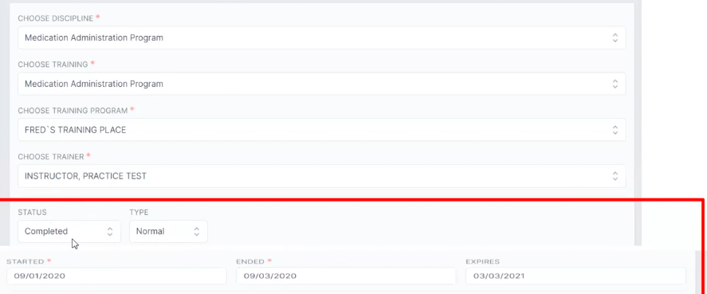
Post course responsibilities
Notes:
View the D&S DT tutorial titled, ‘How to Complete an Individual Student’ or the one titled ‘How to Mass Complete a Group of Students.
The online Certification course officially ends on the last day of the two-week course. Students must complete all 9 units and corresponding unit quizzes to receive credit for the course.
In the student TMU© record you will select the student status as ‘completed’ and enter the training end date.
An expiration date will automatically populate to six months from the training end date entered.
The course end date entered in TMU© is the start of the 6-month D&S DT Certification testing timeline.
If the student does not complete all Certification testing within 6-months they will need to repeat the full Certification training again.

Slide 101
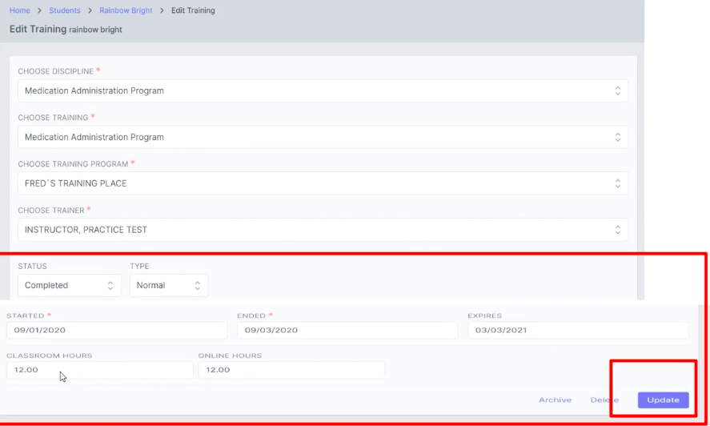
Post course responsibilities
Notes:
You will also enter the number of hours it took the student to complete the online Certification training under ‘Virtual Hours’.

Slide 102
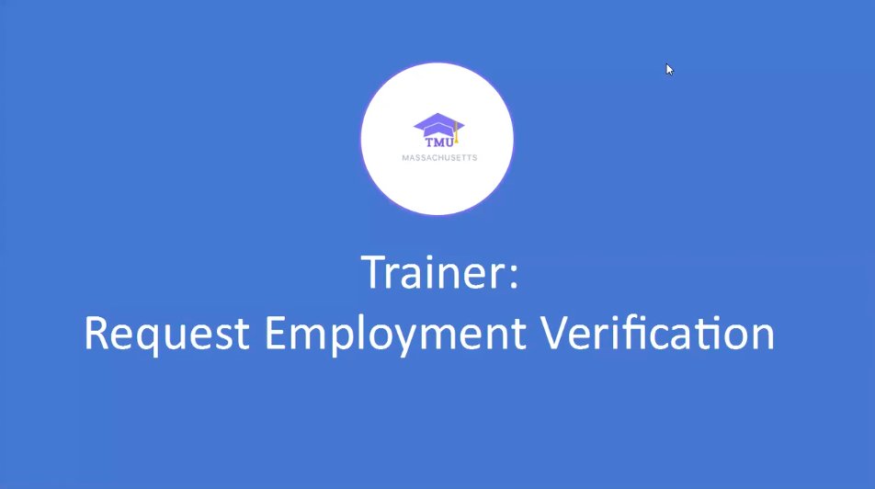
Post course responsibilities
Notes:
The last step is to request employment verification, if applicable.
To complete this step, view the D&S DT tutorial titled, ‘Request Employment Verification’.

Slide 103
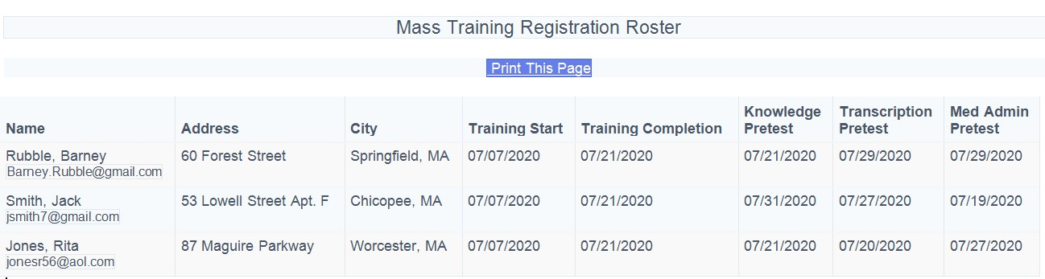
Student Roster TMU©
Notes:
After you complete each student TMU© record, the dates will automatically populate in your roster.
On your screen is an example of a completed roster indicating these students are ready to schedule to take the Certification Tests.

Slide 104
Course Time Extensions
Trainer Discretion
Students who ‘Never’ log in
If the issue was not due to technology email issues
‘Rollover’ to next student group OR
Students who are almost finished content, but do not finish at end of 2 weeks
Trainer enters training end date in TMU student record when content completed
Students who are almost finished content, or pretests but linger for >3 to 4 weeks
‘Rollover’ to next student group OR
Student completed 9 Units and Quizzes, but need to take or finish taking pretests
Trainer enters training end date in TMU student record
Do not ‘Rollover’ to next student group
‘Rollover’ to next student group OR
Trainer enters successful completion of Medication Demonstration Pretest date when completed
Trainer enters successful completion of Medication Demonstration Pretest date when completed
Do not ‘Rollover’ to next student group
Trainer enters training end date in TMU student record when content completed
Trainer enters successful completion of Medication Demonstration Pretest date when completed
Do not 'Rollover' to the next student group
Notes:
Course time extensions are at the Trainer’s Discretion.
There are a variety of reasons, some of which are listed, that you may choose to grant a course extension.
A student may continue to progress in the course they are currently in or if you want to keep track of all students in one course group only, you can elect to roll them over into your next course.

Slide 105
Student rollover
Trainer Discretion
Check Template ‘Previously Enrolled’
Student Continues their Progression
Notes:
Students may ‘Rollover’ into future groups at Trainer discretion, as many times as the Trainer wishes within the 6-month period of the student’s original start date.
Trainers must communicate this on the Training Roster template for the new group by checking the box to indicate that the student was ‘previously enrolled in the online MAP course’ so that the student can be rolled forward into the new group.
CDDER sends an email to all ‘rollover’ students alerting them to the date of the future group and to remind them of their usernames, with a link to reset their password if needed.
Best practice for online learning strongly discourage forcing a complete ‘restart’ of the course, therefore students will continue their progression.
This is similar to the method used in an in-person training; if a student missed one day, they would only repeat that one day, not the entire course.

Slide 106

MAP certification test components
Knowledge
Transcription
Medication Administration
Notes:
Completion of the Unit quizzes, skill check assignments and pretests set your student group up for success when taking the state Certification tests.
There is detailed scheduling and test information in the D&S DT MAP Testing Candidate Handbook located on the hdmaster website.

Slide 107

STATE tests
Notes:
Although this is not typically a Trainer responsibility, if you schedule your student group for the Certification Tests, please view the related tutorial.

Slide 108
Knowledge Test
Subject Area | Number of Questions
Introduction | 1
Unit 1 Working in a MAP Registered Program | 4
Unit 2 Observing and Reporting | 6
Unit 3 Medications | 4
Unit 4 Interacting with Health Care Provider | 3
Unit 5 Obtaining, Storing, and Securing Medication | 6
Unit 6 Recording Information | 5
Unit 7 Administering Medication | 10
Unit 8 Chain of Custody | 7
Unit 9 Medication Occurrences | 4
  50 Multiple-Choice Questions
  75 minutes
  80% or higher is passing
Notes:
The purpose of the Knowledge component is to test the student’s understanding of all job duties detailed in the ‘RIA’ curriculum, as they relate to medication management.
To prepare for the Certification Knowledge test, encourage your student group to read ‘RIA’ from cover to cover and take the Knowledge pretest over and over.
The test plan shown is the number of questions a student will be asked from each Subject Area.

Slide 109

Transcription test
  Discontinue a Medication and Transcribe a New Medication
  20 minutes
  100% accuracy
Notes:
The purpose of the transcription component is for a student to demonstrate their ability, using an HCP order and a pharmacy label, to correctly document the discontinuation of a medication and to transcribe a new medication onto a medication administration sheet as outlined in ‘RIA’ , Unit 6.
To prepare for the Transcription Certification test, encourage your student group to continue practicing using Transcription Workbook 2 .

Slide 110
Medication administration test
  Demonstrate process by verbally comparing the 5 Rights of the 3 Checks
  10 minutes
  100% accuracy
Notes:
The purpose of the medication administration component is for a student to demonstrate that they can administer medication safely as outlined in ‘RIA’, Unit 7.
To prepare for the Medication Administration Demonstration Certification test, encourage your student group to review the medication administration video and to continue to practice using the materials in their Resource Packet.

Slide 111
Auditing course
Certified Supervisory Staff
Registered Nurse non-Trainer
Licensed Practical Nurse
Other Service Provider Personnel
Notes:
If you have MAP Certified Supervisory staff, nurses or any other personnel who wish to audit the course for knowledge purposes only, please contact a DDS MAP Coordinator.

Slide 112
Additional
Online Resource
www.mass.gov/dph/map
Online MAP Topics
What's New in MAP
MAP Policy Manual
MAP Regulations
Notes:
The mass.gov site is an additional resource for numerous Medication Administration Program related topics.

Slide 113

Map trainer resources
Notes:
In conclusion, please take advantage of the wealth of MAP Trainer resources to assist you in using the online MAP Certification course.
If you have any questions, contact your DDS, MRC, DMH or DCF MAP Coordinator.
Thank you for listening.

