Slide 1
MAP Trainer Webinar
October 2021
Notes:
Welcome to the Fall 2021 MAP Trainer webinar. I’m Carolyn Whittemore, a Department of Developmental Services MAP Coordinator and I’m your webinar presenter.
By viewing webinars marked as ‘required’ within the specific time period, you’ll meet the MAP Trainer meeting ‘attendance’ requirement.
After the webinar, you’re encouraged to contact your Regional MAP Coordinator if you have a question or need further clarification on a topic presented.

Slide 2
Agenda
What’s New
Coming Soon
D&S Diversified Technologies
Moodle
Reminders
Updates
Notes:
On your screen are the agenda items that I will be covering today.

Slide 3
What’s New
Notes:
We’ll start with ‘What’s New’…

Slide 4
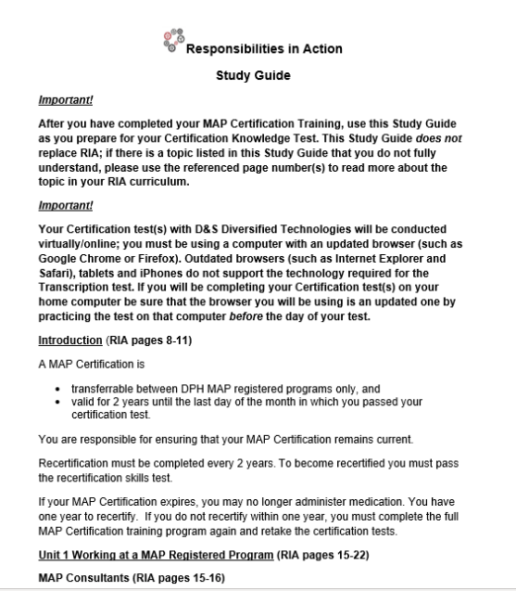
Study Guide
MAP Certification Training
Notes:
Back by popular demand, the Responsibilities In Action Study Guide has been updated and is now posted on the mapmass site (https://mapmass.com). All students should receive a copy of this Study Guide as they prepare for their Knowledge Certification Test.

Slide 5
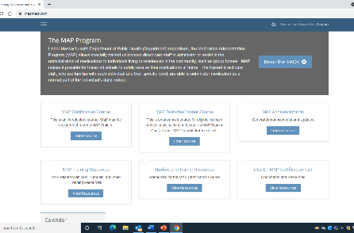
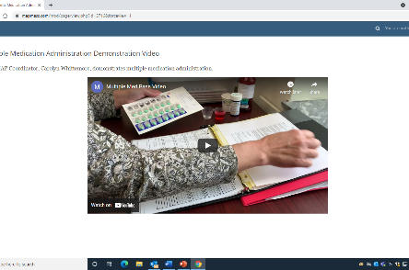
Multiple Med Pass Video
How to prepare more than one medication for the same person
Notes:
Also, back by request, the Multiple Med Pass video has been re-created and is posted under the MAP Trainer Resources on the mapmass site.

Slide 6
MAP Trainers may now run their own ‘audit groups’ of the MAP Certification course in Moodle
Starting October 1st, 2021
Notes:
Starting October 1st, MAP Trainers may now run their own audit groups of staff (who are not seeking Certification, such as Site Supervisors who are already Certified, LPNs etc.,) through the MAP Certification course in Moodle. You will submit your rosters to CDDER as you do now, one week in advance.

Slide 7
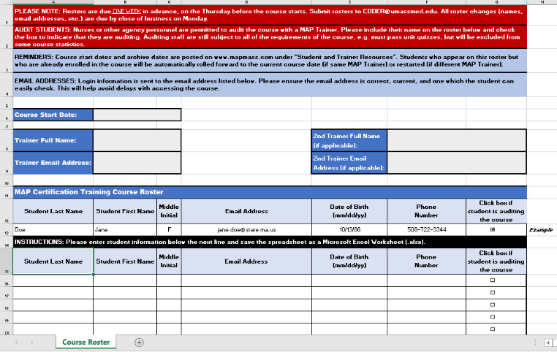
New MAP Certification Course Roster
mapmass.com
‘Student and Trainer Resources’
Notes:
We have a new roster to be used when registering staff for the MAP Certification course. To indicate that someone will be auditing the course, you will now check the corresponding box on the registration roster.
Also, a reminder that students who appear on submitted rosters, who are already enrolled in the course, will either be automatically rolled forward to the current course date (if they are with the same MAP Trainer) or restarted (if they are enrolling with a different MAP Trainer).
Another reminder that Email addresses need to be correct for proper and timely processing.
The new roster template is posted on the mapmass site in the ‘Student and Trainer Resources’.

Slide 8
Coming sooner…
…rather than later…
Notes:
We have a few new projects to let you know about, they are not ready yet for release, but we hope within the next month or so that they will be.

Slide 9
MAP Supervisor’s Training
This training will focus on key responsibilities of the MAP Supervisor including:
assignment of Medication Administration duties;
participating in and overseeing the Disposal process;
responsibility for the accuracy of the Count Book Index;
responsibility for follow-up to Medication Occurrences;
and more!
Notes:
The first one is an optional Supervisor’s Training that will be available in Moodle. When the Supervisor’s Training is available, we will send out an announcement with information regarding how MAP Certified Site Supervisors can register for the course. The training will cover the four key responsibilities of the Site Supervisor and lots more!

Slide 10
Overview of the Medication Administration Program (MAP) Training
This training will be specific to employees working in different departments wanting to learn more about the Medication Administration Program and how MAP relates to the work they do.
Notes:
The second project is more of an FYI, we are creating an Overview of the Medication Administration Program Training, it will also be available in Moodle, this one will be specific to other departments that will want to learn more about MAP, such as the Office of Quality Enhancement, Investigations, DPPC, etc. Again, when the training is completed, we will send out an announcement with information regarding how interested parties can register for the course.

Slide 11
Coming later…
...rather than sooner…
Notes:
…and then we have projects ‘in the works’ that will be coming your way later…within the following year…

Slide 12
‘Blended’ MAP Certification Training
Required:
9 units of the online MAP Certification Training; and
‘Face to Face’ session(s) for skills
Notes:
The first one is that all MAP Certification trainings will be required to be conducted in the ‘Blended’ format.
A blended training format means that the 9 units and quizzes of the online MAP Certification course must be completed by all students and that there is a ‘face-to-face’ session or sessions with the MAP Trainer to cover the skills (Medication Administration and Transcription).
Based on our goal of offering a standardized training, in addition to Trainer feedback, it has been determined that the blended training format offers the students the most complete learning experience.

Slide 13
Blended Training ‘Tools’
Guidelines
Sample Medication Administration Power Point
Sample Transcription Power Point
Notes:
To help you navigate the process for conducting a ‘Blended Training’ we have created a set of Guidelines and two sample Power Points that may be used as resource materials when conducting the ‘face-to-face’ skill portions of the training.

Slide 14
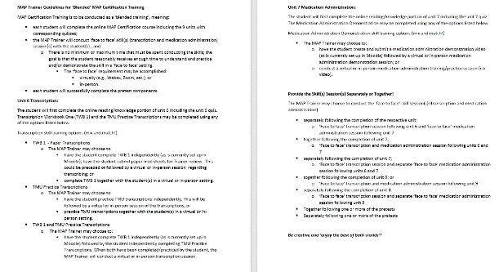
‘Blended Training Guidelines’
To help you structure your MAP Certification Training in the ‘blended format’
Notes:
The ‘MAP Trainer Guidelines for the ‘Blended’ MAP Certification Training’ will provide you with the details of the blended training format and all the various options available to you for when and how you may choose to conduct the face-to-face skill sessions.

Slide 15
‘Face-to-Face’ Session(s)
May be conducted
in-person or
virtual process
Such as Zoom
Notes:
The face-to-face skill sessions can be conducted in-person or via a virtual process, or even a combination of the two.
If you will be conducting in-person ‘face-to-face’ skill sessions, be sure to check with your Service Provider for training safety guidelines.

Slide 16
Medication Administration Skill Session
Sample Med Admin Power Point for use in the ‘face-to-face’ session of the ‘Blended Training’
Notes:
A Medication Administration Skill Session PowerPoint has been created as an option for you to use when conducting the face-to-face session for medication administration. In addition,

Slide 17
Transcription Skill Session
Sample Transcription Power Point for use in the ‘face-to-face’ session of the ‘Blended Training’
Notes:
…a Transcription Skill Session Power Point has been created as an option for you to use when conducting the face-to-face session for Transcription.
Students will continue to use their Resource Packets when learning and practicing both skills.
Both PowerPoints and the Blended Training Guidelines will be posted on the mapmass site.
Remember…this is a ‘heads-up’ of what is coming and is not yet a requirement at this time.

Slide 18
Transcription Skill to be Removed from Certification Testing
Transcription will remain in Certification Training; students must pass the Transcription Pretest in TMU to be eligible for Certification Testing
Once Certified, staff responsible for Transcription will be trained by the Service Providers on the system used (e.g., MedSoft, pharmacy generated Med Sheets, etc.)
Notes:
And speaking of Transcription…there is a plan to remove the Transcription Skill Test requirement from the Certification Test Process.
The Transcription skill training will remain unchanged in the Certification Training and all students will still be required to pass the Transcription Pretest in TMU to be eligible for Certification Testing.
After the student becomes Certified, Service Providers will then be responsible for training the Certified staff Transcription on the system used by the Service Provider (such as, MedSoft, pharmacy generated med sheets, etc.).
If staff will not be responsible for Transcribing, then Transcription Training by the Service Provider is not required.

Slide 19
Online MAP Certification Course
Required to be completed within 1 month from the training start date entered in TMU
Students will no longer ‘stay active’ in Moodle for 6 months
Notes:
Also coming later, the timeline for students to complete the online portion of the Certification Training will be decreased from 6 months to 1 month, and

Slide 20
MAP Certification Testing
Must be completed within 3 months from the training end date entered in TMU
Notes:
…the timeline for students to complete the Certification Testing will be decreased from 6 months to 3 months.
Statistics show that staff have a higher probability of successfully completing their MAP Certification training and testing when done in a shorter timeline.

Slide 21
Updates
Notes:
Next, I’ll go over a few updates…

Slide 22
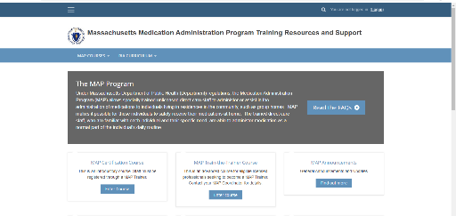
To View MAP Trainer Webinar(s)
Sign in on the mapmass.com site
Notes:
Most of you watching this webinar right now, probably accessed it through the link sent in the email announcement, however, if you don’t have time right away to view a webinar, instead of searching later through your emails looking for the link, I am going to show you where the webinar is posted on the mapmass site.
First you will go to the mapmass.com site and sign-in…

Slide 23
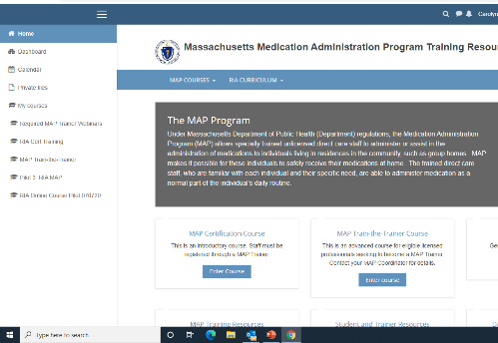
Click on the ‘Hamburger’
Notes:
…then, look for the ‘Hamburger’ in the upper left corner (displayed on the screen as three horizontal bars, so named for its unintentional resemblance to a hamburger)…click on the Hamburger and a drop-down list will appear.

Slide 24
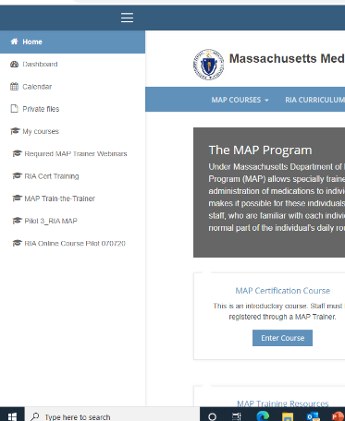
Drop-down Menu
Required MAP Trainer Webinars
Notes:
From the drop-down menu, choose Required MAP Trainer Webinars.
Remember, all current MAP Trainers should view MAP Trainer Webinars by logging in. Logging in is how you will receive credit for viewing it.
Once a webinar is posted, the typical viewing time to receive credit is 6 weeks.

Slide 25
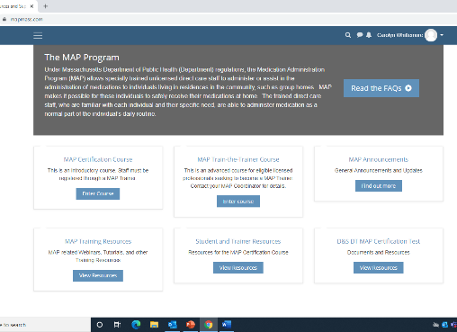
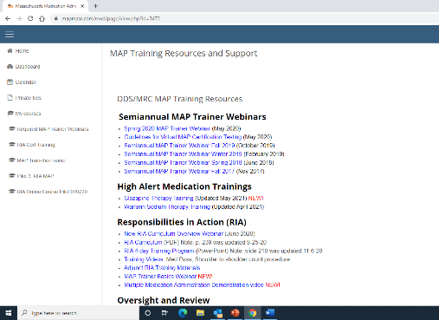
Previous MAP Trainer Webinars
Notes:
After the 6 weeks timeline for viewing has ended, the webinar will be posted under MAP Trainer Resources with all other prior webinars.
From this page anyone that wants to view it (Certified staff, Site Supervisors, Managers, etc.) has the ability to view it without logging in.

Slide 26
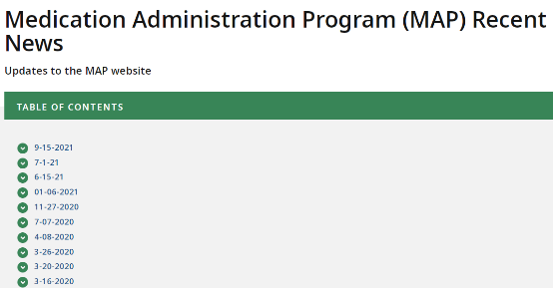
MAP Flexibilities
Mass.gov
Medication Administration Program
Recent MAP News
Notes:
During the COVID-19 emergency period, the DPH Drug Control Program (DCP), in consultation with DDS, DMH, DCF and MRC developed flexibilities to reduce barriers in MAP.
These flexibilities were slated to end on September 15, 2021, however the DPH and the MAP State Agencies recommended a plan for extending some of the flexibilities and replacing others with Waiver opportunities.
I will review with you on the following slides, the current flexibilities and notices that were issued by the DPH DCP.

Slide 27
Insulin Pen Administration
MAP – Insulin Pen Admin by MAP Certified Staff via Telehealth
Summary: Allows MAP Certified staff, rather than licensed health care professional, to administer insulin pens, with support of licensed health care professional via telehealth.
Recommendation: Extend flexibility until 12/31/21.
Service Provider will notify MAP Coordinator or Agency Administrator of sites using this flexibility.
Notes:
The insulin pen administration by MAP Certified staff via telehealth flexibility allows MAP Certified staff, rather than a licensed nurse, to administer insulin pens, with support of a licensed health care professional via telehealth.
There are several requirements to be implemented if this flexibility is to be carried out including notifying your DDS/DMH/DCF/MRC MAP Coordinator or the DDS/DMH/DCF/MRC MAP Administrator if using this flexibility. For full details please visit the Mass.gov site.
This flexibility will be ending 12/31/21

Slide 28
Rescue Inhalers and Epinephrine Auto-Injectors
MAP – Rescue Inhalers, Epinephrine Auto-Injectors and Oxygen in Community Programs
Summary: Allows non-certified staff to administer rescue medications at MAP Registered sites.
Recommendation: Extend flexibility through 12/31/21.
Amended order and advisory will not include oxygen as an authorized rescue medication.
Service Provider will notify MAP Coordinator or Agency Administrator of sites using this flexibility.
Notes:
The Rescue Inhalers, Epinephrine Auto-Injectors and Oxygen flexibility in Community Programs was extended until 12/31/21 with one amendment, that the oxygen is removed from this flexibility. Only Certified staff or licensed nurses may administer oxygen.
Non-MAP Certified staff at Community Programs are authorized to possess and administer rescue inhalers and epinephrine auto-injectors to individuals in Community Programs under certain conditions and following all requirements of the flexibility including notifying your DDS/DMH/DCF/MRC MAP Coordinator or the DDS/DMH/DCF/MRC MAP Administrator if using this flexibility.
For full details please visit the Mass.gov site.

Slide 29
Leave of Absence Medication Supply Expansion
MAP – Leave of Absence Medication Supply Expansion
Summary: Allows MAP Certified staff to prepare a LOA medication supply greater than currently allowed in MAP Policy without a pharmacist
Recommendation: Extend flexibility through 12/31/21.
Service Provider will notify MAP Coordinator or Agency Administrator of sites using this flexibility.
Notes:
The Leave of Absence Medication Supply Expansion flexibility was extended but will also end as of 12/31/21.
This flexibility is specific to individuals who are “learning to self-administer,” per MAP Policy section 7, and are located at DMH independent supported apartments, outside of a Group Living Environment (GLE) or for individuals who are temporarily relocated to an unregistered site or Group Living Environment.
For full details please visit the Mass.gov site.

Slide 30
Virtual 2 Person Count and Disposal
MAP – Virtual Two-Person Count and Disposal of Countable Controlled Substances
Summary: Allows the required two-person count MAP drug security measure to be conducted with one in-person MAP Certified staff and a second virtual MAP Certified staff.
Recommendation: Allow flexibility to expire on 9/15/21.
MAP Registered sites may apply, through the Service Provider, for a waiver to use a second MAP Certified staff virtually.
Notes:
The Virtual Two-Person Count and Disposal of Countable Controlled Substances flexibility ended 9/15/21 however the DPH DCP will accept waiver applications to allow Programs to continue using an alternative process for complying with MAP Policies 10-03 and 10-05. For additional information, such as the full list of requirements, the waiver application process and the applicable waiver template, please visit the Mass.gov site.

Slide 31
OTC Method B Remote Verification
MAP – OTC Method B – Remote verification by licensed Health Care Professional
Summary: Allows MAP Certified staff to administer over-the-counter drugs and dietary supplements with the support of a licensed health care professional via telehealth.
Recommendation: Allow flexibility to expire on 9/15/21.
MAP Registered sites may apply, through the Service Provider, for a waiver to use remote verification of Method B.
Notes:
The OTC Method B – Remote Verification by licensed professional flexibility ended on 9/15/21, however in light of continuing challenges and to provide further flexibility, the DPH DCP will accept waiver applications to allow Programs to continue using an alternative process for complying with MAP Policy 06-6. For additional information such as the full list of requirements, the waiver application process and the applicable waiver template, please visit the Mass.gov site.

Slide 32
D&S Diversified Technologies
TestMaster Universe (TMU©)
Notes:
This next section covers information from D&S Diversified Technologies.

Slide 33
Candidate Handbooks
Each student must receive a D&S MAP Candidate Handbook
www.hdmaster.com
Notes:
Each student that you have in your Certification training, should receive a D&S MAP Testing Candidate Handbook. It’s important to review with students what will be expected of them during their virtual Certification test, the D&S testing policies (such as the required form of ID, no show policies, etc.).
Candidate handbooks are available to download and print on the Massachusetts homepage of the D&S site.

Slide 34
TMU© Data Entry
The initial data entry should only include the student’s
Name
Email address
Phone number
The student should complete the rest of their demographics
Address
Date of birth
Social Security number
Etc.
Notes:
When registering a student in TMU©, the initial data entry should only include the student’s name, email address, and phone number. The student will receive an email or text alert informing them of their need to complete the rest of their demographics such as their address, date of birth, social security number, etc. One of the reasons to have the student complete the data entry is so that the information will be correct. There have been many instances when a supervisor or HR staff does the data entry and incorrectly enters a date of birth or social security number. Often this will go unnoticed until the time of testing at which time, the student will not be able to test and will incur a ‘no show’ fee.

Slide 35
Transcription Pre-test
The training ‘end date’ must be entered into TMU© before the student may take the transcription ‘pretest’
Notes:
A reminder that you must enter the Training End date into TMU© before the student is able to take their Transcription pretest. Any transcriptions done prior to the entry of the Training End date are ‘practice’ transcriptions only; be sure that the student has enough time to practice the Transcription in TMU© prior to entering the training end date.

Slide 36
‘Contacts’ in TMU©
To receive all the notifications from D&S that the student receives
You must be listed as a contact in the student’s record
D&S 888-734-6211
Notes:
If you would like to receive the same notifications from D&S that the student receives, you will need to be added as a ‘Contact’ in the student’s record in TMU©.
First - Call D&S and request that your name be added to the list of contacts with a particular Service Provider. D&S will ask for your name, phone number and email address, then D&S will add your name to the list of contacts for your service provider.

Slide 37
Click on ‘Students’
Notes:
After D&S has added your name to the list of Contacts for the Service Provider, you will login to TMU©, click on the Student’s tab…and then ‘search’ for the student that you would like to receive notifications about.

Slide 38
Click on ‘View’
Notes:
Click on the ‘view’ button to the right of the student’s name…

Slide 39
Click on ‘Contacts’
Notes:
…in the student’s record, you will then click on ‘Contacts’…

Slide 40
Click on ‘Add Contacts’
Notes:
…in Contacts, click the ‘Add Contacts’ button and the full list of available Contacts listed for this student will appear…

Slide 41
Click on ‘Link Contact’
Notes:
…from the list, check the box to the left of the Contact’s name and then select ‘Link Contact’.
Once this is done, this Contact will receive the same notifications from D&S that the student receives.

Slide 42
Testing Tips; students should….
practice on the device that they will be using when testing
use an updated browser to support transcriptions in TMU©
get familiar with Zoom
login a few minutes early
speak loudly and clearly
point with their finger when reading
Notes:
On your screen are some ‘Testing Tips’ provided by D&S, that you should review with all of your students prior to testing.
Students should practice on the same device that they will be using when taking their Certification test.
The device must have an updated Browser to support transcription in TMU© such as Google Chrome or Firefox; Internet Explorer and Safari do not support the transcriptions in TMU©.
Zoom is the platform used for Certification testing. Consider setting up a practice Zoom session with students so that they are familiar with joining a session.
Students should login a few minutes early, speak loudly and clearly and point with their finger when reading; this is the best way for a test observer to ‘see’ and ‘hear’ the student demonstrate their 3 checks of the 5 rights.

Slide 43
Knowledge Test Questions
How to answer a Knowledge Test Question:
Read the question and see if you know the answer before reading any of the answers
Notice if the stem has any ‘key’ words such as ‘most’, ‘first’, ‘last’, etc.
Read through all choices before selecting an answer
Narrow answers to 2 possible choices then pick the BEST of the 2 choices
Notes:
Regarding Knowledge Test questions, we received some emails voicing concern that there is often more than one correct answer in the choices given for some of the test questions. We thought we would share some information with you that you can share with your students regarding how to determine which answer is best as there is only one correct answer.
Students should:
Read the question and see if you know the answer before reading any of the answers
Notice if the stem of the question has any ‘key’ words such as ‘most’, ‘first’, ‘last’, etc.
Read through all of the choices before selecting an answer
Narrow the answers to 2 possible choices then pick the BEST of the 2 choices

Slide 44
Common Testing Mistakes
Testing Trends
What staff commonly fail on when testing
Notes:
D&S has provided the following information regarding common mistakes students make when testing causing them to fail the test. Knowing what students struggle with when testing, can help you to focus on these topics when training.

Slide 45
Testing Trends
Medication Administration
Common Mistakes:
Pop the wrong number of tabs
Forget to complete check #3
Forget to document in the Count Book
Document on the wrong Count Sheet page
Forget to secure the medication when done
Notes:
During the Medication Administration component of the Certification Test, the most common mistakes that students make are:
they will pop the wrong number of tabs into the cup;
they administer the medication after it is prepared into the cup, completely skipping check 3;
they will document in the med book but completely forget to subtract the tab from the Count Book;
if they do document in the Count Book, often it is on the wrong Count Sheet page;
Or sometimes they forget to secure the medication when done.

Slide 46
Testing Trends
When documenting on the Medication Sheet and in the Count Book
Spelling counts
Penmanship counts
Notes:
Remind students that not only does their spelling count but also their penmanship counts; if the tester cannot read what is written, it will be marked as incorrect.

Slide 47
Testing Trends
Transcription
Spelling counts
Students should not initial the med sheet when completing transcription
Notes:
Also, remind students when transcribing, not to put their initials on the med sheet as a med given. It is transcription only.

Slide 48
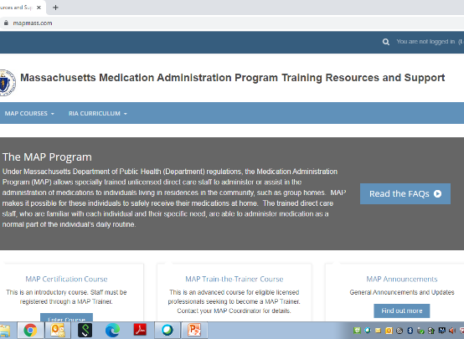
Training
Mapmass.com
Moodle
Center for Developmental Disabilities Evaluation and Research (CDDER)
Notes:
And we have received some feedback from some of you that there is confusion with the websites we use and what the differences are. From the MAP Trainers perspective, we have two main avenues of information which typically dictates where the information will be located online. We have Training, and we have Testing.
For Training,
MAP Mass is our new website where you will find mostly Training Resources and Login access to the MAP Cert course and the Train The Trainer course;
Moodle is the technical platform used for the Certification and Train The Trainer courses; lots of colleges also use moodle as the platform for their online courses; and
CDDER is the wonderful group of people that has helped us put all of this together. They are also the group that enters your student rosters for the Certification course, they host our Friday support meetings, and they help to answer all of your moodle questions.

Slide 49
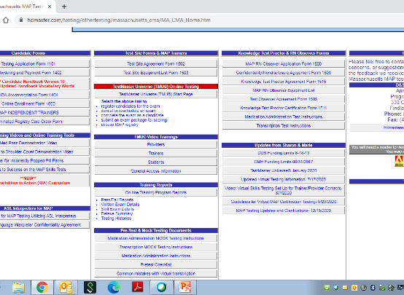
Testing
D&S Diversified Technologies
www.hdmaster.com
Testmaster Universe (TMU©)
ma.tmuniverse.com
Notes:
For Testing, D&S Diversified Technologies is our testing company. Their main website is hdmaster.com, from there you need to click on the Massachusetts box. Once you are on the Massachusetts page, this is where you will find information such as the MAP Candidate Handbook, ADA Accommodation Forms, Testmaster Universe (TMU©) training tutorials and the access to TMU©. TMU© is the secure testing section of the D&S website; you will need your Trainer login information issued to you by D&S to access TMU©. You can also get directly to TMU© by going to ma.tmuniverse.com.

Slide 50
MAP Focus Group
Training Challenges and Strategies
Notes:
Have some of you been feeling like you hit a ‘brick wall’ with your MAP Certification trainings?
CDDER hosted a MAP Focus group comprised of a variety of MAP Trainers. These Trainers participated in answering survey questions and attended a post-survey meeting to determine what they found to be the most challenging aspects of training students online, followed by what they found to be successful strategies for training students online.

Slide 51
MAP Focus Group Training Challenges
Lack of
Technology equipment
Time
Space
Motivation
Notes:
Some of the reoccurring challenges that we heard about include:
Students have a lack of technology equipment (such as a computer);
Lack of technology skills;
Lack of dedicated time and space; and
Trainers struggle with online facilitation, such as having students motivated to complete the course.

Slide 52
MAP Focus Group Training Strategies
Success with
Strict rules
Mandatory Zoom sessions
Supervisor involvement
Dedicated time, space, technology
Peer mentoring
Notes:
Some of the strategies that these MAP Trainers have found to be successful include:
Instituting strict completion timelines;
Scheduling mandatory Zoom sessions;
Involving the Supervisor;
Offering dedicated time, space and technology; and
Using peer-mentoring such as another veteran staff in the house helping to support staff as needed.
For additional information regarding the MAP Focus Group and strategies you may find helpful in your trainings, please visit the mapmass site.

Slide 53
Taking over a Training Roster
One MAP Trainer from Service Provider is unexpectedly gone, a second MAP Trainer from same Service Provider may take over
Contact:
D&S
and
CDDER
Notes:
The question has been asked, may one MAP Trainer take over another MAP Trainer’s roster to complete a training that has already been started. Typically, no. However, there are some circumstances when this is allowed such as when the MAP Trainer has an unplanned medical leave, an unexpected change in employment or even death. If there is a co-Trainer, then of course the co-Trainer may take over. If there is no co-Trainer and the unexpected circumstances apply, then another MAP Trainer from the same Service Provider can take the class over. If this happens, you will need to contact CDDER to arrange this and contact D&S to adopt the students in TMU©.
This does not include Independent MAP Trainers taking over a Service Provider class and vice versa. In this case, students need to restart the course with the new MAP Trainer. Also not included is MAP Trainers wanting to transfer students between themselves. In these cases, the student must restart the class with the new Trainer.

Slide 54
Reminders
Notes:
Next, a few reminders…

Slide 55
Resource Packets
Order from Long Term Pharmacy Solutions (LTPS); or
Assemble your own
Notes:
Resource Packets are required for all staff attending MAP Certification Training.
There are two options for obtaining Resource Packets:
You can either order them from Long Term Pharmacy Solutions or you can assemble your own Resource Packets.

Slide 56
To Order from LTPS
cdunn@ltps.us
978-458-4000 ext. 135
Notes:
When ordering Resource Packets from Long Term Pharmacy Solutions (LTPS), order them at least 2 weeks in advance. The contact person for LTPS is Carolyn Dunn and her email address is on your screen. When emailing, add the term ‘Resource Packets’ in the subject line of the email. In the body of the email include the name and address that the packet will be sent to. We have heard feedback that it is better to have the Resource Packets sent to the Service Provider’s main office and then distributed to the student. There have been instances when the Resource Packet was delivered directly to the student’s home and there was confusion regarding what the package contained, what it was for, etc. After you place your order, LTPS will respond to you. If you do not receive an email from LTPS within 48 hours, follow up with a call, the number is listed on your screen.

Slide 57
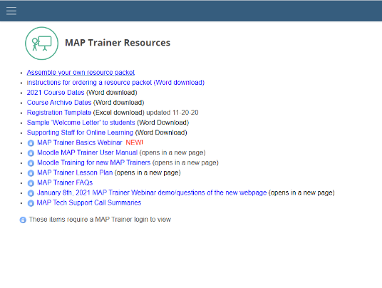
Assemble Your Own Resource Packets
Must use actual Blister Packs
May not use photo-copies of Blister Packs
Notes:
If you will be assembling your own Resource Packets using the directions on the mapmass site, you must still order actual blister packs from the pharmacy of your choice and label the blister pack using one of the label templates provided. You may not photocopy blister packs for staff to use in lieu of an actual blister pack.
When requesting the blister packs from the pharmacy, please request that the ‘candy’ used in the packet is uniform in color, shape and size.

Slide 58
Testing Packets
May only be used for Certification Testing Process
May not be used as a Resource Packet for practice medication administration
Testing Packets are ordered from LPTS
Notes:
‘Testing Packets’ may only be used for MAP Certification Testing. Testing Packets may not be used in lieu of a Resource Packet as practice materials for students to use prior to Certification Testing.
If you are responsible for ordering Testing Packets you will use the same process as when ordering Resource Packets from LTPS however be sure to include ‘Testing Packets’ in the subject line of the email request.

Slide 59
RIA Current Version- Revised Sept 2020
Must be available in all MAP Registered sites by July 1st, 2022
Notes:
Each site must have a copy of the Responsibilities in Action curriculum on site. A revised version of RIA was released in September of 2020. This revision has lots of documentation examples that were added to the back of the book as an appendix along with a Documentation Quick-Guide. As of July 1st, 2022, the revised version must be available for staff reference at all sites.
And don’t forget, you have the ability to order the RIA curriculum on Amazon.

Slide 60
Sharon Oxx RN, CDDN
Your Someday is Here….
Congratulations and
Happy Retirement!
Notes:
I know many of you already know but for those of you that don’t, Sharon Oxx has officially retired from state service as of October 1st. I know you all are with me when I say, thank you to Sharon for her dedication, her time and her unwavering support; she will certainly be missed!

Slide 61
Next MAP Trainer Webinar
Spring 2022
Notes:
And lastly, if you have any questions regarding topics presented today, please contact your area or regional MAP Coordinator.
Our next MAP Trainer Webinar will be in the Spring of 2022.

